Slide 1
House price diffusion and cross-border house price dynamics in the Greater China Economic Area
Mei-Se, Chien and Chien-Chiang, Lee
2012/6/15 ERES2012

Slide 2
1. Introduction(1/7)
In the past two decades, regional integration schemes have multiplied, as shown by many agreements of regional economic integration, such as the EU, NAFTA, APEC, ASEAN, and so on.
When regional economic integration is increasing significantly, what will cause cross-border house prices to be cointegrated?

Slide 3
1. Introduction(2/7)
Reviewing the past relative literature, some work has been done to examine the overall impact of European economic integration on real estate markets, such as
Rydin et al.(1990)
Parsa (1993)
Healey and Baker (1992)
Worzala and Bernasek (1996)
Yang et al. (2005)

Slide 4
1. Introduction(3/7)
The Asia Pacific region, and in particular East Asia, has seen rapid growth and economic integration at an extraordinary speed and depth.
Will regional economic integration in the Greater China Economic Area (GCEA) cause cross-border house prices to be cointegrated?
This paper examines cointegation, lead-lag relationships and the dynamic linkages among cross-border house in GCEA: China, Taiwan, Hong Kong, and Singapore

Slide 5
1. Introduction(4/7)
. The reasons to choose these four economies used in this study are as follows.
(1) As global property investors have expanded from the traditional mature markets (e.g. U.S., UK, Europe) to the emerging markets, e.g. China.
In 2008, Asian property markets accounted for
19% of global investible property
over 25% of global commercial property transaction volumes (Newell et al., 2009).

Slide 6
1. Introduction(5/7)
(2) China and the surrounding East Asia have continuously been a sustained growth center for decades and economic integration has also made considerable progress.
The number of concluded FTAs in Asia increased from 3 to 61 (2000 to 2010).
Asia is ahead of the Americas in FTAs per country. Compared with 2.9 for the Americas, Asia has 3.8 on average (Kawai and Wignaraja, 2010).
As economic integration has made considerable progress in East Asia, which will cause cross-border house prices to be cointegrated?

Slide 7
1. Introduction(6/7)
(3)since the late 1980s, an emerging culturalist discourse has produced a “Greater Chinese Economic Area” myth, assuming that ethnic Chinese from Hong Kong, Taiwan, Singapore, and elsewhere in Southeast Asia can present a seamless web of businesses through regional trade and investment linkages in China based upon a common culture and heritage.
After the economic crisis in 2008, China is gradually taking a lead role in East Asian regional economic integration.

Slide 8
1. Introduction(7/7)
This paper examines the following questions.
(1) Is there an integration of cross- border house prices between China, Taiwan, Hong Kong, and Singapore? We use the cointegration method to examine it.
(2) We apply the Toda and Yamamoto (1995) causality test to analysis the transmission mechanism among various cross-border house prices.
(3)The aims of this paper are also to evaluate the relative strengths among different cross-border house prices, using generalized forecast error variance decompositions (GVDC).

Slide 9
2. Economic Integration and Housing Markets in the GCEA
Since the late 1980s, the Greater China Economic Area (GCEA) has emerged as a new epicenter for industry, commerce, and finance. There are some theorems to explain integrating the GCEA. (Chao, 2003)
1.cultural integration.
2. economic integration
3. political integration
Chao (2003) indicated that the growing economic integration among the GCEA reflects the triumph of economic forces over political constraints.

Slide 10
2.1 Economic Integration in the GCEA(1/3)
One way to assess the extent of integration is to look at trade and investment flows.
1. trade relationships of the GCEA (Thorbecke ,2011)
China has significantly intensified its trade relationship with Hong Kong and Taiwan. In 2009,
China’s exports to the others
Hong Kong - 20.57%, Singapore - 3.36%, Taiwan-1.86%
China’s imports from the others
Taiwan-16.96% , Singapore - 2.18%, Hong Kong -1.32%,

Slide 11
2.1 Economic Integration in the GCEA(2/3)
2. foreign direct investment relationships
In 2011, Hong Kong, Taiwan, and Singapore are top 3 foreign direct investors in China (see Table 1).
- total is 77.7% in 2011
the capital from these three economies has played an important role in China’s recent economic success.

Slide 12
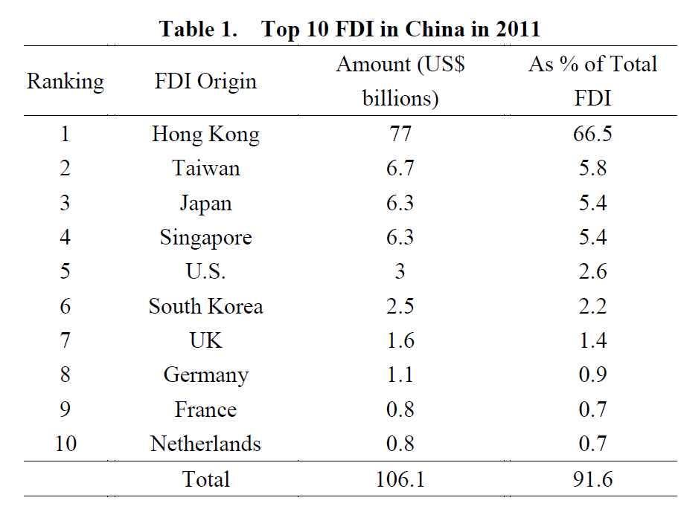
2.1 Economic Integration in the GCEA(3/3)

Slide 13
2.2 Housing Markets in the GCEA(1/3)
By the late 1990s in the GCEA, a consensus had emerged around the promotion of home ownership with government policies.
In Singapore, home ownership increased from 29% to 92% (1970 -2003 ) (Chua, 2003)
In Hong Kong, from 23% to 52% (1976-1997) (Ronald, 2010).
Although Taiwan has had a very high rate of home ownership, in Taiwan, from 73% to 85% (1981- 1999).
China’s urban home ownership was from 17% to 82% (1985 - 2003 (Wang and Murie, 2000).

Slide 14
2.2 Housing Markets in the GCEA(2/3)
In the GCEA, one characteristic of the high speed economic growth period (1960s – 1990s) was government participation in the housing sector.
The state arranges the developmental stage with grand, highly directive plans and state control over the economy, affecting the speed, location, and nature of development.
Construction is executed by private companies, and housing sold as a market good is in terms of ability to pay.
Housing policies have thus taken a particular role in GCEA’s social and economic development. (Ronald, 2007).

Slide 15
2.2 Housing Markets in the GCEA(3/3)
The turning point in policy and housing system trajectories in the GCEA is 1997. The Asian financial crisis that year had a significant impact on currency and stock market values, and there was also a deep crash in housing markets.
After the Asian financial crisis, the changes in housing policies among these four economies converged towards a similar direction, that is, increasingly market-led, for the purpose of facilitating economic recovery. As such, subsidy policies protecting the low-income groups were retained or even expanded.

Slide 16
3. Related Literature(1/3)
The empirical research refers to a convergence or divergence in regional house prices, including
Meen (1999), Alexander & Barrow(1994), Millington(1994), Ashworth & Parker(1997), Johns et al.(2003, 2004, 2005), Johns & Leishman(2006). Stevenson (2004), Luo et al. (2007), Liu et al.(2008), Oikarinen(2008), Chien(2009)…
The above empirical literature has examined this topic by different methods for different countries, but few discuss the interrelationships between cross-border house prices except Stevenson (2004).
Stevenson (2004) studied the long-run relationships among cross-border house prices between the Republic of Ireland and Northern Ireland, finding that long-run relationships exist within the Irish housing market.

Slide 17
3. Related Literature(2/3)
There are some works studying the overall impact of European economic integration on real estate markets.
Some show significant barriers to the flow of real estate investment across European borders (Rydin et al., 1990; Parsa, 1993).
Healey and Baker (1992) analyzed the prospects for commercial property in the 1990s in the U.K. and continental Europe and indicated major divergent trends between the member states.
Worzala and Bernasek (1996) found evidence of some convergence, but the extent is small, which implies that barriers to the efficient flow of investment funds into real estate remain and distinct markets will continue to characterize real estate within the European Community.

Slide 18
3. Related Literature(3/3)
Some papers have more optimistic results about the integration of housing markets.
Yang et al. (2005) examined dynamic linkages among nine European public real estate markets. The empirical results show, after the establishment of the EMU in 1999, the real estate markets of larger economies became more integrated with others, while some smaller economies did not.

Slide 19
4. Methodology (1/3)
4.1. Granger causality tests of Toda and Yamamoto (1995)
The approach used in this paper is a modified version of the Granger causality test proposed by Toda and Yamamoto (1995, TY).
This approach improves the limitations of past methodologies where all variables are needed to be integrated of order one.

Slide 20
4. Methodology (2/3)
To carry out the TY version of the Granger non-causality test, we represent each GCEA’s house prices (in natural logarithms) - Taiwan (LTW), China (LCH), Hong Kong (LHK), and Singapore (LSP) - in the following four-variable VAR system:
Economic hypotheses can be expressed as restrictions on the coefficients in the model in accordance with the following:
(2)

Slide 21
4. Methodology (3/3)
4.2. Generalized Forecast Error Variance Decomposition
(GVDC)
To evaluate the relative strengths among different cross-border house prices in the GCEA, we apply generalized forecast error variance decompositions (GVDC) of Pesaran and Shin (1998).

Slide 22
5. Data and Empirical Results
Data
Data period - the first quarter of 1998 to the fourth quarter of 2010.
area | source
Taiwan | housing index database of Sinyi Real Estate evelopment Company
China | the National Statistical Bureau
Hong Kong | the Hong Kong Rating and Valuation Department
Singapore | the Urban Redevelopment Authority (URA) of Singapore

Slide 23
5.1. the Results of the Unit-root Tests(1/3)
We start by testing for the presence of a unit root in regional house prices using the ADF (Dickey and Fuller, 1979), DF-GLS (Elliott et al., 1996), PP (Phillips and Perron, 1988), KPSS (Kwiatkowski et al., 1992), and NP (Ng and Perron, 2001) unit root tests.
Table 2 reports the results of unit root tests with intercept and trend. The results show that all variables are non-stationary and follow I(1) processes.

Slide 24
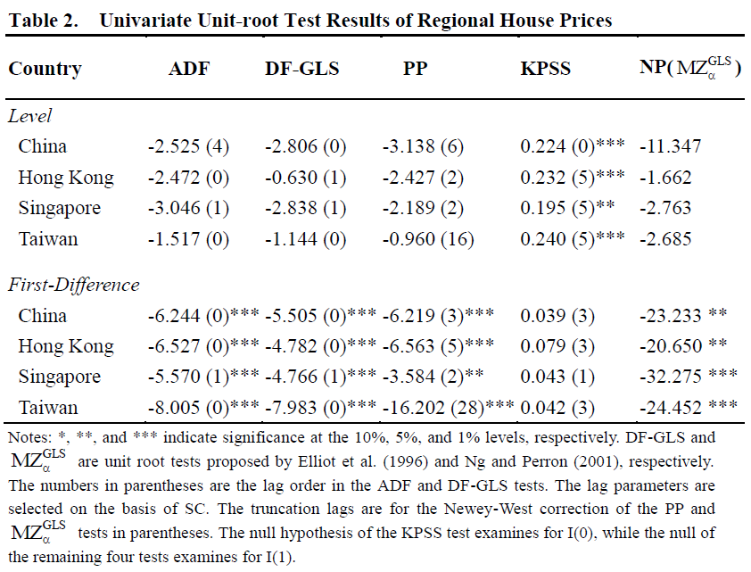
5.1. the Results of the Unit-root Tests(2/3)

Slide 25
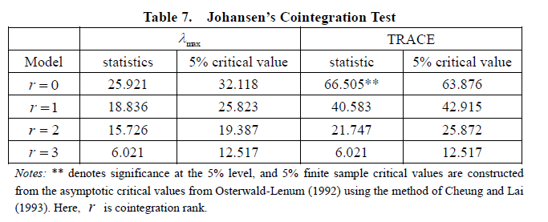
5.2 Test for Cointegration Procedures(1/5)
According to the empirical results of all unit-root tests, all of these four regional house are I(1) processes. Hence, we further use Johansen’s (1988) cointegration test to analysze the long-run relationships.
We employ the LR, FPE, AIC, SC, and HQ to determine the number of lags of the VAR. We select lag 1.
We next perform to test for the number of cointegrating vectors, and the results are reported in Table 7.

Slide 26
5.2 Test for Cointegration Procedures(2/5)
According to the results of the trace (TRACE), we confirm that among the variables there is a stable long-run equilibrium relationship. The results of the cointegrated coefficients of the long-run relationship equation are as equation (6),
All of these coefficients in equation (6) have been tested for significances based on Johansen and Juselius’ (1990) approach in Table 8.

Slide 27
5.2 Test for Cointegration Procedures(3/5)
The coefficient of LCH is positive and significant, while the coefficients of LHK and LSP are insignificant
Only the ripple effect of cross-border house prices between China and Taiwan is significant in the long run.
What causes this? In the last decade, the fast economic growth of China and the resulting increased links between China and Taiwan have produced a complex network of trade, cultural interaction, educational exchange, tourism, and so on.
According to Taiwan Customs’ statistics in 2011, China is the largest trading partner for Taiwan, making up around 22% of Taiwan’s total trade values, ahead of the Japan and the U.S.

Slide 28
5.2 Test for Cointegration Procedures(4/5)
Taiwan is also a main contributor to China’s FDI. Taiwan’s FDI to China accounted for over 60% of Taiwan’s total FDI in the past decade.
The accumulated investment in China from Taiwan has been estimated at around US$45.8 billion as of 2007, higher than the US$33.4 billion from Singapore.
At present, one to two million Taiwanese, or 5-10% of Taiwan’s population, frequently work or live in China, most of them accompanying firms’ reestablishment or investment in China (Tsai & Lin, 2011).

Slide 29
5.2 Test for Cointegration Procedures(5/5)
There is obviously a close and complex network of trade, investment, and migration between China and Taiwan.
As a matter of fact, because of the ease of factor movement between these two, the relationship can be described as that of two domestic regions.
The ease of factor movement between Taiwan and China is a distinguishing characteristic as compared with other inter-country relationships (Tsai & Lin, 2011), which make cross-border house prices between Taiwan and China integrated.

Slide 30
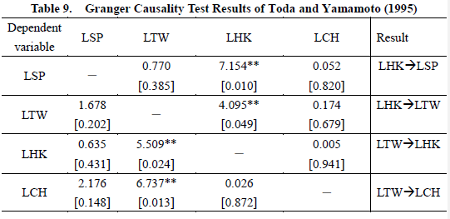
5.3. Results of Granger causality tests (1/4)
Table 9 shows results of TY (1995) Granger causality tests between cross-border house price indices of the GCEA.

Slide 31
5.3. Results of Granger causality tests (2/4)
1. We observe a bidirectional relationship between house prices in Taiwan and Hong Kong. For political and ideological differences and occasional tensions between Taiwan and China, much trade and investment from Taiwan to China went through the intermediary trading hub of Hong Kong in past decades.
Among the surveyed Taiwanese companies, 80.9% indicate they use Hong Kong banks for fund transfers between Taiwan, China, and Hong Kong (Wang and Thi, 2010).

Slide 32
5.3. Results of Granger causality tests (3/4)
2.There is a unidirectional relationship running from Taiwan to China.
The housing market in China has some substitute effects on the housing market in Taiwan. In the past decade, firms turned highly mobile across Taiwan and China, with more than 60% of Taiwan’s outward FDI having gone to China, and trade barriers between China and Taiwan have fallen, causing some Taiwanese firms to choose China to invest in instead of Taiwan in order to target the larger demand in China.
Currently, one to two million Taiwanese, or 5-10% of Taiwan’s population, are working or living in China.
These two areas’ house prices have some linkages through migration and equity transfer.

Slide 33
5.3. Results of Granger causality tests (4/4)
3. As to Singapore, being geographically far away from the other three, there is no causality with Taiwan and China.
However, there is a unidirectional relationship that runs from Hong Kong to Singapore. Hong Kong and Singapore represent developed Asian property markets, the financial markets, including real estate, of these two cities are in direct competition, causing an existing causality between the two cities.

Slide 34
5.4. Results of generalized variance decomposition (GVDC) (1/3)
The GVDC can measure the relative importance of different regional house prices, in explaining the volatility of each other. The relative importance of an individual area’s house prices due to its own shocks and the shocks of others can be measured by using the decomposed variances.
Table 10 presents the results of the GVDC.

Slide 35
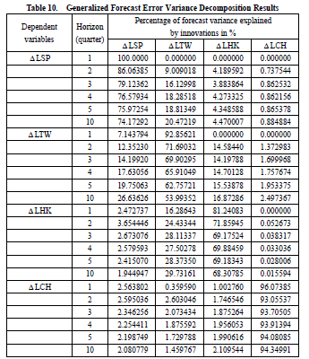
5.4. Results of GVDC (2/3)

Slide 36
5.4. Results of generalized variance decomposition (GVDC) (3/3)
No matter in short run or long run, Taiwan is clearly the most endogenous in these four areas: over 46% of its fluctuations are explained by other regions’ house prices after 10 quarters.
Comparing with others in the GCEA, Taiwan’s government uses less intervention to control the housing sector, causing a more flexible housing market and for it to be more easily impacted by others.
In the long run, China’s house prices have become the most exogenous, implying that the large scale of China’s market cannot be easily impacted by others.

Slide 37
6. Conclusions(1/3)
This paper examines interrelationships and the dynamic linkages among cross-border house prices in the GCEA. Our main findings are as follows:
First, our results of Johansen’s (1988) cointegration test show
only a diffusion effect of cross-border house prices between China and Taiwan is significant in the long run.
There is ease of factor movement between Taiwan and China, making cross-border house prices between China and Taiwan integrated.

Slide 38
6. Conclusions(2/3)
Second, the results of Toda and Yamamoto’s Granger causality test provide evidence of
a unidirectional relationship running from Taiwan to China.
There is a bidirectional relationship between Taiwan and Hong Kong.
Hong Kong can lead Singapore.

Slide 39
6. Conclusions(3/3)
Third, the results of the GDVC indicate that
house prices of China are the most exogenous in the long run, implying that China’s market, due to its large scale, cannot easily be impacted by others.
No matter for the short or long run, Taiwan is the most endogenous, because its government has used less intervention to control the housing sector, resulting in a more flexible housing market and one that is more easily impacted by others.

