Slide 1
The Impact of Corporate Social Responsibility Practices on the Performance of European Property Companies
Chyi Lin Lee and Graeme Newell
University of Western Sydney

Slide 2
INTRODUCTION
CSR = Corporate social responsibility
*environment *social *governance
SRI = Socially responsible investment
UN Principles of Responsible Investment
Institutional Investors Group on Climate Change
RPI, SRPI re: property sector
Investors, fund managers, tenants, government regulation ✓

Slide 3
SRI SCENE
Global: $11 trillion
Europe: €5 trillion
US: $3 trillion
France: € 1.8 trillion
UK: € 1.0 trillion

Slide 4
PREVIOUS SRI RESEARCH
SRI versus conventional investing
Property and SRI
* CSR * SRPI ”added value”
* green buildings “added value”
Financial performance drivers ✓
Next step: do CSR factors add unique value to listed property performance
* separate pricing of CSR factors?
Recent publications ✓

Slide 5
PURPOSE OF PAPER
Assess impact of CSR factors and financial factors on European listed property performance over 2007 – 2010
Assess separate pricing of environmental, social and governance dimensions of CSR (compared to pricing of financial factors) in European listed property performance

Slide 6
CSR AND European Listed Property
CSR reports ✓ ✓
Strategy
Performance
Green buildings
Leaders in CSR✓ ✓

Slide 7
LEADERS
* British Land * Land Securities
* Hammerson * Segro
* Great Portland Estate * Unibail-Rodamco
* Klepierre * Wereldhave
* Corio * Sonae Sierra
* PruPIM * Hermes

Slide 13
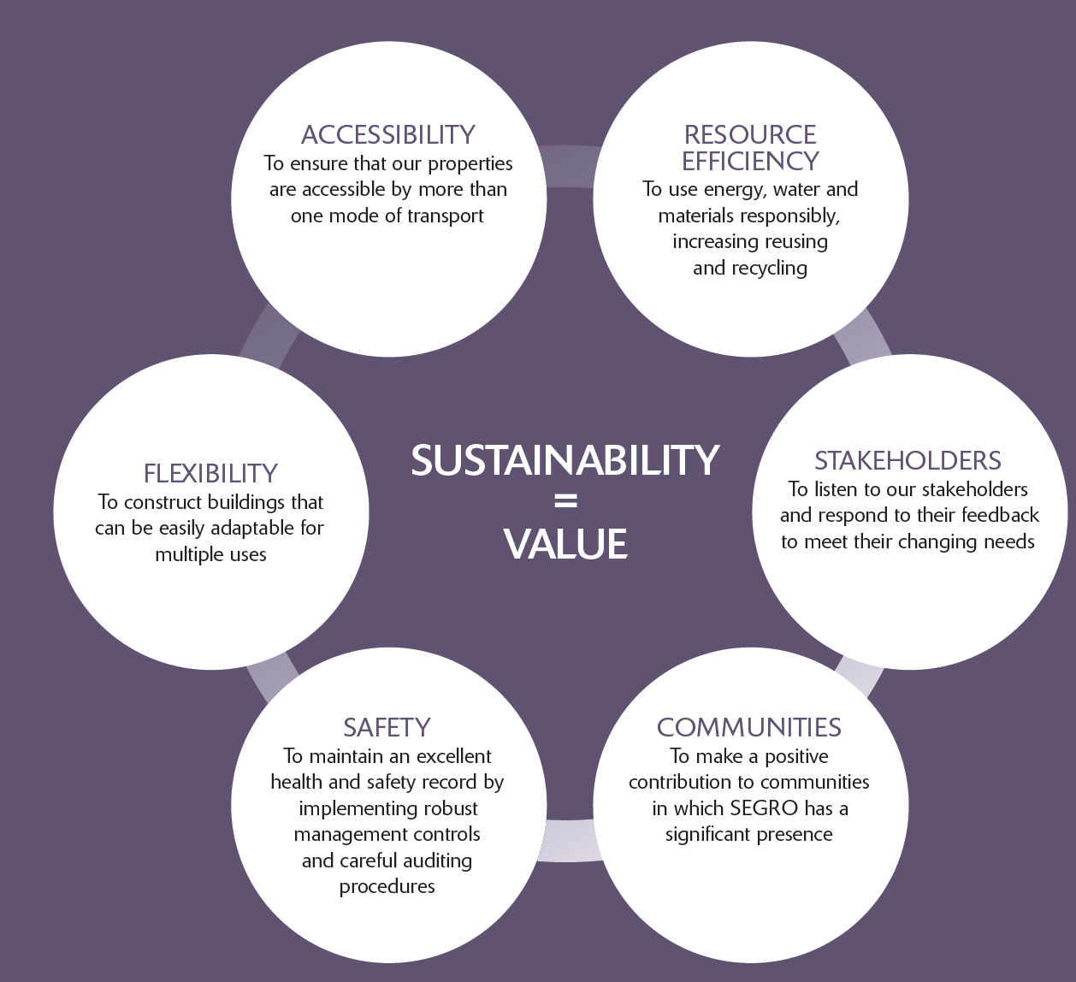

Slide 14
CSR PERFORMANCE MEASURES

Slide 16
METHODOLOGY
ASSET4 ESG ratings database
* environment * social * governance
3500+ listed companies globally
2002-2011: annual
18 KPI categories: E, S, G “pillars”
121 factors assessed

Slide 17
ENVIRONMENTAL PERFORMANCE FACTORS : 47
Emissions reduction: 22
Resource reduction: 19
Product innovation: 5

Slide 18
SOCIAL PERFORMANCE FACTORS: 40
Employment quality: 10
Health and safety: 5
Training and development: 5
Diversity: 6
Human rights: 3
Community: 6
Product responsibility: 4

Slide 19
Corporate GOVERNANCE PERFORMANCE FACTORS: 34
Board structure: 8
Board function: 9
Compensation policy: 6
Shareholder rights: 5
Vision and strategy: 5

Slide 20
METHODOLOGY
4Y performance @ 2007-2010
European listed property performance: DataStream
* Total returns * Sharpe ratio
ESG factors (3): ASSET4
* environment * social * governance
Financial factors (2): DataStream
*size (market cap) *book-to-market value

Slide 21
METHODOLOGY
European listed property: #=43 @ $112B
REITs: #=20 @ $81B
* UK * France
* Netherlands * Belgium
Property companies: #= 23 @ $31B
* UK *Sweden * Spain
* Austria * Switzerland * Germany
* Poland

Slide 22
ANALYSIS
Europe: #=43
* all * REITs * PCs
UK: #=20
* all * REITs
Unbalanced panel analysis: 2007-2010

Slide 23
ASSET4 ESG LEADERS @ 2010
Environment: E
#1: Hammerson #2: Land Securities
#3: Great Portland Estate
Social: S
#1: Land Securities #2: Hammerson
#3: Corio
Governance: G
#1: Unibail-Rodamco #2: Grainger
#3: Segro
Overall: ESG
#1: Unibail-Rodamco #2: Hammerson
#3: Land Securities

Slide 24
2007-2010 ESG PERFORMANCE: ALL
 | Environment | Social | Governance | Overall
2007 | 52.2 | 38.9 | 46.8 | 46.0
2008 | 58.3 | 40.2 | 48.5 | 49.0
2009 | 59.6 | 43.8 | 56.1 | 53.2
2010 | 62.2 | 43.9 | 56.6 | 55.1

Slide 25
2007-2010 ESG PERFORMANCE: REITs
 | Environment | Social | Governance | Overall
2007 | 75.0 | 53.6 | 60.7 | 63.1
2008 | 78.2 | 54.7 | 61.3 | 64.7
2009 | 79.1 | 59.2 | 68.0 | 68.8
2010 | 78.8 | 59.2 | 67.3 | 68.4

Slide 26
CORRELATION: 2007-2010: ALL
 | Environment | Social | Governance | Market Cap.
Environment | 1.00
Social | 0.74 | 1.00
Governance | 0.68 | 0.63 | 1.00
Market Cap | 0.32 | 0.35 | 0.07 | 1.00

Slide 27
CORRELATION: 2007-2010: REITs
 | Environment | Social | Governance | Market Cap.
Environment | 1.00
Social | 0.61 | 1.00
Governance | 0.48 | 0.56 | 1.00
Market Cap | 0.53 | 0.42 | 0.16 | 1.00

Slide 28
MODELS: ALL: TOTAL RETURNS
 | #1 | #2 | #3 | #4 | #5 | #6 | #7
E | X |  |  |  | X | X
S |  | X |  |  | X | X
G |  |  | X |  | X | ✓ (+)
Overall ESG |  |  |  | X |  |  | X
Size |  |  |  |  |  | ✓ (+) | ✓ (+)
BTM |  |  |  |  |  | X | X

Slide 29
MODELS: ALL: SHARPE RATIO
 | #1 | #2 | #3 | #4 | #5 | #6 | #7
E | X |  |  |  | X | X
S |  | X |  |  | X | X
G |  |  | X |  | X | ✓ (+)
Overall ESG |  |  |  | X |  |  | X
Size |  |  |  |  |  | ✓ (+) | ✓ (+)
BTM |  |  |  |  |  | X | X

Slide 30
Result
Governance is separately priced after controlling for financial factors

Slide 31
MODELS: REITs: TOTAL RETURNS
 | #1 | #2 | #3 | #4 | #5 | #6 | #7
E | X |  |  |  | X | ✓ (-)
S |  | X |  |  | X | ✓ (+)
G |  |  | X |  | X | X
Overall ESG |  |  |  | X |  |  | X
Size |  |  |  |  |  | X | ✓ (+)
BTM |  |  |  |  |  | X | X

Slide 32
MODELS: REITs: SHARPE RATIO
 | #1 | #2 | #3 | #4 | #5 | #6 | #7
E | ✓ (-) |  |  |  | ✓ (-) | ✓ (-)
S |  | ✓ (-) |  |  | X | ✓ (+)
G |  |  | X |  | X | ✓ (+)
Overall ESG |  |  |  | X |  |  | ✓ (-)
Size |  |  |  |  |  | ✓ (+) | ✓ (+)
BTM |  |  |  |  |  | X | X

Slide 33
Result
Stronger role by E,S,G factors for REITs after controlling for financial factors
Environmental factor has negative effect

Slide 34
MODELS: PCs: TOTAL RETURNS
 | #1 | #2 | #3 | #4 | #5 | #6 | #7
E | X |  |  |  | X | X
S |  | X |  |  | X | X
G |  |  | X |  | X | ✓ (+)
Overall ESG |  |  |  | X |  |  | ✓ (+)
Size |  |  |  |  |  | ✓ (+) | ✓ (+)
BTM |  |  |  |  |  | X | X

Slide 35
MODELS: PCs: SHARPE RATIO
 | #1 | #2 | #3 | #4 | #5 | #6 | #7
E | X |  |  |  | X | X
S |  | X |  |  | X | X
G |  |  | X |  | X | X
Overall ESG |  |  |  | ✓ (+) |  |  | ✓ (+)
Size |  |  |  |  |  | ✓ (+) | ✓ (+)
BTM |  |  |  |  |  | X | X

Slide 36
Result
Separate pricing of governance and overall ESG after controlling for financial factors

Slide 37
MODELS: UK ALL: TOTAL RETURNS
 | #1 | #2 | #3 | #4 | #5 | #6 | #7
E | X |  |  |  | X | X
S |  | X |  |  | X | X
G |  |  | X |  | X | ✓ (+)
Overall ESG |  |  |  | X |  |  | X
Size |  |  |  |  |  | ✓ (+) | ✓ (+)
BTM |  |  |  |  |  | X | X

Slide 38
MODELS: UK ALL: SHARPE RATIO
 | #1 | #2 | #3 | #4 | #5 | #6 | #7
E | X |  |  |  | X | X
S |  | X |  |  | X | X
G |  |  | X |  | ✓ (+) | ✓ (+)
Overall ESG |  |  |  | X |  |  | X
Size |  |  |  |  |  | X | X
BTM |  |  |  |  |  | X | X

Slide 39
RESULT
Governance is separately priced
Governance is separately priced after controlling for financial factors

Slide 40
MODELS: UK REITs: TOTAL RETURNS
 | #1 | #2 | #3 | #4 | #5 | #6 | #7
E | X |  |  |  | X | X
S |  | X |  |  | X | X
G |  |  | ✓ (-) |  | ✓ (-) | X
Overall ESG |  |  |  | X |  |  | X
Size |  |  |  |  |  | ✓ (+) | ✓ (+)
BTM |  |  |  |  |  | X | X

Slide 41
MODELS: UK REITs: SHARPE RATIO
 | #1 | #2 | #3 | #4 | #5 | #6 | #7
E | X |  |  |  | X | X
S |  | X |  |  | X | X
G |  |  | X |  | X | X
Overall ESG |  |  |  | X |  |  | X
Size |  |  |  |  |  | X | X
BTM |  |  |  |  |  | X | X

Slide 42
RESULTS
Governance is separately priced for total returns (-ve)
Governance is not priced separately after adjusting for financial factors

Slide 43
IMPLICATIONS
Different ESG features re: all, REITs, PCs
Governance factor is the most influential CSR factor; even after controlling for financial factors
Environmental factor has negative impact for REITs
Compare with A-REIT ESG results of Newell and Lee: JPIF (2012)
Implications re: CSR for European listed property sector

