Slide 1
Structural breaks in the Spanish housing market. Evidence from a spatial panel for the period 1995-2010
Ramiro Gil-Serrate (*) and Jesús Mur (**)
(*) Centro Universitario de la Defensa (CUD) and Department of Geography and Environment, LSE (r.gil-serrate@lse.ac.uk)
(**) Economic Analysis Department, University of Zaragoza (jmur@unizar.es)
European Real Estate Society. ERES2012
Edinburgh, 13th-16th June 2012

Slide 2
Overview
We present the case of the Spanish housing market in the last 15 years, from 1995 to 2010. The contribution of the building and construction sector has been one of the key features of the Spanish economy.
The housing sector experienced a vigorous growth process from the mid of the nineties to 2007, with an average annual increase of 5%. This was the BOOM period. The sector now is in a severe crisis, with an annual growth rate of -8.0%. This is the BLUST period.
Our purpose is to study this evolution, focusing at the prices of the housing markets in the 50 Spanish provinces.
We consider the specific literature in order to obtain a theoretical framework for the analysis of the dynamics of the house prices. A statistical analysis follows.
Theoretical Framework
The Spanish case. Some facts and figures
Statistical preliminary analysis
Provisional estimates

Slide 3
Theoretical framework
Let us assume a problem of utility maximization in an inter-temporal consumption model.
Two different goods: a composite consumption good (C) and housing services, assumed proportional to housing stock (H).
Introduce an additive utility function with an inter-temporal discount rate
P is the real price of housing;
N is new purchases of housing;
S is real savings;
τ is the marginal household tax rate;
Y is real household income;
i is the nominal interest rate;
A is real non-housing assets;
δ is the physical depreciation rate on the housing stock;
π rate of inflation.
Technical and budget restrictions:

Slide 4
Theoretical framework
The marginal rate of substitution between housing and the composite consumption good is given by:
expected inflation
This is the real user housing cost of capital (i.e., Meen 1996)
expected increase of the real prices of housing
$$π^{e}+{\left(\frac{\dot{P}}{P}\right)}^{e}$$
measures the expected nominal gain on housing
From a different perspective (housing as an investment asset ; i.e, Holly et al 2010), the real return of housing equals post-tax return on alternative assets
R is the real rental price of housing services in each time period

Slide 5
Theoretical framework
The house price equation ⇒
PROBLEMS:
(A) Slow process of adjustment to changes in the market.
(B) Unobservable variables
R is the real rental price of housing. Usually is replaced by its determinants:
- Stock of housing (H)
- Income (Y)
- Demographic factors (D)
- Other elements.
r is the real (expected) interest rate; the expectations are not uniform.

Slide 6
Variables REG. UNIT: SPANISH PROVINCES
pvr | House prices (€/m2). Aggregate provincial index
stk | Stock of houses, per capita, in the province (units)
rpc | Income per capita (€), in the province
itr | Real interest rate. Aggregate provincial index
hst | Mortgage offer (% of mortgages in relation to the stock of houses). Provincial aggregate
srp | Net migration (x1000). Provincial aggregate
une | Unemployment rate. Provincial aggregate
act | Working population (% of labor force). Provincial aggregate
agr | Agriculture (% of total employment). Provincial aggregate
ind | Industry (% of total employment). Provincial aggregate
cot | Construction (% of total employment). Provincial aggregate
ser | Services (% of total employment). Provincial aggregate
ENDOGENOUS
STOCK OF HOUSES
INCOME
REAL INTEREST RATE
DEMOGRAPHIC FACTORS

Slide 7
The Spanish case. Some facts and figures
 | VALUE |  |  |  | GROWTH RATE
GDP per capita | 1995 | 2000 | 2007 | 2011 | 2000-1995 | 2007-2000 | 2011-2007 | 2011-1995
Euro area | 18000 | 21600 | 27600 | 28300 | 20.0 | 27.8 | 2.5 | 57.2
Spain | 11600 | 15600 | 23500 | 23300 | 34.5 | 50.6 | -0.9 | 100.9
United States | 33690 | 39175 | 43692 | 41990 | 16.3 | 11.5 | -3.9 | 24.6
Japan | 29970 | 30953 | 34222 | 34145 | 3.3 | 10.6 | -0.2 | 13.9
Unemployment rate | 1995 | 2000 | 2007 | 2011 | 2000-1995 | 2007-2000 | 2011-2007 | 2011-1995
Euro area | 10.7 | 8.7 | 7.6 | 10.2 | -18.7 | -12.6 | 34.2 | -4.7
Spain | 20.0 | 11.7 | 8.3 | 21.7 | -41.5 | -29.1 | 161.4 | 8.5
United States | 5.6 | 4.0 | 4.6 | 8.9 | -28.6 | 15.0 | 93.5 | 58.9
Japan | 3.1 | 4.7 | 3.9 | 4.6 | 51.6 | -17.0 | 17.9 | 48.4

Slide 8
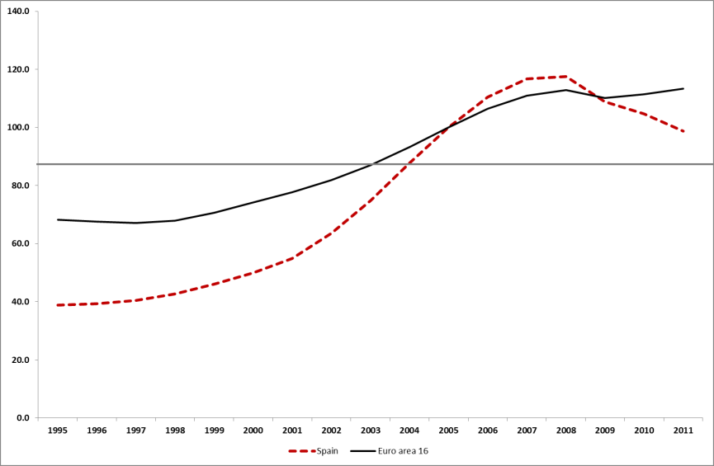
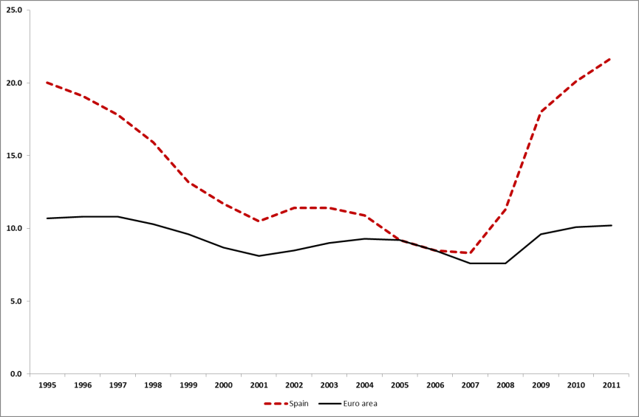
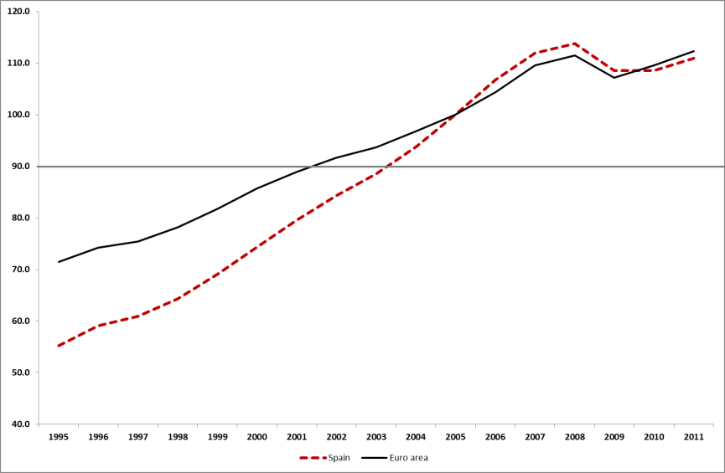
The Spanish case. Some facts and figures
House prices. 2005=100
Unemployment Rate
BLUST
BOOM
Income per capita. 2005=100
EURO
SPAIN

Slide 9
The Spanish case. Some facts and figures
Experimental House Price Indices: Index levels (2005=100)
 | VALUE |  |  |  |  | GROWTH RATE
 | 1995 | 2000 | 2007 | 2010 | 2011 |  | 2000-1995 | 2007-2000 | 2010-2007 | 2010-1995
Belgium | 54.5 | 68.5 | 116.7 | 124.0 | 127.8 | Belgium | 25.7 | 70.5 | 6.3 | 127.7
Germany | 108.1 | 104.4 | 97.7 | 101.1 | : | Germany | -3.4 | -6.4 | 3.5 | -6.4
Ireland | 26.7 | 60.6 | 123.2 | 81.6 | : | Ireland | 126.6 | 103.4 | -33.8 | 205.1
Greece | 43.6 | 64.2 | 118.8 | 122.2 | 107.5 | Greece | 47.2 | 85.0 | 2.9 | 180.1
Spain | 38.8 | 50.0 | 116.8 | 104.7 | 98.8 | Spain | 28.9 | 133.6 | -10.4 | 169.8
France | 49.4 | 57.4 | 119.4 | 117.6 | : | France | 16.1 | 108.0 | -1.5 | 137.9
Italy | 60.1 | 64.7 | 111.9 | 107.4 | : | Italy | 7.6 | 73.0 | -4.0 | 78.7
Netherlands | 39.9 | 75.4 | 109.4 | 105.2 | 106.5 | Netherlands | 89.1 | 45.1 | -3.8 | 164.0
Euro area 16 | 68.3 | 74.3 | 110.9 | 111.4 | 113.4 | Euro area 16 | 8.8 | 49.4 | 0.4 | 63.2
U. Kingdom | 36.4 | 58.3 | 117.9 | 115.4 | 114.6 | U. Kingdom | 60.2 | 102.2 | -2.1 | 217.0
Norway | 42.1 | 73.4 | 128.0 | 139.7 | 150.8 | Norway | 74.6 | 74.3 | 9.1 | 232.1
BOOM
BLUST

Slide 10
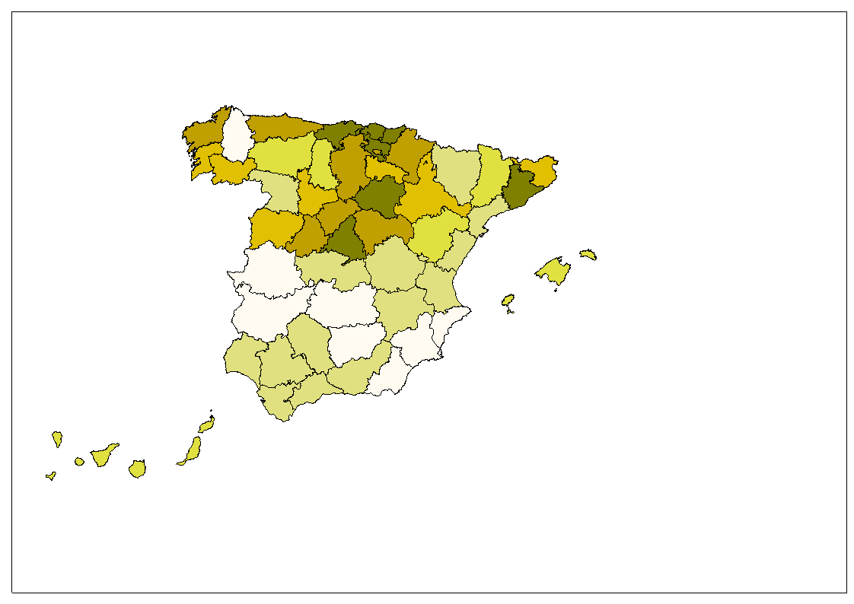
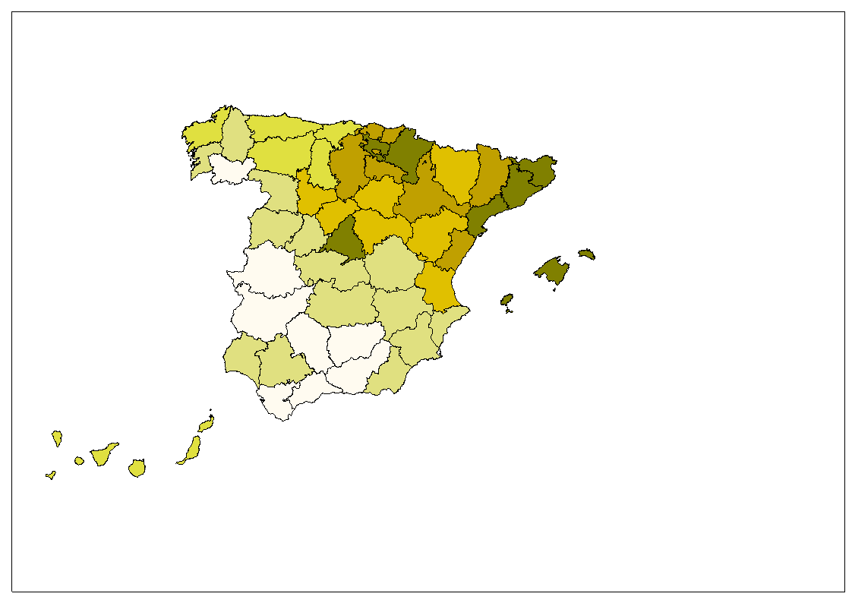
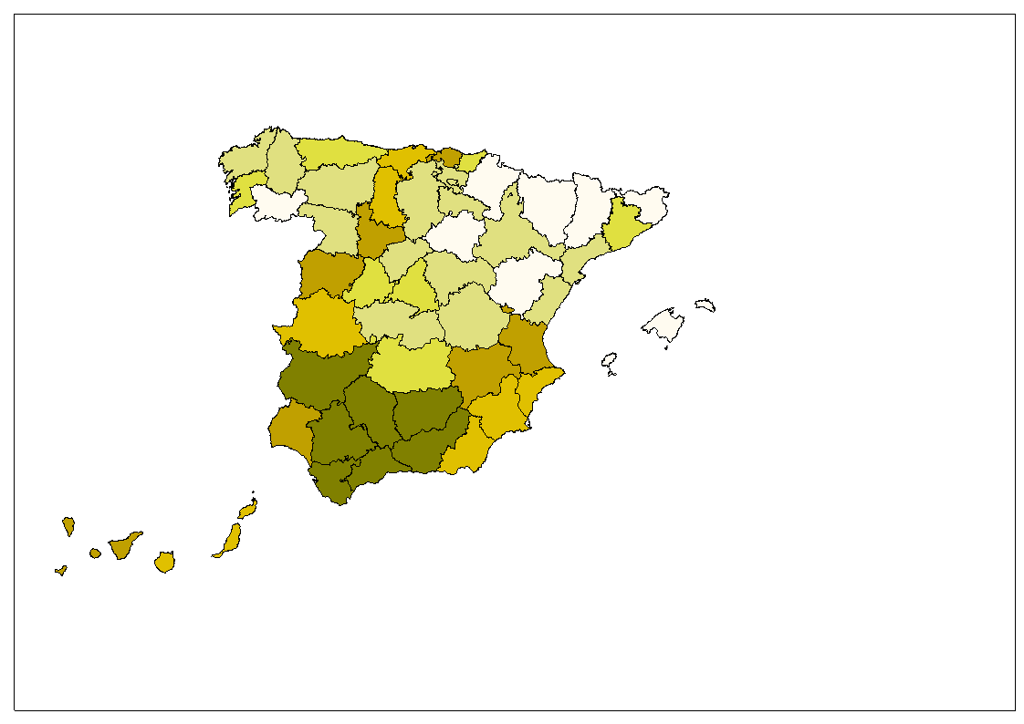
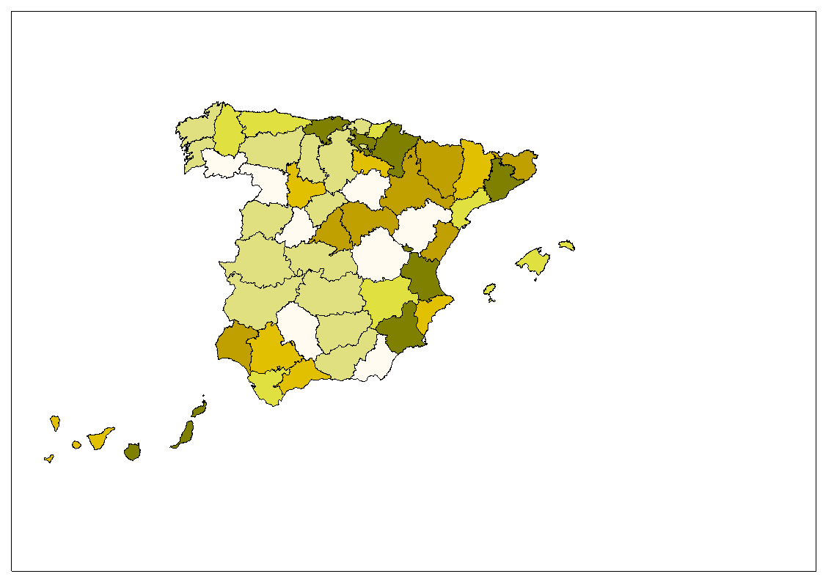
The Spanish case. Some facts and figures
PVR 1995
RPC 1995
HOUSE PRICES
PER CAPITA INCOME
VALU
E
UNE 1995
HST 1995
1995
UNEMPLOYMENT
MORTGAGE OFFER

Slide 11
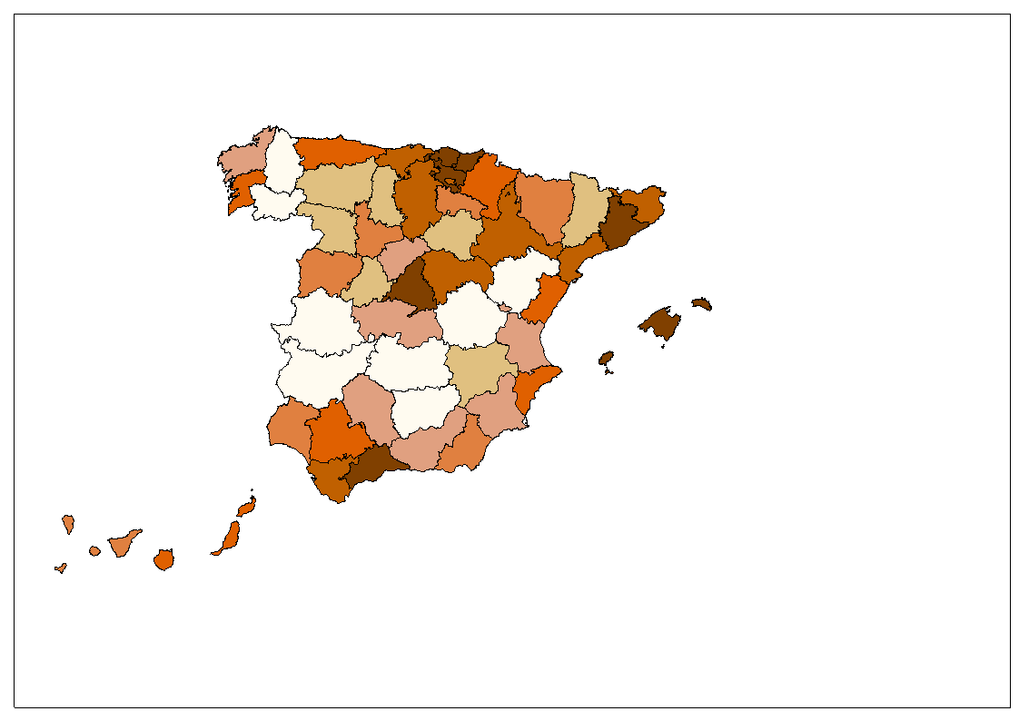
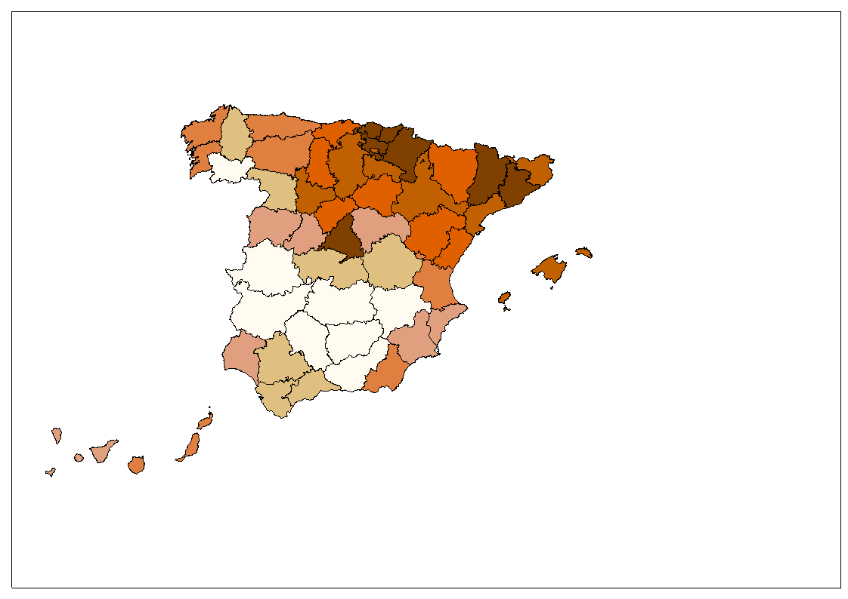
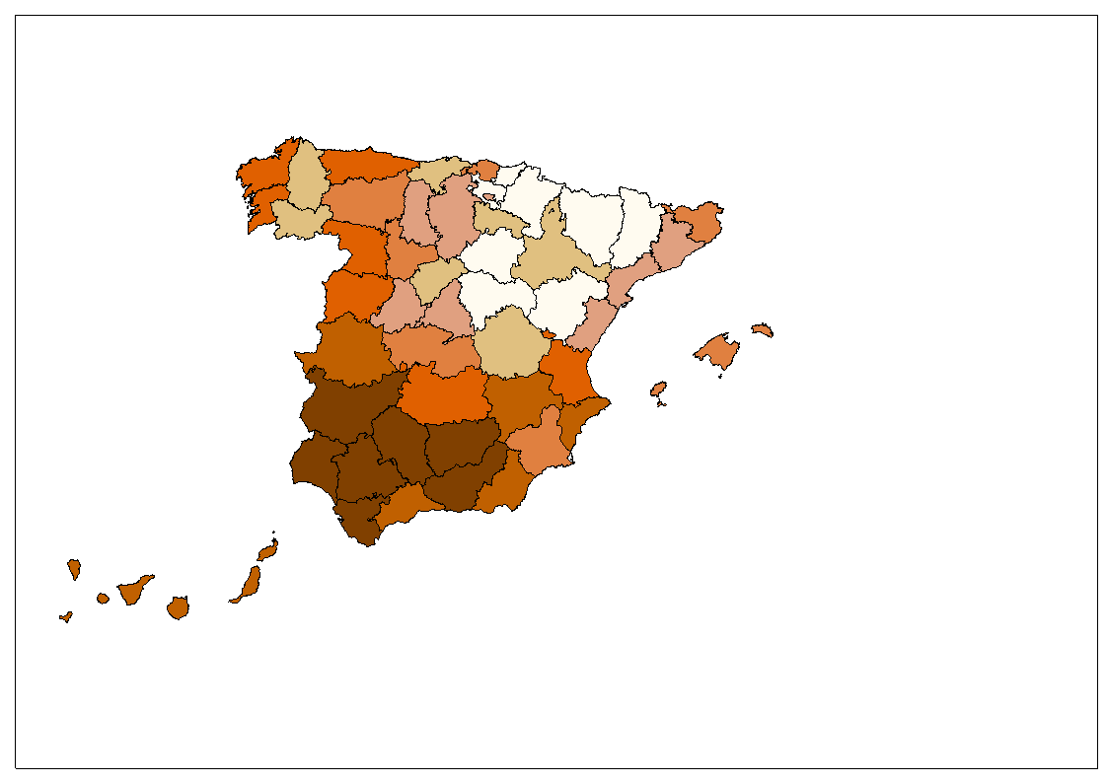
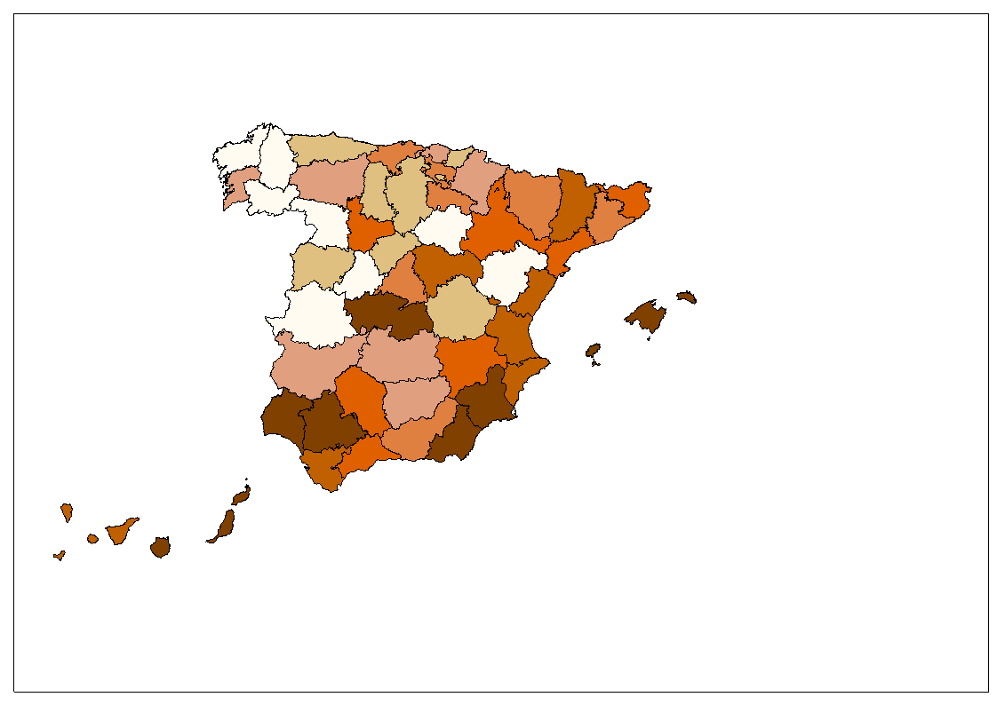
The Spanish case. Some facts and figures
PVR 2007
RPC 2007
HOUSE PRICES
PER CAPITA INCOME
VALU
E
HST 2007
UNE 2007
2007
UNEMPLOYMENT
MORTGAGE OFFER

Slide 12
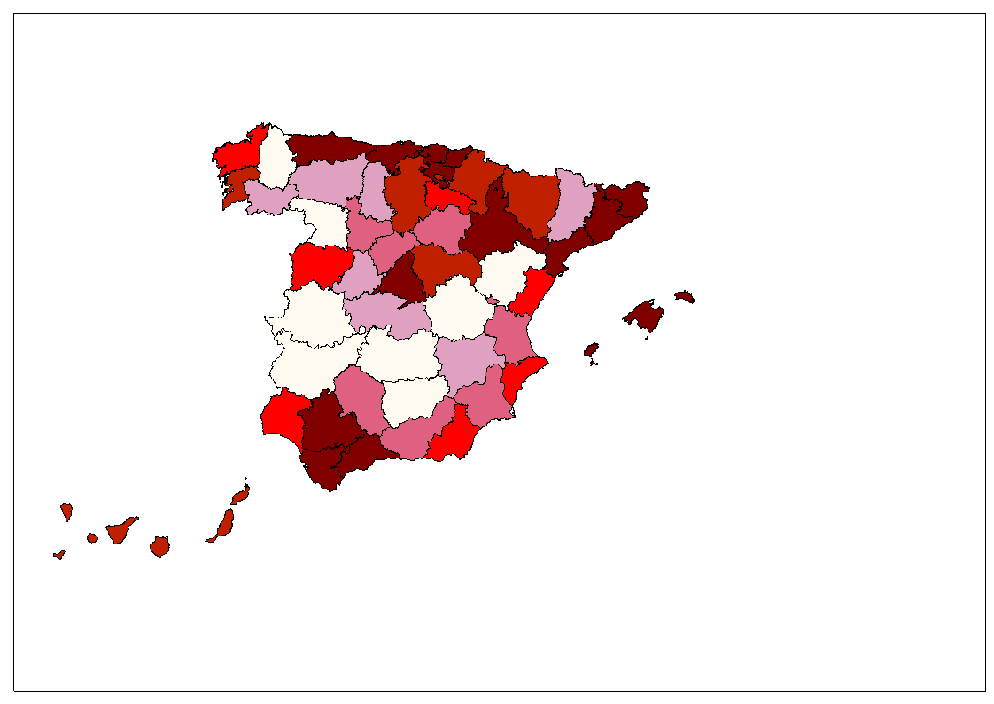
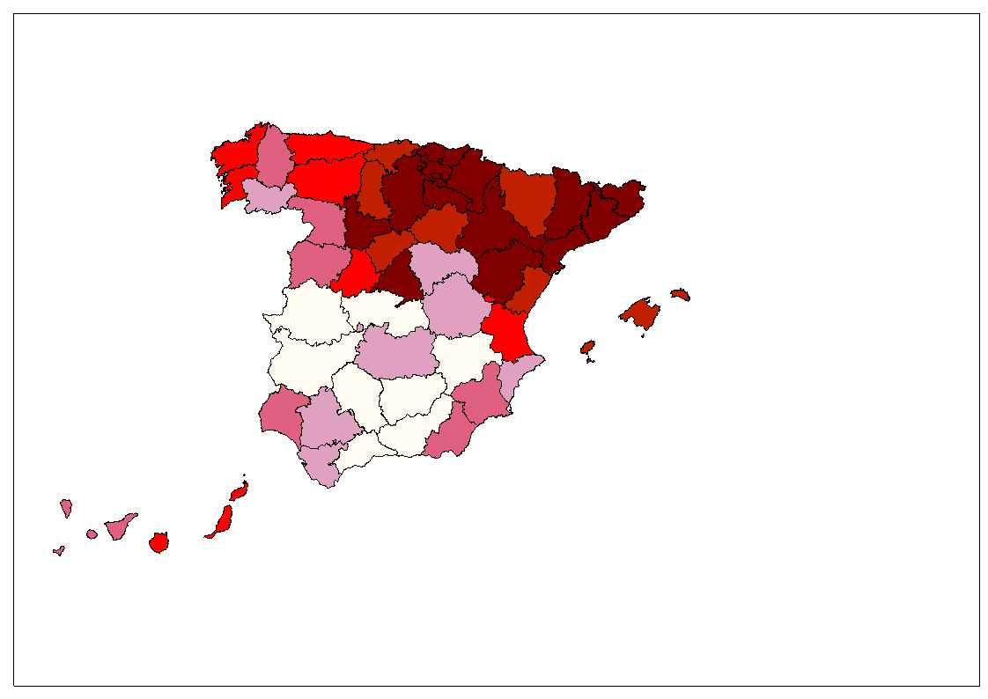
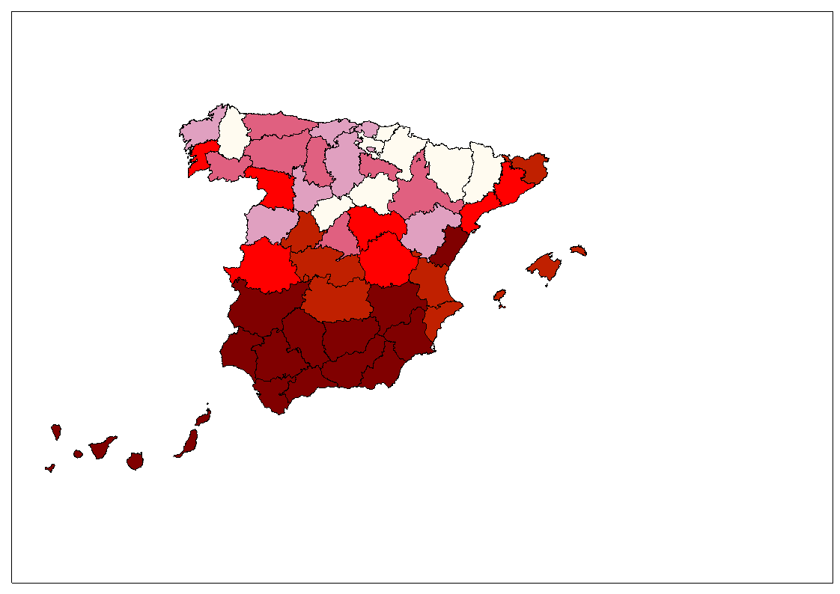
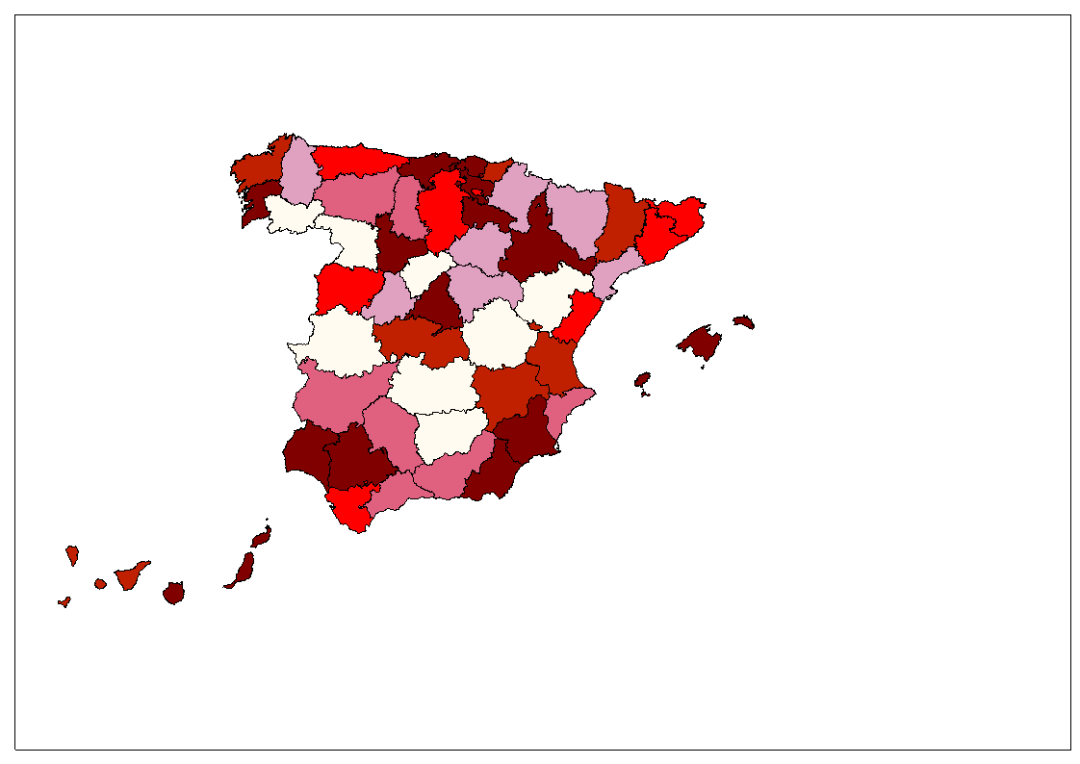
The Spanish case. Some facts and figures
PVR 2011
RPC 2011
HOUSE PRICES
PER CAPITA INCOME
VALU
E
UNE 2011
HST 2011
2011
UNEMPLOYMENT
MORTGAGE OFFER

Slide 13
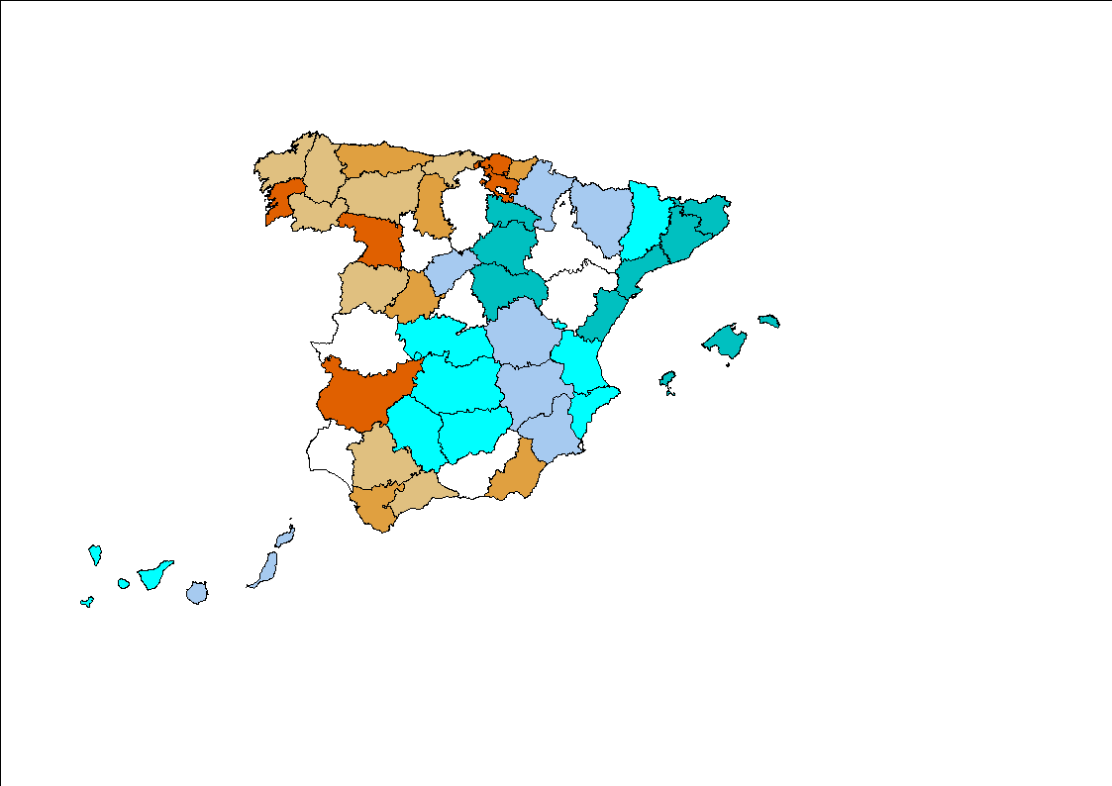
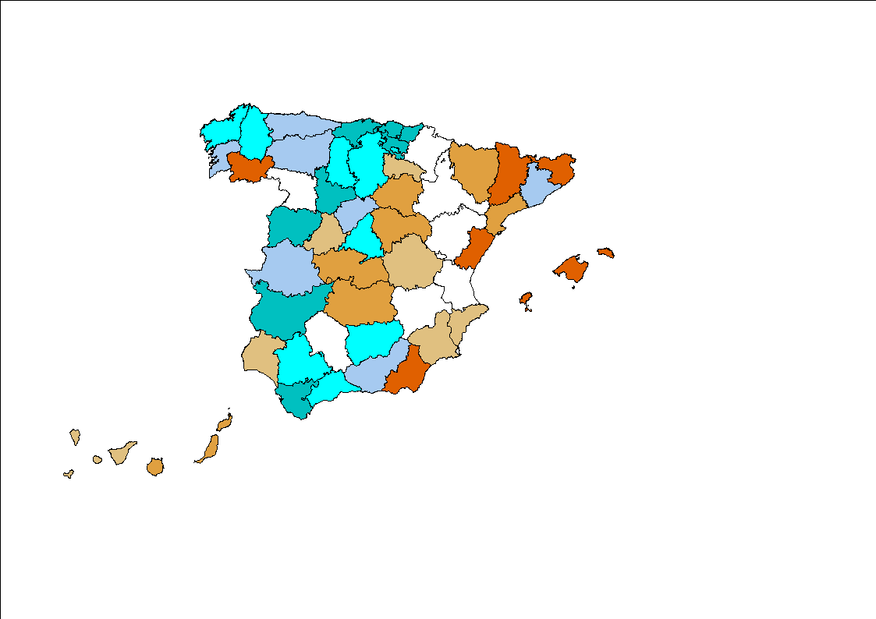
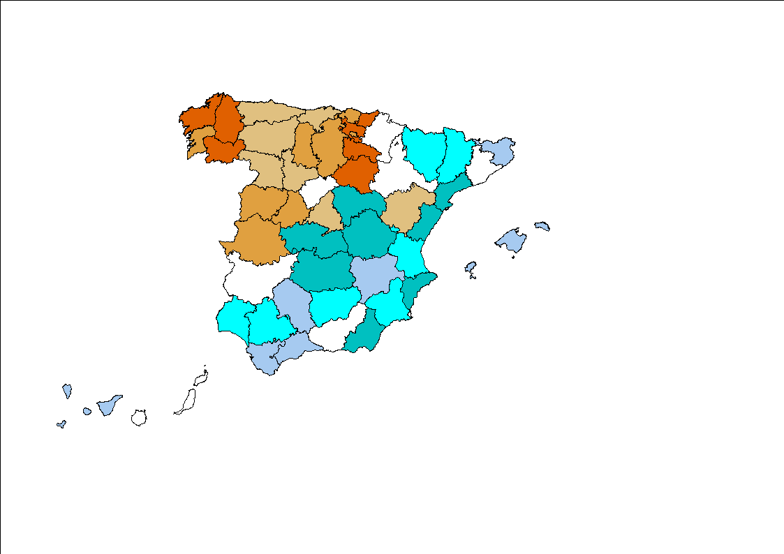
The Spanish case. Some facts and figures
HOUSE PRICES
PER CAPITA INCOME
VARIATION
DPVRT
DRPCT
2011-1995
MORTGAGE OFFER
UNEMPLOYMENT
DUNET
DHSTT
BLUE: LOW RED: HIGH

Slide 14
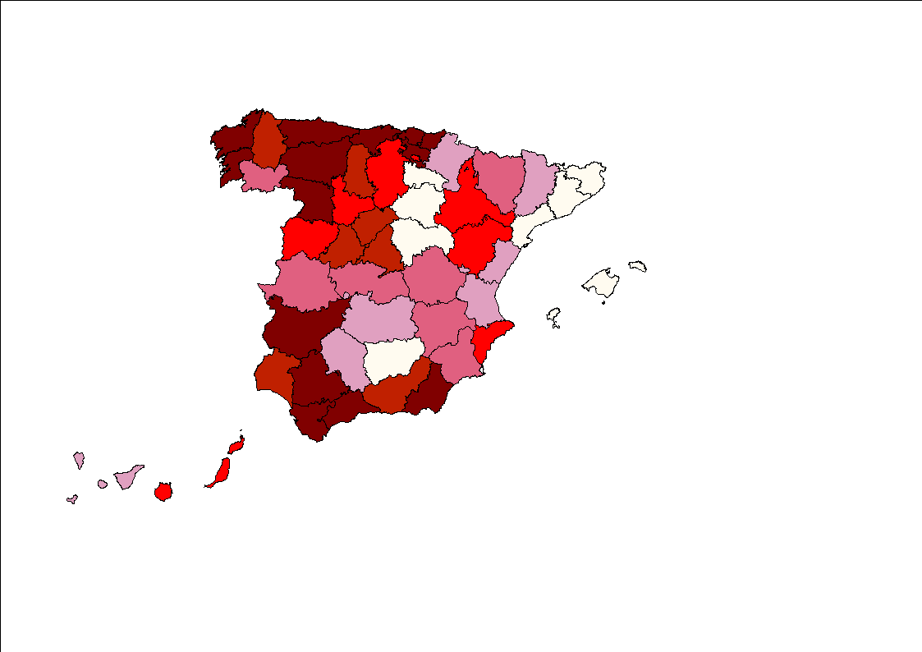
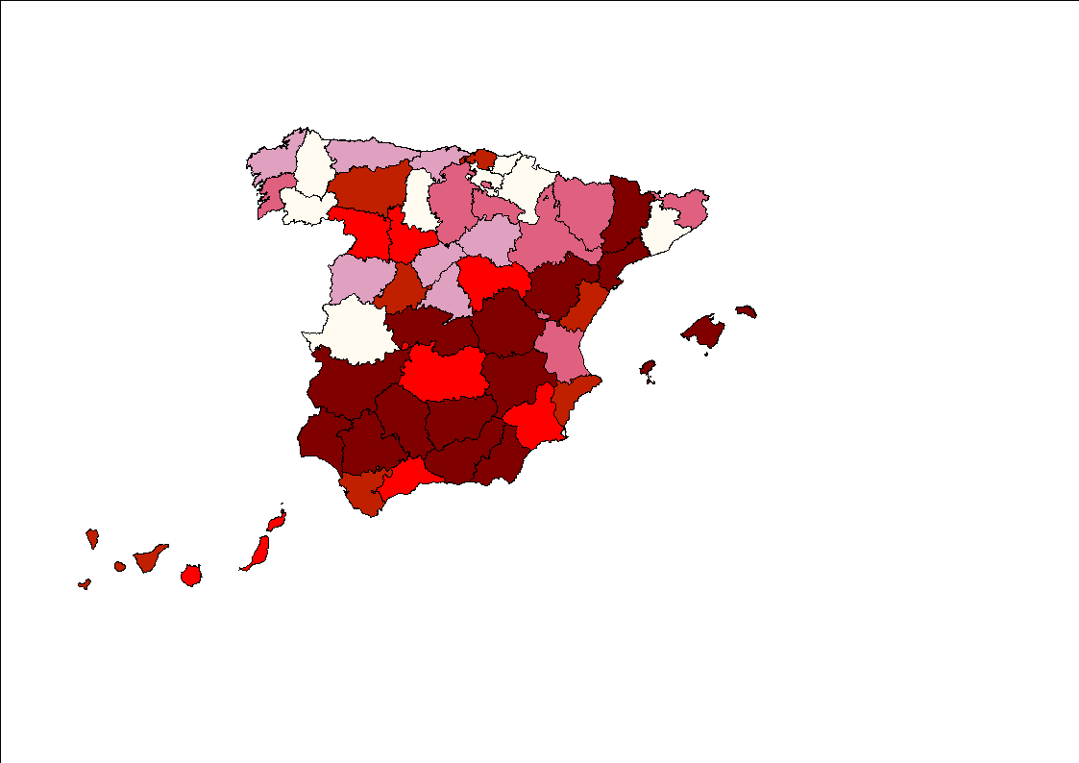
The Spanish case. Some facts and figures
HOUSE PRICES
PER CAPITA INCOME
VARIATION
DPVR (1)
DRPC (1)
UNEMPLOYMENT
MORTGAGE OFFER
2007-1995
DUNE (1)
DHST (1)
BLUE: LOW RED: HIGH

Slide 15
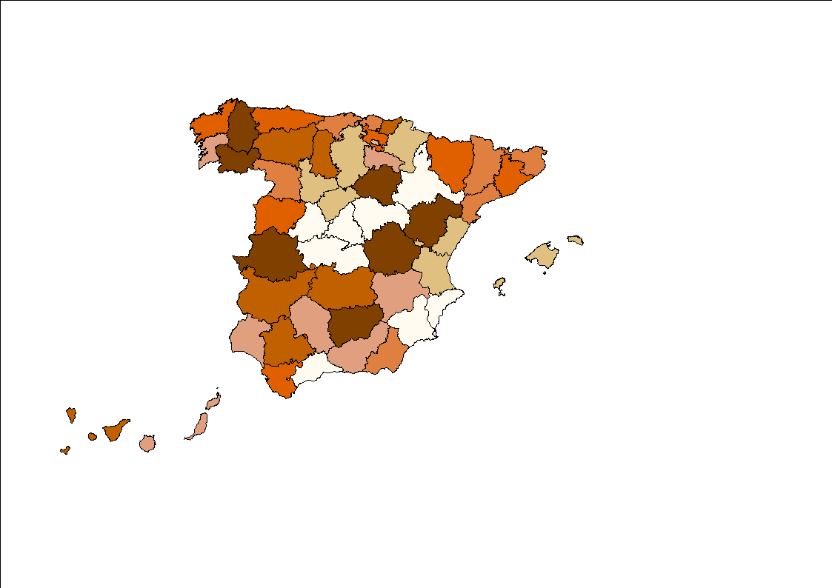
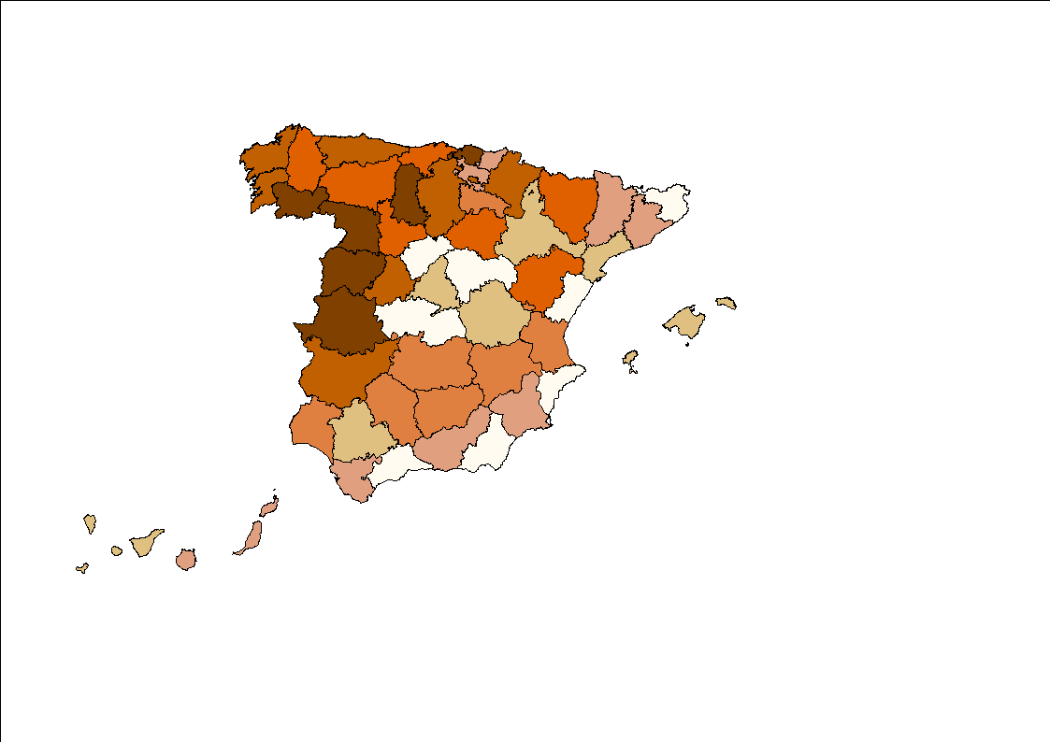
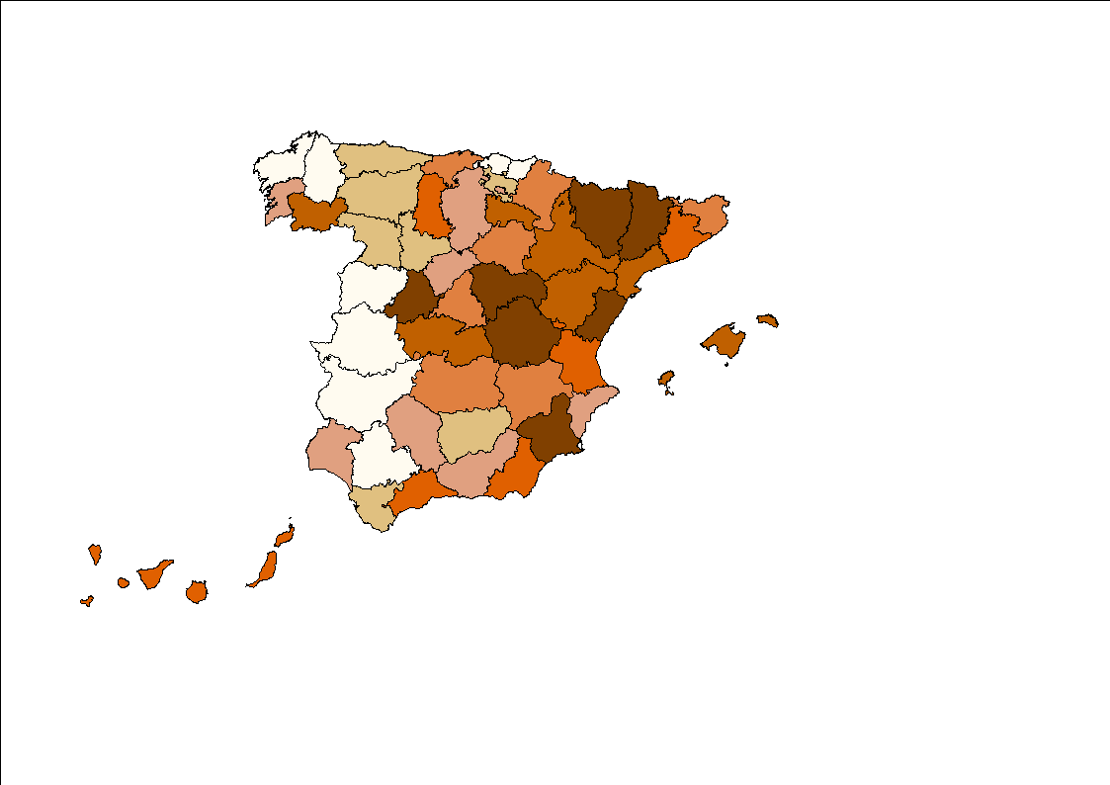
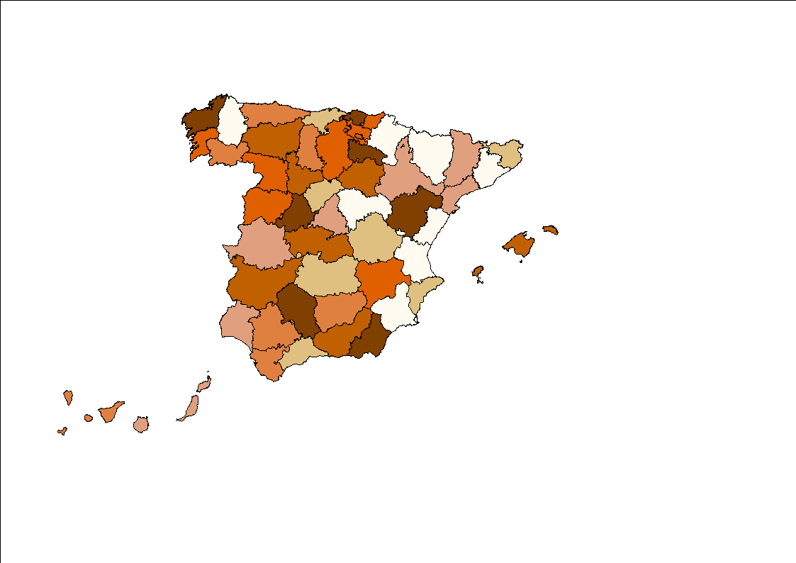
The Spanish case. Some facts and figures
HOUSE PRICES
PER CAPITA INCOME
VARIATION
DPVR (2)
DRPC (2)
MORTGAGE OFFER
2011-2007
UNEMPLOYMENT
DUNE (2)
DHST (2)
BLUE: LOW RED: HIGH

Slide 16
VALUES: Strong Spatial Structure. Moran’s I
Statistical preliminary analysis
 | pvr | stk | rpc | itr | srp | une | act | agr | ind | cot | ser | hst
1995 | 4.66 | 3.29 | 7.67 | 0.96 | - | 6.43 | 2.29 | 4.42 | 6.06 | 3.08 | 5.34 | 1.16
1996 | 4.80 | 3.32 | 7.60 | 2.74 | - | 6.60 | 1.99 | 3.25 | 5.80 | 1.68 | 4.43 | 1.60
1997 | 4.91 | 3.27 | 7.40 | 1.09 | - | 6.97 | 3.14 | 2.22 | 6.14 | 1.91 | 4.06 | 2.64
1998 | 4.86 | 3.30 | 7.29 | 2.65 | 2.31 | 7.14 | 3.37 | 1.61 | 5.70 | 1.75 | 3.30 | 3.17
1999 | 4.88 | 3.29 | 7.10 | 5.91 | 1.93 | 7.15 | 2.76 | 1.41 | 5.39 | 1.65 | 3.07 | 3.69
2000 | 4.87 | 3.18 | 6.96 | 0.01 | 3.10 | 7.47 | 3.47 | 1.54 | 5.92 | 1.87 | 3.41 | 3.16
2001 | 4.90 | 2.94 | 7.06 | -0.97 | 3.49 | 5.54 | 3.84 | 1.29 | 5.68 | 2.51 | 2.77 | 2.50
2002 | 4.60 | 2.68 | 7.04 | 3.00 | 3.13 | 6.32 | 3.78 | 0.89 | 5.82 | 1.45 | 2.58 | 2.22
2003 | 4.08 | 2.39 | 7.12 | -0.10 | 2.85 | 6.47 | 3.73 | 1.30 | 6.30 | 1.68 | 2.39 | 2.59
2004 | 3.60 | 2.14 | 7.01 | -0.08 | 3.20 | 6.42 | 3.41 | 1.38 | 6.52 | 3.39 | 2.61 | 4.00
2005 | 3.27 | 2.07 | 6.82 | -0.62 | 2.98 | 7.36 | 3.67 | 1.12 | 6.52 | 3.71 | 2.98 | 4.55
2006 | 3.21 | 2.04 | 6.70 | 0.14 | 3.71 | 8.10 | 3.48 | 1.44 | 6.39 | 2.93 | 2.55 | 4.29
2007 | 3.12 | 1.99 | 6.74 | 2.98 | 3.63 | 7.75 | 3.69 | 1.64 | 6.74 | 2.71 | 2.70 | 3.36
2008 | 3.17 | 1.89 | 6.79 | 3.20 | 1.89 | 8.77 | 3.96 | 1.51 | 7.13 | 3.11 | 2.84 | 1.77
2009 | 3.55 | 1.88 | 6.85 | 1.87 | -0.34 | 8.59 | 4.00 | 1.59 | 6.97 | 2.31 | 3.74 | 0.31
2010 | 3.55 | 1.92 | 7.00 | 5.35 | 0.34 | 8.29 | 4.03 | 1.85 | 6.78 | 0.97 | 3.63 | 0.88
2011 | 3.68 | - | - | 4.72 | - | 7.81 | 3.85 | 1.24 | 6.78 | 1.99 | 3.81 | -
5% Significant
I$=\frac{y^{′}Wy}{y^{′}y}\frac{R}{S_{0}}→Normally distributed$

Slide 17
Statistical preliminary analysis
INCREMENTS: Weaker Spatial Structure for the variable in increments. Moran’s I
 | pvr | stk | rpc | itr | srp | une | act | agr | ind | cot | ser | hst
1996 | 1.13 | 3.46 | -0.42 | 1.94 |  | -0.96 | 0.77 | -0.51 | 0.69 | -0.12 | -0.03 | 0.98
1997 | -0.51 | 0.86 | 2.37 | 1.64 |  | 0.11 | 3.74 | 3.21 | 0.70 | 0.22 | 0.51 | 1.91
1998 | 0.96 | 3.07 | 1.54 | 1.06 |  | 1.33 | 0.02 | 1.45 | 0.06 | 2.23 | 0.14 | 1.37
1999 | 3.79 | 2.25 | -1.34 | 3.61 | -0.14 | 1.57 | -1.01 | -0.01 | -0.06 | -0.96 | 0.93 | 2.71
2000 | 2.95 | 2.32 | 1.15 | 4.20 | 2.47 | 0.27 | 0.55 | -1.11 | 0.04 | -1.62 | 0.05 | 0.58
2001 | 2.01 | 2.12 | 0.71 | -0.86 | 0.08 | 4.30 | 1.95 | 3.44 | 2.32 | -0.04 | 0.17 | -0.74
2002 | 1.29 | 3.44 | 0.46 | 2.65 | 0.29 | 0.29 | 0.84 | -0.04 | -0.95 | -0.64 | -1.02 | 0.13
2003 | 2.39 | 3.00 | 3.81 | -0.06 | -1.35 | 0.38 | -1.31 | -1.48 | -1.34 | -1.56 | -0.69 | -0.33
2004 | 2.35 | 3.80 | 0.26 | -0.82 | 1.53 | -0.21 | -0.10 | 0.11 | -0.16 | -0.64 | -1.26 | 5.31
2005 | 2.40 | 4.22 | 2.83 | -0.96 | -0.08 | 1.49 | 0.29 | -0.72 | 2.02 | 1.50 | 1.12 | 3.02
2006 | -0.22 | 2.75 | -1.23 | -0.27 | 2.72 | 0.60 | -1.59 | -0.63 | -0.69 | -1.33 | 0.96 | -0.27
2007 | 2.22 | 2.44 | 0.73 | 1.47 | 2.14 | 1.32 | -0.98 | -0.51 | 1.30 | 0.49 | -0.13 | 2.75
2008 | 4.40 | 2.79 | 0.47 | 3.40 | 3.70 | 6.87 | -0.98 | 0.10 | 0.02 | 0.42 | 0.63 | 4.21
2009 | 0.99 | 1.98 | 4.42 | 3.49 | 5.16 | 5.76 | -0.12 | 1.89 | -0.66 | 3.42 | -0.65 | 3.39
2010 | 1.88 | 1.92 | 5.46 | 1.67 | 0.20 | 1.47 | -0.29 | 2.01 | 0.65 | -0.18 | -0.53 | 0.66
2011 | -0.69 |  |  | 0.15 |  | -0.20 | 0.40 | -1.36 | -0.77 | -0.13 | -1.27
5% Significant
I$=\frac{y^{′}Wy}{y^{′}y}\frac{R}{S_{0}}→Normally distributed$

Slide 18
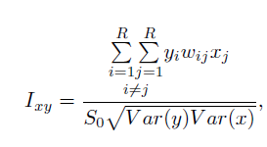
Statistical preliminary analysis
Spatial Independence between the series (with pvr)
 | stk | rpc | itr | srp | une | act | agr | ind | cot | ser | hst | stk | CONCLUSION
1995 | 0.07 | 0.42 | -0.10 |  | -0.35 | 0.05 | -0.10 | 0.31 | -0.15 | -0.15 | 0.09 | 0.07 | RPC, IND, UNE , COT
1996 | 0.05 | 0.40 | -0.14 |  | -0.35 | 0.04 | -0.09 | 0.32 | -0.20 | -0.14 | 0.11 | 0.05 | RPC, IND, UNE , COT
1997 | 0.04 | 0.40 | -0.08 |  | -0.35 | 0.10 | -0.13 | 0.32 | -0.19 | -0.12 | 0.12 | 0.04 | RPC, IND, UNE , COT
1998 | 0.05 | 0.42 | -0.26 | 0.08 | -0.33 | 0.12 | -0.16 | 0.32 | -0.14 | -0.11 | 0.12 | 0.05 | RPC, IND, UNE , COT
1999 | 0.03 | 0.45 | -0.33 | 0.06 | -0.34 | 0.16 | -0.20 | 0.35 | -0.17 | -0.13 | 0.10 | 0.03 | RPC, IND, UNE , COT
2000 | 0.00 | 0.44 | 0.04 | -0.01 | -0.32 | 0.18 | -0.21 | 0.36 | -0.26 | -0.11 | 0.07 | 0.00 | RPC, IND, UNE , COT
2001 | 0.01 | 0.46 | -0.13 | 0.04 | -0.25 | 0.26 | -0.22 | 0.35 | -0.25 | -0.06 | 0.08 | 0.01 | RPC, IND, UNE , COT
2002 | 0.01 | 0.45 | 0.07 | 0.03 | -0.24 | 0.24 | -0.21 | 0.35 | -0.24 | -0.08 | 0.11 | 0.01 | RPC, IND, UNE , COT
2003 | 0.03 | 0.43 | -0.06 | 0.04 | -0.27 | 0.23 | -0.22 | 0.33 | -0.19 | -0.08 | 0.11 | 0.03 | RPC, IND, UNE , COT
2004 | 0.05 | 0.41 | -0.06 | 0.04 | -0.26 | 0.20 | -0.20 | 0.30 | -0.22 | -0.07 | 0.04 | 0.05 | RPC, IND, UNE , COT
2005 | 0.06 | 0.39 | -0.01 | 0.03 | -0.27 | 0.23 | -0.17 | 0.29 | -0.15 | -0.08 | 0.05 | 0.06 | RPC, IND, UNE , COT
2006 | 0.04 | 0.39 | -0.02 | 0.09 | -0.27 | 0.22 | -0.19 | 0.28 | -0.15 | -0.07 | 0.05 | 0.04 | RPC, IND, UNE , COT
2007 | 0.03 | 0.38 | -0.10 | 0.14 | -0.25 | 0.21 | -0.20 | 0.27 | -0.06 | -0.09 | 0.02 | 0.03 | RPC, IND, UNE , COT
2008 | 0.00 | 0.37 | -0.13 | 0.16 | -0.17 | 0.23 | -0.20 | 0.26 | -0.09 | -0.07 | 0.04 | 0.00 | RPC, IND, UNE , COT
2009 | 0.00 | 0.39 | -0.20 | -0.03 | -0.18 | 0.19 | -0.18 | 0.27 | -0.09 | -0.09 | 0.11 | 0.00 | RPC, IND, UNE , COT
2010 | 0.00 | 0.40 | 0.02 | 0.03 | -0.24 | 0.16 | -0.16 | 0.30 | -0.08 | -0.12 | 0.15 | 0.00 | RPC, IND, UNE , COT
2011 |  |  | 0.02 |  | -0.22 | 0.21 | -0.17 | 0.27 | -0.07 | -0.08 |  |  | RPC, IND, UNE , COT
Positive association
Negative association

Slide 19
Statistical preliminary analysis
Strong Spatio-Temporal Independence
 | LEVELS |  |  | FIRST DIFFERENCE |  |  | CONCLUSION
 | STMI | STBP | STLM | STMI | STBP | STLM
pvr | 22.4 | 266.7 | 93.5 | 30.0 | 93.2 | 30,4 | REJECT: THERE IS ST DEP
stk | 10.5 | 28.7 | 104.9 | 22.4 | 104.3 | 122.4 | REJECT: THERE IS ST DEP
rpc | 25.9 | 4510.7 | 751.8 | 31.0 | 104.7 | 122.5 | REJECT: THERE IS ST DEP
itr | 26.1 | 3765.3 | 974.0 | 28.0 | 409.4 | 127.5 | REJECT: THERE IS ST DEP
srp | 12.4 | 3813.7 | 795.9 | 19.0 | 182.9 | 186.8 | REJECT: THERE IS ST DEP
une | 29.1 | 3901.4 | 302.8 | 29.4 | 747.2 | 246.5 | REJECT: THERE IS ST DEP
act | 18.1 | 144.4 | 89.9 | 22.8 | 100.7 | 193.2 | REJECT: THERE IS ST DEP
agr | 7.8 | 423.1 | 103.5 | 21.0 | 132.4 | 174.1 | REJECT: THERE IS ST DEP
ind | 22.0 | 309.5 | 247.7 | 11.2 | 36.8 | 77.5 | REJECT: THERE IS ST DEP
cot | 13.4 | 300.6 | 92.3 | 13.8 | 173.8 | 76.1 | REJECT: THERE IS ST DEP
ser | 15.2 | 408.9 | 74.6 | 21.1 | 452.4 | 151.4 | REJECT: THERE IS ST DEP
hst | 17.1 | 395.5 | 122.5 | 20.9 | 651.7 | 149.1 | REJECT: THERE IS ST DEP

Slide 20
‘First Generation’ Unit Root Tests. No robust to cross-sectional dependence
Statistical preliminary analysis
Time series properties
 |  | lpvr | lstk | lrpc | itr | srp | lune | lact | lagr | lind | lcot | lser | lhst
LLC | level | 12.03 | -5.67 | 8.03 | -6.53 | 3.86 | 0.12 | -4.83 | -8.31 | -6.91 | 4.94 | -4.65 | 2.75
 | p-value | 1.00 | 0.00 | 1.00 | 0.00 | 1.00 | 0.55 | 0.00 | 0.00 | 0.00 | 1.00 | 0.00 | 0.99
 | first diff | -8.18 | -7.52 | -3.65 | -11.84 | -9.78 | -13.07 | -12.46 | -11.51 | -14.17 | -13.17 | -14.17 | -7.42
 | p-value | 0.00 | 0.00 | 0.01 | 0.00 | 0.00 | 0.00 | 0.00 | 0.00 | 0.00 | 0.00 | 0.00 | 0.00
HT | level | 15.26 | 6.06 | 8.07 | -15.94 | 9.07 | 8.85 | -4.93 | -6.55 | -5.43 | 7.24 | -0.99 | 9.51
 | p-value | 1.00 | 1.00 | 1.00 | 0.00 | 1.00 | 1.00 | 0.00 | 0.00 | 0.00 | 1.00 | 0.16 | 1.00
 | first diff | -1.65 | 0.82 | -8.95 | -33.75 | -9.02 | -8.58 | -20.53 | -19.96 | -21.49 | -13.38 | -17.90 | -7.10
 | p-value | 0.05 | 0.80 | 0.00 | 0.00 | 0.00 | 0.00 | 0.00 | 0.00 | 0.00 | 0.00 | 0.00 | 0.00
B | level | 16.98 | 4.08 | 8.96 | -9.33 | 8.06 | 9.21 | -1.89 | -1.45 | -1.29 | 9.23 | 2.02 | 10.55
 | p-value | 1.00 | 1.00 | 1.00 | 0.00 | 1.00 | 1.00 | 0.03 | 0.07 | 0.10 | 1.00 | 0.97 | 1.00
 | first diff | 3.92 | -6.41 | -2.94 | -2.04 | -10.52 | -10.59 | -11.75 | -6.96 | -10.12 | -8.38 | -10.49 | -5.70
 | p-value | 0.00 | 0.00 | 0.01 | 0.00 | 0.00 | 0.00 | 0.00 | 0.00 | 0.00 | 0.00 | 0.00 | 0.00
IPS | level | 18.68 | 0.14 | 7.39 | -11.34 | 7.27 | 8.36 | -5.74 | -8.05 | -6.28 | 5.91 | -2.52 | 8.15
 | p-value | 1.00 | 0.55 | 1.00 | 0.00 | 1.00 | 1.00 | 0.00 | 0.00 | 0.00 | 1.00 | 0.01 | 1.00
 | first diff | -2.02 | -8.93 | -11.84 | -17.74 | -11.07 | -11.11 | -13.66 | -13.83 | -14.31 | -12.45 | -14.11 | -10.51
 | p-value | 0.02 | 0.00 | 0.00 | 0.00 | 0.00 | 0.00 | 0.00 | 0.00 | 0.00 | 0.00 | 0.00 | 0.00
H | level | 33.58 | 30.04 | 28.10 | 15.75 | 39.00 | 39.23 | -1.92 | 13.24 | 20.03 | 2.07 | -2.23 | 6.77
 | p-value | 0.00 | 0.00 | 0.00 | 0.00 | 0.00 | 0.00 | 0.97 | 0.00 | 0.00 | 0.02 | 0.98 | 0.00
 | first diff | 5.69 | 5.94 | 2.10 | -6.77 | 3.76 | 0.60 | 14.33 | -2.04 | -3.44 | -2.24 | 27.46 | 1.88
 | p-value | 0.00 | 0.00 | 0.02 | 1.00 | 0.00 | 0.27 | 0.00 | 0.98 | 0.99 | 0.98 | 0.00 | 0.03
LLC: Levin-Lin-Chu; HT: Harris-Tzavalis; B: Breitung; IPS: Im-Pesaran-Shin; H: Hadri
I(1) SERIES
I(0) SERIES

Slide 21
‘First Generation’ Unit Root Tests. No robust to cross-sectional dependence
Statistical preliminary analysis
Time series properties
 |  | lpvr | lstk | lrpc | itr | srp | lune | lact | lagr | lind | lcot | lser | lhst
P | level | 37.56 | 64.32 | 236.62 | 1590.35 | 34.56 | 128.68 | 160.13 | 244.83 | 189.40 | 188.39 | 250.47 | 82.26
 | p-value | 1.00 | 0.99 | 0.00 | 0.00 | 1.00 | 0.03 | 0.01 | 0.00 | 0.00 | 0.00 | 0.00 | 0.90
 | first diff | 378.09 | 242.26 | 691.71 | 2483.33 | 459.88 | 746.70 | 633.67 | 713.02 | 731.36 | 701.86 | 782.41 | 591.37
 | p-value | 0.00 | 0.00 | 0.00 | 0.00 | 0.00 | 0.00 | 0.00 | 0.00 | 0.00 | 0.00 | 0.00 | 0.00
Z | level | 6.61 | 4.00 | -4.26 | -33.93 | 7.68 | -1.94 | -3.03 | -7.00 | -4.99 | -3.82 | -7.13 | 2.57
 | p-value | 1.00 | 1.00 | 0.00 | 0.00 | 1.00 | 0.03 | 0.01 | 0.00 | 0.00 | 0.00 | 0.00 | 0.99
 | first diff | -10.70 | -6.77 | -19.14 | -45.49 | -15.06 | -20.44 | -19.14 | -20.67 | -20.97 | -20.43 | -21.91 | -16.68
 | p-value | 0.00 | 0.00 | 0.00 | 0.00 | 0.00 | 0.00 | 0.00 | 0.00 | 0.00 | 0.00 | 0.00 | 0.00
L* | level | 6.77 | 4.02 | -6.03 | -62.11 | 7.91 | -2.07 | -3.30 | -7.83 | -5.35 | -4.25 | -8.25 | 2.55
 | p-value | 1.00 | 0.99 | 0.00 | 0.00 | 1.00 | 0.02 | 0.01 | 0.00 | 0.00 | 0.00 | 0.00 | 0.99
 | first diff | -13.32 | -7.61 | -26.80 | -97.00 | -17.62 | -28.90 | -24.58 | -27.67 | -28.43 | -27.33 | -30.45 | -22.49
 | p-value | 0.00 | 0.00 | 0.00 | 0.00 | 0.00 | 0.00 | 0.00 | 0.00 | 0.00 | 0.00 | 0.00 | 0.00
Pm | level | -4.41 | -2.52 | 9.66 | 105.38 | -4.62 | 2.02 | 4.25 | 10.24 | 6.32 | 6.25 | 10.64 | -1.25
 | p-value | 1.00 | 1.00 | 0.00 | 0.00 | 1.00 | 0.02 | 0.00 | 0.00 | 0.00 | 0.00 | 0.00 | 0.89
 | first diff | 19.66 | 10.05 | 41.84 | -168.52 | 25.44 | 45.73 | 32.73 | 43.34 | 44.64 | 42.56 | 48.25 | 34.75
 | p-value | 0.00 | 0.00 | 0.00 | 0.00 | 0.00 | 0.00 | 0.00 | 0.00 | 0.00 | 0.00 | 0.00 | 0.00
Phillips-Perron Tests
I(1) SERIES
I(0) SERIES

Slide 22
Pesaran’s CIPS. Most of the series are I(1)
Statistical preliminary analysis
Time series properties. ‘Second Generation’ Unit Root Tests.
 | LEVELS |  |  | FIRST DIFFERENCE |  |  | CONCLUSION
 | CIPS | p-val | m | CIPS | p-val | m | d
pvr | -2.19 | 0.65 | 3 | -2.53 | 0.01 | 2 | 1
stk | -2.07 | 0.07 | 2 | -1.85 | 0.01 | 1 | 1
rpc | -2.36 | 0.32 | 3 | -2.53 | 0.01 | 2 | 1
itr | -3.67 | 0.01 | 2 | -4.46 | 0.01 | 1 | 0
srp | -1.91 | 0.21 | 2 | -2.07 | 0.01 | 2 | 1
une | -2.57 | 0.08 | 3 | -3.67 | 0.01 | 2 | 1
act | -2.93 | 0.01 | 2 | -3.21 | 0.01 | 2 | 0
agr | -2.77 | 0.02 | 3 | -3.14 | 0.01 | 2 | 0
ind | -2.75 | 0.02 | 3 | -3.34 | 0.01 | 2 | 0
cot | -2.47 | 0.18 | 3 | -3.23 | 0.01 | 2 | 1
ser | -2.8 | 0.01 | 3 | -3.22 | 0.01 | 2 | 0
hst | -1.43 | 0.99 | 3 | -2.85 | 0.01 | 2 | 1

Slide 23
Statistical preliminary analysis
Time series properties. ‘Second Generation’ Unit Root Tests.
Bai & Ng’s PANIC. Most of the series are I(1)
 | LEVELS |  |  |  |  |  |  | FIRST DIFFERENCE
 | Idiosincratic component |  |  | Common factors: MQf statistic |  |  |  | Idiosincratic component |  |  | Common factors: MQf statistic
 | ADF | p-val | Conclu | MQf(3) | MQf(2) | MQf(1) |  | ADF | p-val | d | MQf(3) | MQf(2) | MQf(1)
pvr | 1.01 | 0.16 | H0 | -0.62 | -10.52 | -20.45 | r=1 | 6.56 | 0 | 1 | -1.22 | -8.39 | -12.24 | r=0
stk | 5.64 | 0 | HA | -0.84 | -4.05 | -16.88 | r=0 |  |  | 0 | -12.25 | -15.54 | -11.84 | r=0
rpc | 0.38 | 0.35 | H0 | -4.36 | -6.45 | -10.56 | r=0 | 1.76 | 0.04 | 1 | -2.1 | -17.54 | -19.34 | r=1
itr | -1.73 | 0.96 | H0 | -7.88 | -14.38 | -16.26 | r=0 | 2.51 | 0.01 | 1 | -7.89 | -8.35 | -10.54 | r=0
srp | 2.93 | 0 | HA | -3.91 | -5.87 | -8.92 | r=0 |  |  | 0 |  |  |  | r=0
une | -2.27 | 0.98 | H0 | -4.3 | -9.15 | -17.96 | r=1 | 2.67 | 0 | 1 | -5.11 | -17.97 | -13.76 | r=0
act | 0.1 | 0.46 | H0 | -2.46 | -2.6 | -7.91 | r=1 | 2.14 | 0.02 | 1 | -7.78 | -16.63 | -16.45 | r=0
agr | -1.1 | 0.86 | H0 | -2.46 | -2.6 | -7.91 | r=0 | 1.38 | 0.08 | 1 | -10.6 | -13.55 | -13.1 | r=0
Iid | -1.78 | 0.96 | H0 | -4.38 | -14.57 | -15.01 | r=0 | 1.76 | 0.04 | 1 | -13.53 | -14.81 | -14.08 | r=0
cot | -0.17 | 0.57 | H0 | -5.66 | -7.74 | -9.26 | r=0 | 2 | 0.02 | 1 | -3.31 | -19.15 | -13.01 | r=0
ser | -0.93 | 0.82 | H0 | 1.91 | -10.37 | -12.14 | r=0 | 2.22 | 0.01 | 1 | -3.97 | -12.37 | -14.05 | r=0
hst | 0.21 | 0.42 | H0 | -3.7 | -6.43 | -12.34 | r=0 | 2.05 | 0.02 | 1 | -5.84 | -17.41 | -20.56 | r=1

Slide 24
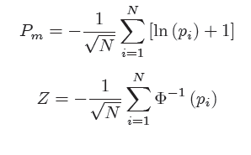
Statistical preliminary analysis
Time series properties. ‘Second Generation’ Unit Root Tests.
Choi’s Tests. All the series are I(1)
 | LEVELS |  |  |  |  |  |  | FIRST DIFFERENCE
 | Pm | p-val | Z | p-val | L* | p-val | Conclu. | Pm | p-val | Z | p-val | L* | p-val | Conclu.
pvr | -3.62 | 0.99 | 2.64 | 0.99 | 2.38 | 0.99 | H0 | 1.40 | 0.08 | -3.17 | 0.00 | -2.93 | 0.00 | I(1)
Stk | -1.04 | 0.85 | 0.22 | 0.59 | 0.18 | 0.57 | H0 | 6.06 | 0.00 | -6.61 | 0.00 | -6.49 | 0.00 | I(1)
rpc | -2.23 | 0.98 | 0.70 | 0.76 | 0.63 | 0.74 | H0 | 2.37 | 0.01 | -4.05 | 0.00 | -3.72 | 0.00 | I(1)
Itr | -4.16 | 0.99 | 3.32 | 0.99 | 2.99 | 0.99 | H0 | 7.13 | 0.00 | -7.51 | 0.00 | -7.11 | 0.00 | I(1)
Srp | -2.55 | 0.99 | 0.84 | 0.80 | 0.76 | 0.77 | H0 | 5.87 | 0.00 | -6.81 | 0.00 | -6.34 | 0.00 | I(1)
Une | -3.62 | 0.99 | 2.64 | 0.99 | 2.38 | 0.99 | H0 | 1.40 | 0.08 | -3.15 | 0.00 | -2.93 | 0.00 | I(1)
Act | -2.80 | 0.99 | 1.49 | 0.93 | 1.35 | 0.91 | H0 | 6.37 | 0.00 | -6.92 | 0.00 | -6.54 | 0.00 | I(1)
Agr | 0.15 | 0.44 | -0.65 | 0.25 | -0.86 | 0.19 | H0 | 11.79 | 0.00 | -9.18 | 0.00 | -9.65 | 0.00 | I(1)
Ind | -1.93 | 0.97 | 0.74 | 0.77 | 0.67 | 0.75 | H0 | 9.21 | 0.00 | -7.87 | 0.00 | -8.06 | 0.00 | I(1)
cot | -3.95 | 0.99 | 3.47 | 0.99 | 3.20 | 0.99 | H0 | 1.98 | 0.02 | -3.26 | 0.00 | -3.12 | 0.00 | I(1)
Ser | -2.95 | 0.99 | 1.96 | 0.97 | 1.79 | 0.96 | H0 | 6.65 | 0.00 | -6.69 | 0.00 | -6.49 | 0.00 | I(1)
hst | -1.80 | 0.99 | 0.76 | 0.77 | 0.72 | 0.76 | H0 | 5.74 | 0.00 | -6.85 | 0.00 | -5.81 | 0.00 | I(1)

Slide 25
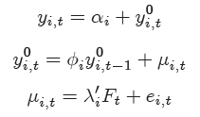
Statistical preliminary analysis
Time series properties. ‘Second Generation’ Unit Root Tests.
Moon-Perron Tests. Almost all the series are I(0)
 | LEVELS |  |  |  | Conclu. | FIRST DIFFERENCE |  |  |  | Conclu.
 | ta | p-val | tb | p-val |  | ta | p-val | tb | p-val
pvr | -0.67 | 0.25 | -1.13 | 0.13 | H0 | -14.85 | 0 | -7.84 | 0 | I(1)
stk | -8.65 | 0 | -4.12 | 0 | HA | -30.63 | 0 | -17.38 | 0 | I(0)
rpc | -6.45 | 0 | -8.98 | 0 | HA | -38.23 | 0 | -18.96 | 0 | I(0)
itr | -35.77 | 0 | -17.67 | 0 | HA | -57.99 | 0 | -36.96 | 0 | I(0)
srp | -4.03 | 0 | -6.29 | 0 | HA | -19.6 | 0 | -7.86 | 0 | I(0)
une | -2.98 | 0.01 | -4.34 | 0 | HA | -28.67 | 0 | -18.95 | 0 | I(0)
act | -10.39 | 0 | -16.66 | 0 | HA | -51.02 | 0 | -25.69 | 0 | I(0)
agr | -10.07 | 0 | -16.41 | 0 | HA | -40.13 | 0 | -23.02 | 0 | I(0)
ind | -12.99 | 0 | -19.91 | 0 | HA | -52.23 | 0 | -25.92 | 0 | I(0)
cot | -4.83 | 0 | -7.67 | 0 | HA | -39.54 | 0 | -24.44 | 0 | I(0)
ser | -10.37 | 0 | -16.68 | 0 | HA | -45.01 | 0 | -25.47 | 0 | I(0)
hst | -2.31 | 0.02 | -3.46 | 0 | HA | -22.01 | 0 | -13.42 | 0 | I(0)

Slide 26
Statistical preliminary analysis
We have found:
Strong Spatial Structure
Strong Bivariate Spatial Association with HOUSING PRICE
Strong temporal structure
Strong Spatiotemporal structure
A Great Heterogeneity

Slide 27
Provisional estimates
Let us specify a PANEL DATA model
No spatial effects (STATIC)
No time dynamics (STATIC)

Slide 28
Provisional estimates
Let us specify a PANEL DATA model
With spatial effects (DYNAMIC)
No time dynamics (STATIC)
SLM
SEM

Slide 29
Provisional estimates
Let us specify a PANEL DATA model
Without spatial effects (STATIC)
With time dynamics (DYNAMIC)
With spatial effects (DYNAMIC)
With time dynamics (DYNAMIC)
SLM

Slide 30
Panel data model. Dependent Variable = lpvr
LEVELS
INCREMENTS
Fixed-effects (within) regression
R-sq: within = 0.832
between = 0. 597
overall = 0. 676
corr(αi; Xb) = -0.477
 | Coef. | Std. Err | t | pvalue
lstk | -0.278 | 0.139 | -2.000 | 0.045
lrpc | 1.018 | 0.118 | 8.600 | 0.000
lact | 0.932 | 0.113 | 8.220 | 0.000
lune | -0.003 | 0.023 | -0.130 | 0.893
lagr | -0.123 | 0.022 | -5.550 | 0.000
lind | -0.273 | 0.036 | -7.650 | 0.000
lcot | 0.146 | 0.036 | 4.030 | 0.000
itr | 0.003 | 0.002 | 1.330 | 0.182
lhst | 0.022 | 0.023 | 0.970 | 0.334
srp | 0.006 | 0.001 | 6.750 | 0.000
constant | -6.244 | 1.214 | -5.140 | 0.000
sigma α= 0.207 | sigma ε= 0.111
F test that all αi=0: F(49,740)=30.28 pval=0.000
Fixed-effects (within) regression
R-sq: within = 0.460
between =0.049
overall = 0.447
corr(αi; Xb) = -0.018
 | Coef. | Std. Err | t | pvalue
lstk | -0.981 | 0.265 | -3.700 | 0.000
lrpc | 0.534 | 0.083 | 6.420 | 0.000
lact | 0.119 | 0.080 | 1.480 | 0.139
lune | -0.042 | 0.013 | -3.190 | 0.001
lagr | 0.000 | 0.014 | 0.010 | 0.994
lind | 0.043 | 0.022 | 1.990 | 0.047
lcot | 0.074 | 0.019 | 3.830 | 0.000
itr | 0.006 | 0.001 | 5.890 | 0.000
lhst | 0.082 | 0.013 | 6.080 | 0.000
srp | 0.003 | 0.001 | 5.040 | 0.000
constant | 0.032 | 0.004 | 8.150 | 0.000
sigma_α= 0.124 | sigma_ε= 0.052
F test that all αi=0: F(49,791)=0.76 pval=0.883
LM lag test for omitted spatial lag in panel data
LM value 172.2088 pval=0.0000
LM error test for spatial errors in panel data
LM value 50.65570432 pval=0.0000
Robust LM lag test for omitted spatial lag in panel data
LM value 121.6128 pval=0.0000
Robust LM error test for spatial errors in panel data
LM value 0.02865406 pval=0. 8605
LM lag test for omitted spatial lag in panel data
LM value 324.2534 pval=0.0000
LM error test for spatial errors in panel data
LM value 214.8854 pval=0.0000
Robust LM lag test for omitted spatial lag in panel data
LM value 109.86825 pval=0.0000
Robust LM error test for spatial errors in panel data
LM value 0.04553 pval=0.8310

Slide 31
Dynamic panel data model . One lag of the dependent variable. Dependent Variable = lpvr
System dynamic panel-data estimation
 | Coef. | Std. Err | t | pvalue
lpvr(-1) | 0.705 | 0.008 | 87.930 | 0.000
lstk | 0.067 | 0.031 | 2.130 | 0.033
lrpc | 0.087 | 0.027 | 3.240 | 0.001
lact | -0.206 | 0.026 | -7.820 | 0.000
lune | -0.035 | 0.006 | -6.390 | 0.000
lagr | -0.071 | 0.005 | -13.060 | 0.000
lind | -0.037 | 0.012 | -3.010 | 0.003
lcot | 0.007 | 0.009 | 0.750 | 0.455
itr | -0.005 | 0.000 | -14.390 | 0.000
lhst | 0.089 | 0.005 | 16.730 | 0.000
srp | 0.005 | 0.000 | 15.890 | 0.000
constant | 2.098 | 0.254 | 8.240 | 0.000
Wald chi2(10) = 252398.54 | Number of instruments = 130
Arellano-Bond test for zero autocorrelation in first-differenced errors
Order | z | pvalue
1 | -4.169 | 0.000
2 | -2.200 | 0.028
Sargan test of overidentitying restrictions
H0: Overidentitying restrictions are valid
 | chi2(118)= 48.826
 | pvalue = 1.000

Slide 32
Pooled model with spatially lagged dependent variable and spatial fixed effects Dependent Variable = lpvr
LEVELS
INCREMENTS
Dependent variable: lpvr
R-squared | 0.935
sigma^2 | 0.009
log-likelihood | 733.003
****************************************************
Variable | Coefficient | t-stat | pvalue
lstk | -0.405 | -3.449 | 0.001
lrpc | 0.601 | 5.825 | 0.000
lact | 0.498 | 5.031 | 0.000
lune | 0.027 | 1.407 | 0.159
lagr | -0.059 | -3.091 | 0.002
lind | -0.250 | -8.271 | 0.000
lcot | 0.101 | 3.270 | 0.001
itr | 0.002 | 0.895 | 0.371
lhst | -0.004 | -0.205 | 0.838
srp | 0.006 | 7.427 | 0.000
W*dep.var. | 0.475 | 15.736 | 0.000
Dependent variable: lpvr
R-squared | 0.698
sigma^2 | 0.003
log-likelihood | 1145.540
****************************************************
Variable | Coefficient | t-stat | pvalue
lstk | -0.318 | -5.700 | 0.000
lrpc | 0.435 | 13.007 | 0.000
lact | 0.174 | 2.428 | 0.015
lune | -0.028 | -2.400 | 0.016
lagr | -0.102 | -11.875 | 0.000
lind | -0.011 | -0.641 | 0.522
lcot | -0.013 | -0.698 | 0.485
itr | 0.004 | 4.936 | 0.000
lhst | 0.082 | 6.118 | 0.000
srp | 0.002 | 4.192 | 0.000
W*dep.var. | 0.287 | 9.373 | 0.000
LR-test joint significance spatial fixed effects = 1175.085
degrees of freedom= 66
pvalue = 0.000
LR-test joint significance spatial fixed effects= 373.441
degrees of freedom= 66
pvalue = 0.000

Slide 33
Pooled model with spatial error dependence and spatial fixed effects Dependent Variable = lpvr
LEVELS
INCREMENTS
Dependent variable: lpvr
R-squared | 0.913
sigma^2 | 0.011
log-likelihood | 659.324
****************************************************
Variable | Coefficient | t-stat | pvalue
lstk | -0.302 | -2.280 | 0.023
lrpc | 0.958 | 8.495 | 0.000
lact | 0.850 | 8.036 | 0.000
lune | -0.008 | -0.362 | 0.718
lagr | -0.115 | -5.485 | 0.000
lind | -0.278 | -8.260 | 0.000
lcot | 0.155 | 4.538 | 0.000
itr | -0.001 | -0.284 | 0.777
lhst | 0.003 | 0.132 | 0.895
srp | 0.006 | 6.723 | 0.000
spat.aut. | 0.260 | 5.608 | 0.000
Dependent variable: lpvr
R-squared | 0.698
sigma^2 | 0.003
log-likelihood | 1146.038
****************************************************
Variable | Coefficient | t-stat | pvalue
lstk | -0.314 | -5.895 | 0.000
lrpc | 0.612 | 22.273 | 0.000
lact | 0.240 | 3.532 | 0.000
lune | -0.005 | -0.353 | 0.724
lagr | -0.086 | -10.241 | 0.000
lind | -0.025 | -1.575 | 0.115
lcot | 0.011 | 0.623 | 0.534
itr | 0.004 | 4.252 | 0.000
lhst | 0.067 | 4.862 | 0.000
srp | 0.002 | 4.205 | 0.000
spat.aut. | 0.448 | 11.458 | 0.000
LR-test joint significance spatial fixed effects = 1244.786
degrees of freedom= 66
pvalue = 0.000
LR-test joint significance spatial fixed effects = 369.852
degrees of freedom= 66
pvalue = 0.000
LRCOM-test = 258.725
degrees of freedom= 10
pvalue = 0.000
LRCOM-test = 50.960
degrees of freedom= 10
pvalue = 0.000

Slide 34
Pooled dynamic model with spatially lagged dependent variable Dependent Variable = lpvr
LEVELS
INCREMENTS
Dependent variable: lpvr
R-squared | 0.428
sigma^2 | 0.002
log-likelihood | 5368.89
****************************************************
Variable | Coeffic | t-stat | pvalue
pvr(-1) | 0.762 | 47.750 | 0.000
rpc | 0.141 | 2.457 | 0.014
une | -0.013 | -1.210 | 0.226
agr | 0.004 | 0.343 | 0.732
ind | -0.173 | -1.631 | 0.164
cot | 0.020 | 1.254 | 0.210
itr | 0.003 | 2.672 | 0.008
stk | -0.123 | -1.978 | 0.048
hst | 0.046 | 4.566 | 0.000
act | -0.181 | -3.400 | 0.001
spataut | 0.197 | 8.377 | 0.000
Dependent variable: lpvr
R-squared | 0.272
sigma^2 | 0.002
log-likelihood | -1044.704
****************************************************
Variable | Coeffic | t-stat | pvalue
pvr(-1) | 0.387 | 11.321 | 0.000
rpc | 0.114 | 1.483 | 0.138
une | -0.001 | -0.118 | 0.906
agr | -0.003 | -0.236 | 0.813
ind | -0.015 | -0.730 | 0.466
cot | 0.011 | 0.622 | 0.534
itr | 0.003 | 3.353 | 0.001
stk | 0.139 | 0.567 | 0.570
hst | 0.012 | 0.987 | 0.324
act | -0.113 | -1.530 | 0.126
spataut | 0.481 | 13.436 | 0.000
sigma^2 | 0.002 | R2 | 0.417
log-likelih. | 5368.17
Variable | Coefficient | t-stat | pval
pvr(-1) | 0.742 | 48.332 | 0.000
rpc | 0.189 | 5.438 | 0.000
hst | 0.094 | 7.442 | 0.000
itr | -0.012 | -4.231 | 0.000
spataut | 0.384 | 16.347 | 0.000
sigma^2 | 0.002 | R2 | 0.269
log-likelih. | -1045.002
Variable | Coefficient | t-stat | pvalt
pvr(-1) | 0.380 | 11.495 | 0.000
rpc | 0.128 | 2.096 | 0.036
Itr | 0.003 | 3.781 | 0.000
spataut | 0.501 | 14.796 | 0.000

Slide 35
Pooled dynamic model with spatially lagged dependent variable and a BREAK in 2007. Dependent Variable = lpvr. INCREMENTS
PERIOD: 1995-2007
PERIOD: 2008-2011
Dependent variable: lpvr
R-squared | 0.577
sigma^2 | 0.002
log-likelihood | 3909.356
****************************************************
Variable | Coeffic | t-stat | pvalue
pvr(-1) | 0.895 | 38.623 | 0.000
rpc | 0.116 | 1.599 | 0.110
une | -0.093 | -1.057 | 0.291
agr | 0.003 | 0.201 | 0.841
ind | 0.005 | 0.347 | 0.728
cot | 0.003 | 0.113 | 0.910
itr | -0.013 | 0.589 | 0.556
stk | 0.003 | 1.581 | 0.114
hst | 0.002 | 0.115 | 0.908
act | 0.212 | -2.874 | 0.004
spataut | 0.224 | 7.471 | 0.000
Dependent variable: lpvr
R-squared |  | 0.198
sigma^2 |  | 0.003
log-likelihood |  | 238.025
****************************************************
Variable | Coeffic |  | t-stat | pvalue
pvr(-1) | 0.471 |  | 3.688 | 0.000
rpc | 0.000 |  | 0.654 | 0.513
une | -0.903 |  | -1.105 | 0.269
agr | 0.000 |  | 0.004 | 0.997
ind | -0.002 |  | -0.670 | 0.503
cot | 0.005 |  | 1.324 | 0.185
itr | 0.003 |  | 0.679 | 0.497
stk | 0.014 |  | 1.880 | 0.060
hst | 0.000 |  | 0.228 | 0.820
act | 0.002 |  | 0.408 | 0.683
spataut | 0.444 |  | 4.591 | 0.000
LR= 2443.04
pval=0.000
sigma^2 | 0.002 | R2 | 0.574
log-likelih. | 3908.442
Variable | Coefficient | t-stat | pval
pvr(-1) | 0.884 | 47.631 | 0.000
une | -0.017 | -1.913 | 0.058
spataut | 0.192 | 8.701 | 0.000
sigma^2 | 0.002 | R2 | 0.197
log-likelih. | 237.994
Variable | Coefficient | t-stat | pval
pvr(-1) | 0.467 | 4.446 | 0.000
itr | 0.012 | 1.760 | 0.078
spataut | 0.492 | 6.091 | 0.000

Slide 36
Pooled dynamic model with spatially lagged dependent variable and a BREAK in 2007. Dependent Variable = lpvr. INCREMENTS
PERIOD: 1995-2007
PERIOD: 2008-2011
Dependent variable: lpvr
R-squared | 0.547
sigma^2 | 0.002
log-likelihood | -754.281
****************************************************
Variable | Coeffic | t-stat | pvalue
pvr(-1) | 0.458 | 2.436 | 0.015
rpc | 0.000 | 0.929 | 0.353
une | -0.565 | -0.328 | 0.743
agr | 0.000 | -0.141 | 0.887
ind | 0.000 | -0.142 | 0.887
cot | -0.002 | -0.515 | 0.607
itr | 0.002 | 0.438 | 0.661
stk | 0.001 | 0.164 | 0.869
hst | 0.000 | -0.155 | 0.877
act | 0.000 | -0.045 | 0.964
spataut | 0.580 | 6.531 | 0.000
Dependent variable: lpvr
R-squared |  | 0.367
sigma^2 |  | 0.002
log-likelihood |  | -161.667
****************************************************
Variable | Coeffic |  | t-stat | pvalue
pvr(-1) | 0.138 |  | 0.687 | 0.492
rpc | 0.661 |  | 2.018 | 0.044
une | -0.605 |  | -0.627 | 0.531
agr | 0.055 |  | 1.350 | 0.177
ind | 0.006 |  | 0.208 | 0.835
cot | 0.036 |  | 0.757 | 0.449
itr | 0.040 |  | 0.850 | 0.395
stk | 0.007 |  | 2.094 | 0.036
hst | 0.017 |  | 0.541 | 0.588
act | -0.134 |  | -0.616 | 0.538
spataut | 0.288 |  | 2.039 | 0.041
LR= 257.512
pval=0.000
sigma^2 | 0.002 | R2 | 0.541
log-likelih. | -758.292
Variable | Coefficient | t-stat | pval
pvr(-1) | 0.385 | 9.965 | 0.000
itr | -0.002 | -1.746 | 0.081
spataut | 0.418 | 9.377 | 0.000
sigma^2 | 0.002 | R2 | 0.358
log-likelih. | -161.948
Variable | Coefficient | t-stat | pval
pvr(-1) | 0.116 | 6.000 | 0.000
rpc | 0.392 | 1.818 | 0.069
itr | -0.005 | -1.697 | 0.090
spataut | 0.301 | 2.166 | 0.030

Slide 37
Now we are looking for:
(1) A Unit root test, with cross-sectional dependence
!and structural breaks!
(2) Testing for structural breaks in dynamic spatial panel
data models
SUGGESTIONS ARE WELCOME:
r.gil-serrate@lse.ac.uk
jmur@unizar.es

