Slide 1
Energy Efficiency in Commercial Buildings – Implications of Compulsory Commercial Building Disclosure of Energy Efficiency for Property Managers
Clive M J Warren
University of Queensland
Business School
ERES 2011 – Eindhoven
Notes:
This is an early draft paper looking at the implications of CBD Commercial Building Disclosure.

Slide 2
Climate Change & Sustainability
'Sustainable development is development that meets the needs of the present without compromising the ability of future generations to meet their own needs.' (Brundtland Commission 1987).
Rio Declaration & Agenda 21
Notes:
What is sustainability?
500 definitions +
Brundtland Commission – UN definition widely adopted.
endorsed by the 1992 UN Earth Summit in Rio which culminated in the global agreement within the Rio Declaration and Agenda 21
Rio Declaration and Agenda 21 requiring all member states to develop a national sustainability development strategy (UN 1992).

Slide 3
‘The future of our economy and way of life, the future of our farmlands, our rich tourist areas, from our cities to Australia’s Antarctic Territory, are at risk, for simply put, the consequences of climate change inaction are potentially devastating’ (Garrett 2008).
Notes:
The growing awareness of climate change in recent years has been the driver for the current sustainability agenda.
The single minded pursuit of short term profitability by business and the development industry, with a ‘couldn’t care less’ approach to the environment, can no longer be justified, the cancer like ideology of unlimited and unending growth can no longer be sustained (Dunphy, Griffiths & Benn 2007, p. 5)

Slide 4
Buildings worldwide account for a surprisingly high 40% of global energy consumption, and the resulting carbon footprint, significantly exceeding those of all transportation combined.
Large and attractive opportunities exist to reduce buildings’ energy use at lower costs and higher returns than other sectors. These reductions are fundamental to support achieving the International Energy Agency’s (IEA) target of a 77% reduction in the planet’s carbon footprint against the 2050 baseline to reach stabilized CO2 levels called for by the Intergovernmental Panel on Climate Change (IPCC).
World Business Council 2009
Notes:
From world business council
Australia has also set a target of a 60% emissions reduction by 2050 which CSIRO have estimated will require over 50% of energy to be from renewable sources (Manning, 2011).

Slide 5
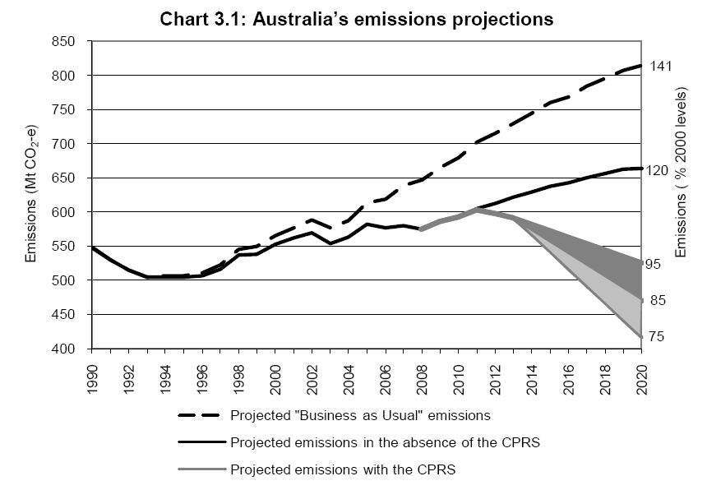
Australia Emissions Projections
Notes:
Carbon Pollution reduction scheme. Source Budget 2009 for carbon trading scheme. The previouse labour govenments scheme now transformed into a political debate over a Carbon Tax which is set to be a major issue at the next election, with a government currently hanging on by a thread which is tied to the Green Party bold moves are not likely.

Slide 6
Australian Government Target
60% emission reduction by 2050
20% of energy from renewable sources by 2020
50% of energy from renewable sources by 2050
Notes:
Australia has also set a target of a 60% emissions reduction by 2050 which CSIRO have estimated will require over 50% of energy to be from renewable sources (Manning, 2011).

Slide 7
Circle of Blame
Source: Cadman in RICS 2008
Notes:
Circle of blame is being addressed by Governments and some developers showing leadership setting mandatory standards for new buildings to increase sustainable development parameters.
While uptake of sustainable measures may have slowed throughout the global financial crisis the sector still continues to grow (Fuerst 2009).

Slide 8
Commercial Building Energy Initiatives
Background
EU Directive 2009/91/EC
UK Energy Performance Certificates 2007
National Framework for Energy Efficiency (NFEE) December 2004
Mandatory Disclosure – Concept Report, March 2008
Consultation draft Dec 2008 Department of Climate Change and Energy Efficiency
Notes:
IPCC Intergovernmental Panel on Climate Change
European Union which, in its Directive 2002/91/EC, introduced a mandatory scheme for the evaluation of energy consumption in buildings, that came into force in January 2003. The UK in response to this directive introduced Energy Performance Certificates for all commercial buildings in 2007.
Within this framework Federal Govenment established its own internal targets in 1990 and reestablshed these benchmark reductions in 2006
8

Slide 9
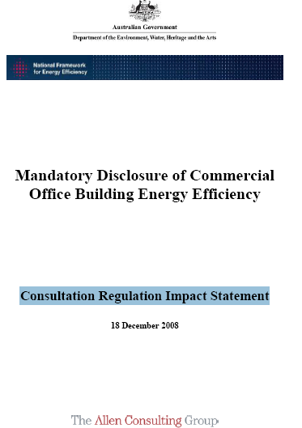
Commercial Building Energy
Background
Consultation Draft Dec 2008
Submissions Feb 2009
Notes:
Consultation draft by Allen Consulting Dec 08
Meetings in major cities Jan & Feb
9

Slide 10
Commercial Building Energy
Consultation Draft
Option 1 — Mandatory disclosure of NABERS energy efficiency ratings at the point of sale and lease. (either Net Lettable Area [NLA] larger than 2000 m2 or larger than 5000 m2)
• Option 2 — Industry code of practice. This option is similar to option 1, except that there is no explicit regulation.
• Option 3 — Mandatory minimum energy efficiency standards.
Notes:
Consultation draft by Allen Consulting Dec 08
Meetings in major cities Jan & Feb
10

Slide 11
Consultation Draft Responses
Consultation Draft Dec 2008
Submissions Feb 2009
Academic | 1
Consultant | 10
Contractor/Supplier | 4
Individual | 2
Industry Association | 5
Owner | 8
Professional Association | 4
Public Sector Organisation | 1
Total | 35
Notes:
Consultation draft by Allen Consulting Dec 08
Meetings in major cities Jan & Feb
11

Slide 12
Consultation Draft Responses
Consultation Draft Dec 2008
Submissions Feb 2009
Support 74%
‘FMA Australia does not, in principle, believe a system of mandatory disclosure is the best vehicle for improving energy efficiency in Australia’s commercial office buildings.’
Notes:
Support whole heartedly or with certain reservations.
National Australian Built Environment Rating System (NABERS)
12

Slide 13
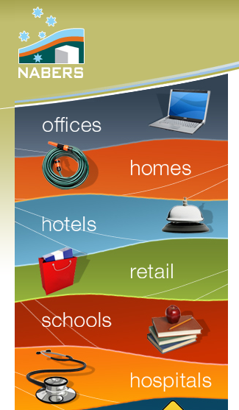
Consultation Draft Responses
Consultation Draft Dec 2008
Submissions Feb 2009
NABERS
4 support
23% Base Building Only
Whole Building and Tenancy issues
National Measure
Industry v Government
Inconsistencies and transparency
Notes:
Support whole heartedly or with certain reservations.
National Australian Built Environment Rating System (NABERS)
13

Slide 14
Consultation Draft Responses
Consultation Draft Dec 2008
Submissions Feb 2009
Costs of compliance
Who pays
1, 2 or 3 year rating period
Waste of assets
‘There is a very real danger that the compliance costs engendered by a mandatory scheme will draw financial resources away from the implementation of energy-saving measures and instead direct them toward reporting requirements.’
Consultants view
introduction of an Australian mandatory energy efficiency disclosure scheme has the potential to provide the foundation for building owners to invest in energy efficiency upgrades to existing building stock. An important measure of success for the Scheme will be the level to which it drives retro-fits and upgrades in Australia’s existing buildings for the purpose of increased energy efficiency.
Notes:
Support whole heartedly or with certain reservations.
National Australian Built Environment Rating System (NABERS)
14

Slide 15
Consultation Draft Responses
Consultation Draft Dec 2008
Submissions Feb 2009
Certificate Disclosure (EU)
Trigger point
1000m² to 5000m² NLA
Resources for NABERS
Skill levels
‘The energy auditing industry is massively underskilled and under resourced, and already does as much harm as good through giving people half‐baked reports’
c
Notes:
Support whole heartedly or with certain reservations.
National Australian Built Environment Rating System (NABERS)
15

Slide 16
Mandatory Disclosure of Commercial Office Building Energy Efficiency
Regulation Document
Plus
Regulatory Impact Statement
November 2009
Format and Recommendations
Notes:
IPCC Intergovernmental Panel on Climate Change
16

Slide 17
Commercial Building Disclosure Scheme
‘The Building Energy Efficiency Disclosure Bill to implement the Commercial Building Disclosure scheme was passed by the Australian Parliament on 24 June 2010. It is anticipated that the requirement to disclose information will commence around October 2010. The Government will make this date known and finalise the regulations of the scheme in the coming weeks’. Department of Climate Change and Energy Efficiency
Notes:
IPCC Intergovernmental Panel on Climate Change
17

Slide 18
Commercial Building Disclosure Scheme
The aim of the scheme is to ensure that credible and meaningful energy efficiency information is given to prospective purchasers and lessees of large commercial office space.
Notes:
in the second year of the scheme (around October 2011) and will include three components:
1. a NABERS Energy base building rating1
2. a tenancy lighting assessment
3. energy efficiency guidance.
The BEEC will be valid for up to 12 months. At the time of disclosure, the certificate will need
to be valid, current and registered on the scheme’s online central registry (currently being
developed). The NABERS Energy star rating will need to be disclosed in any advertisement
about the sale, lease or sublease of the office.
18

Slide 19
Commercial Building Disclosure Scheme
The scheme requires owners and lessors of commercial office space with a net lettable area of 2,000 m² or more, to disclose the energy efficiency rating to prospective purchasers and tenants when the space is to be sold, leased or subleased..
Notes:
in the second year of the scheme (around October 2011) and will include three components:
1. a NABERS Energy base building rating1
2. a tenancy lighting assessment
3. energy efficiency guidance.
The BEEC will be valid for up to 12 months. At the time of disclosure, the certificate will need
to be valid, current and registered on the scheme’s online central registry (currently being
developed). The NABERS Energy star rating will need to be disclosed in any advertisement
about the sale, lease or sublease of the office.
19

Slide 20
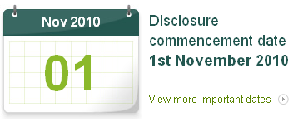
Commercial Building Disclosure Scheme
Start date ~ November 2010
Transition provisions first 12 months
National Australian Built Environment Rating System(NABERS) Energy base or whole building rating obtained up until the end of the transitional period, can be disclosed instead of a full Building Energy Certificate
The NABERS Energy star rating will need to be disclosed in any advertisement about the sale, lease or sublease of the office.
Notes:
in the second year of the scheme (around October 2011) and will include three components:
1. a NABERS Energy base building rating1
2. a tenancy lighting assessment
3. energy efficiency guidance.
The BEEC will be valid for up to 12 months. At the time of disclosure, the certificate will need
to be valid, current and registered on the scheme’s online central registry (currently being
developed). The NABERS Energy star rating will need to be disclosed in any advertisement
about the sale, lease or sublease of the office.
20

Slide 21
Commercial Building Disclosure Scheme
After Transition ~ November 2011
Disclose a Building Energy Efficiency Certificate (BEEC)
a NABERS Energy base building rating
a tenancy lighting assessment
energy efficiency guidance
If a base building rating cannot be obtained due to inadequate metering, a whole building rating will need to be disclosed. NABERS energy ratings disclosed under the scheme must be exclusive of green power
Notes:
in the second year of the scheme (around October 2011) and will include three components:
1. a NABERS Energy base building rating1
2. a tenancy lighting assessment
3. energy efficiency guidance.
The BEEC will be valid for up to 12 months. At the time of disclosure, the certificate will need
to be valid, current and registered on the scheme’s online central registry (currently being
developed). The NABERS Energy star rating will need to be disclosed in any advertisement
about the sale, lease or sublease of the office.
21

Slide 22
Commercial Building Disclosure Scheme
Disclose a Building Energy Efficiency Certificate (BEEC)
Valid 12 months
Must be current when disclosed
Registered online registry
a NABERS rating disclosed in any advertising
Notes:
in the second year of the scheme (around October 2011) and will include three components:
1. a NABERS Energy base building rating1
2. a tenancy lighting assessment
3. energy efficiency guidance.
The BEEC will be valid for up to 12 months. At the time of disclosure, the certificate will need
to be valid, current and registered on the scheme’s online central registry (currently being
developed). The NABERS Energy star rating will need to be disclosed in any advertisement
about the sale, lease or sublease of the office.
22

Slide 23
Commercial Building Disclosure Scheme
Tenancy lighting assessment and energy efficiency guidance
benchmark the existing tenancy lighting against best practice
passed on to incoming tenant or owner
The energy efficiency guidance will provide general advice to building owners and tenants on common energy efficiency opportunities in commercial office buildings.
Notes:
in the second year of the scheme (around October 2011) and will include three components:
1. a NABERS Energy base building rating1
2. a tenancy lighting assessment
3. energy efficiency guidance.
The BEEC will be valid for up to 12 months. At the time of disclosure, the certificate will need
to be valid, current and registered on the scheme’s online central registry (currently being
developed). The NABERS Energy star rating will need to be disclosed in any advertisement
about the sale, lease or sublease of the office.
23

Slide 24
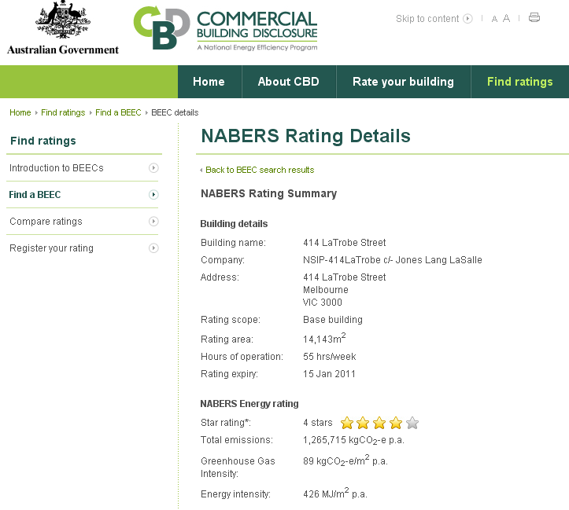

Slide 25
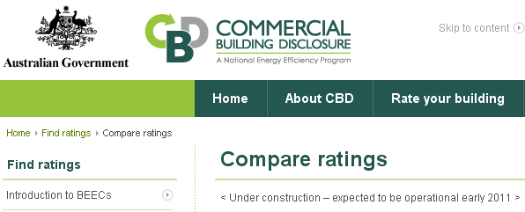

Slide 26
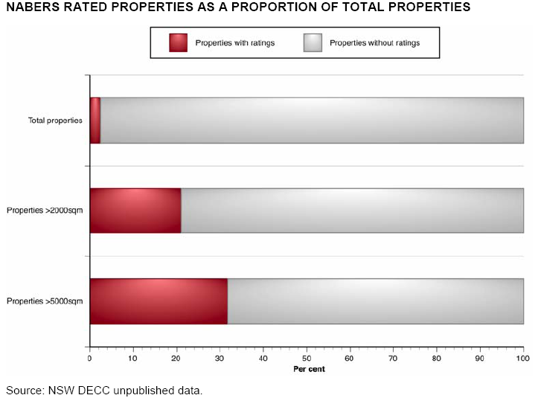
NABERS
Notes:
Low take up of Nabers drop off in first time total on of measures 1999-2007

Slide 27
NABERS – Jan 2011
Notes:
Disparity of NSW Buildings compared to other states. Base Building Measure, ie those building owners able to se parate the Central Services (HVAC, Lifts, Common L/P) from Tenant L/P
Just 484 buildings currently assessed.

Slide 28
NABERS – Jan 2011

Slide 29
NABERS – Jan 2011
484 Rated Buildings
72% are 3* or better which is ‘Very Good’
45% are 4* or better which is ‘Excellent’
12% are 5* Exceptional
11% are 0-1* Poor

Slide 30
IPD Green Index
Notes:
▪The Australian IPD database currently has c1,500 of commercial assets with an asset value of c$117bn. It represents c60% of investment-grade property in Australia.
▪Commercial office assets account for c570 assets with a combined asset value of $51 bn.
▪Rated office assets (c$36 bn) now represent a significant share of the office asset database.

Slide 31
IPD Green Index
Notes:
▪The return spread between rated and non-rated buildings with a Green Star rating is c400bps.
▪Rated office buildings have lower cap rates –an average of 40bps.

Slide 32
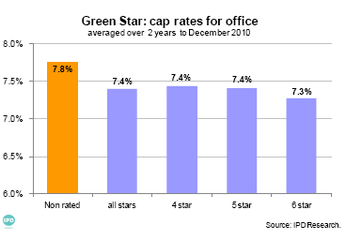
IPD Green Index
Notes:
▪The return spread between rated and non-rated buildings with a Green Star rating is c400bps.
▪Rated office buildings have lower cap rates –an average of 40bps.

Slide 33
IPD Green Index
Notes:
The return spread between rated and non-rated buildings with a NABERS Energy rating is c60bps.
▪Buildings with a rating of 4 star or above deliver significantly higher returns than buildings with a rating of 3.5 star or below.
▪Rated office buildings have lower cap rates than the non-rated building pool.

Slide 34
Will CBD influence property owners managers and tenants?
Are the current measures of energy efficiency the correct metrics?

Slide 35
Thank you and
Questions
Clive M J Warren – University of Queensland – Business School
c.warren@uq.edu.au

