Slide 1
Property Markets and Urban Development: A Case Study of Central Area Office Development in Manchester and Reading
Éamonn D’Arcy
CBRE Fellow in International Real Estate

Slide 2
Introduction
Property Markets and Urban Competitiveness
Outputs – Built Space, Pricing, Problems of Market Failure
Process of Territorial Competition
Ability to attract and retain advanced services a key dynamic of urban growth and development in both primary and secondary centres.
Importance of a built environment which is equipped to meet the needs of such activities a key prerequisite for growth
Role of urban amenities
Characteristics of amenity bundle
Simple arguments but in reality much more complex

Slide 3
The Problem
Key issue of adjustment in the real property market
Supply side very problematic
Institutional capacity
Path dependencies in the urban built environment
Result mismatch between accommodation requirements and stock characteristics
Periods of over and under-pricing
Periods of over and under production of space
Cycles, rents, investment, development, market failure

Slide 4
Objectives
Paper attempts to further our understanding of the role played by property markets as determinants of urban development
Case study analysis of central area office development in Manchester and Reading
Evidence on how the production of office space is driven by a complex combination of factors related to the institutional structure and capacity of local property markets interacting with wider market circumstances

Slide 5
Objectives
How effective are urban restructuring strategies based on central area office development as positive contributors to urban growth and development.
Insights into the role played by property markets as both facilitators and inhibitors of urban development.

Slide 6
Offices and Urban Development
Growth in office based services a key dynamic of contemporary employment growth in developed economics and by implication urban development
Three Key areas of focus
The location dynamics of office based services
The institutional capacity of local property markets
Exogenous factors

Slide 7
The Location Dynamics of Office Based Services
Traditionally strong agglomerative tendencies in the urban core
But the rationale of changes in information technology has increased the feasible set of office locations and the range of locations where office based service activities can be produced
The home. The beach etc.
To get a better handle on location requirements it is important to understand the characteristics of office based services

Slide 8
The Office as Nexus of Information Exchange
What happens in offices? A nexus of Information exchange
Location requirements reflects the characteristics of the exchange
Tacit Knowledge – Face to Face – Location Matters
Financial and Professional Business Services
Routine – Codified Knowledge – Location less important – search for the least cost location
Many activities combine both types of exchange so location still matters but occupiers maybe quite price sensitive within a location and between substitute locations
In secondary cities – office characteristics fit well this latter category

Slide 9
Institutional Capacity of Local Property Markets
Actor Characteristics and Relationships
Public
Regulatory and Policy Contexts
Private
Investors; Developers
Traditional Models of the Development Process

Slide 10
Institutional Capacity of Local Property Markets
Path Dependency Legacies
History Matters
Characteristics of existing built environment
Size and characteristics of existing office agglomeration
Timing of past development decisions
implications for land use change.
determines the set of feasible development opportunities
Characteristics of the urban amenity bundle
Past development decisions related to residential, retail and leisure
Employer and Employee amenity preferences

Slide 11
Exogenous Factors
National and International Economic Drives
Financial Markets
Liquidity - access to capital
Sources of capital for real estate investment
Wider Market circumstances
Property market characteristics in competing locations

Slide 12
Case Studies
Manchester and Reading
Obvious urban development differences
In particular in terms of urban hierarchy
But with some similarities
Constrained locations with numerous substitutable locations within close proximity
Both have a clear focus on central area office development as a key dynamic of urban development

Slide 13
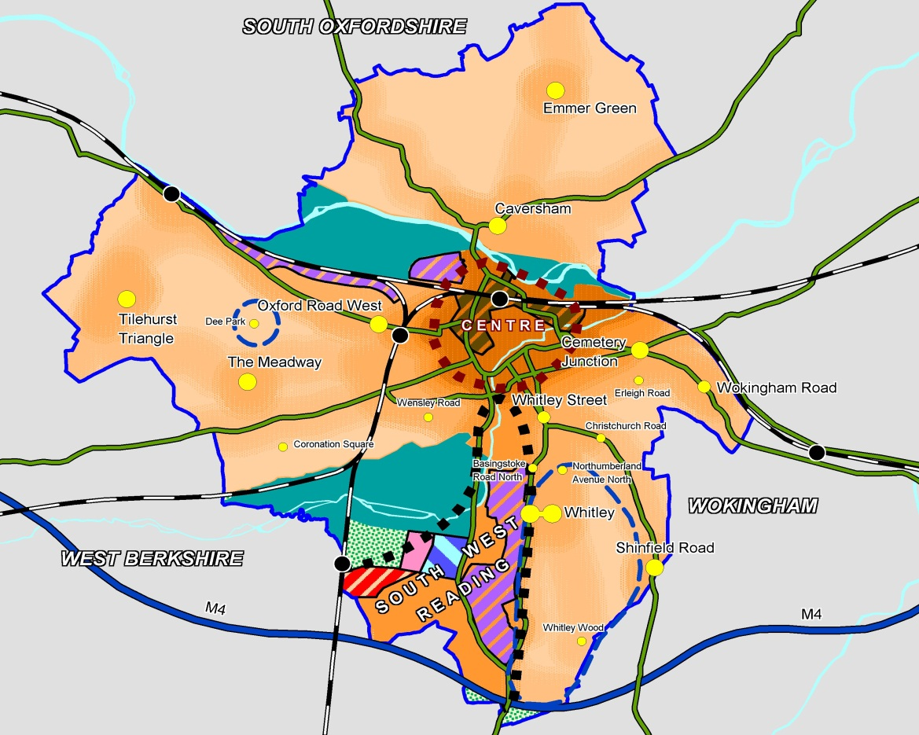
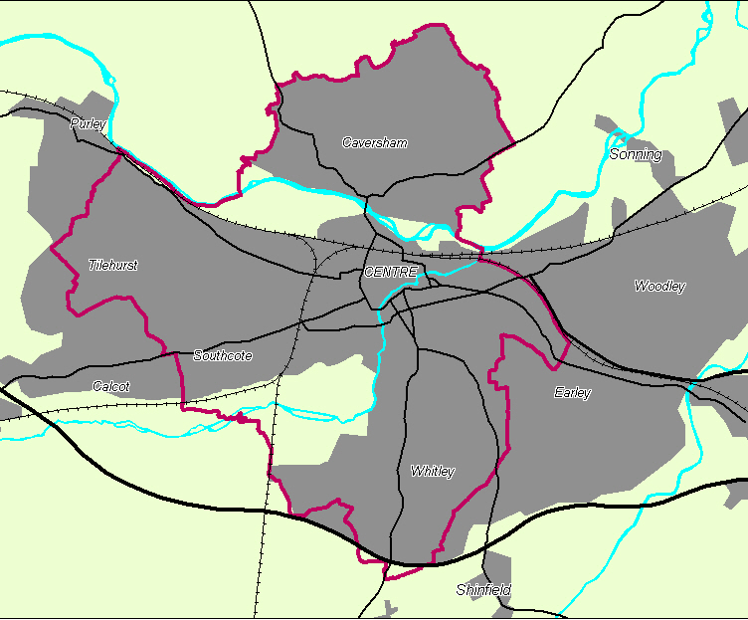
Reading Spatial Context

Slide 14
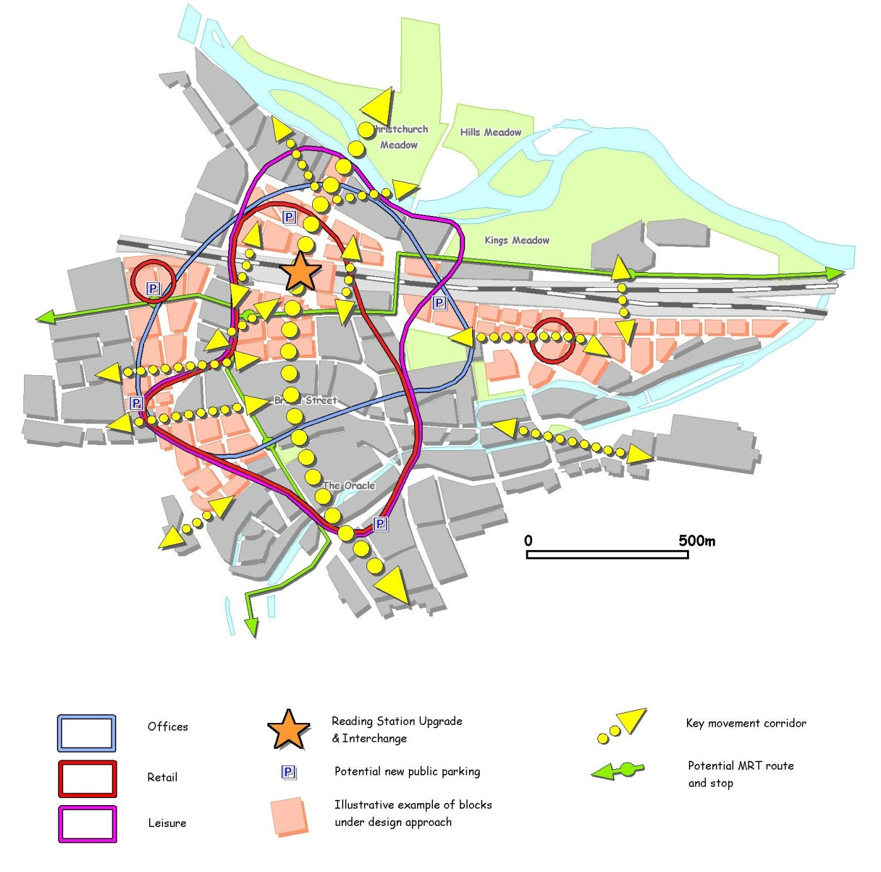
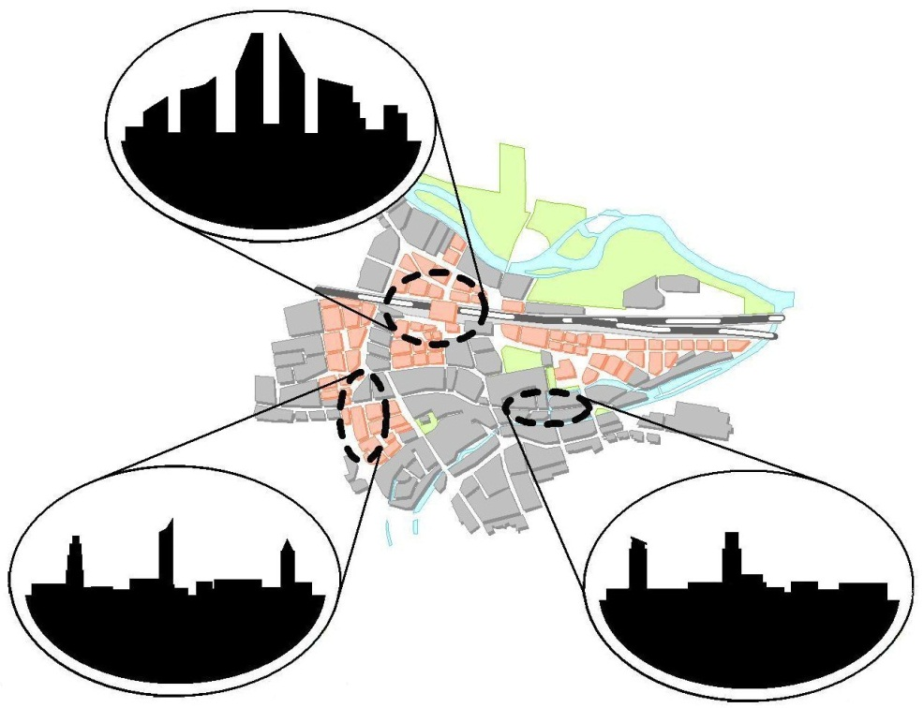
Reading Central Area

Slide 15
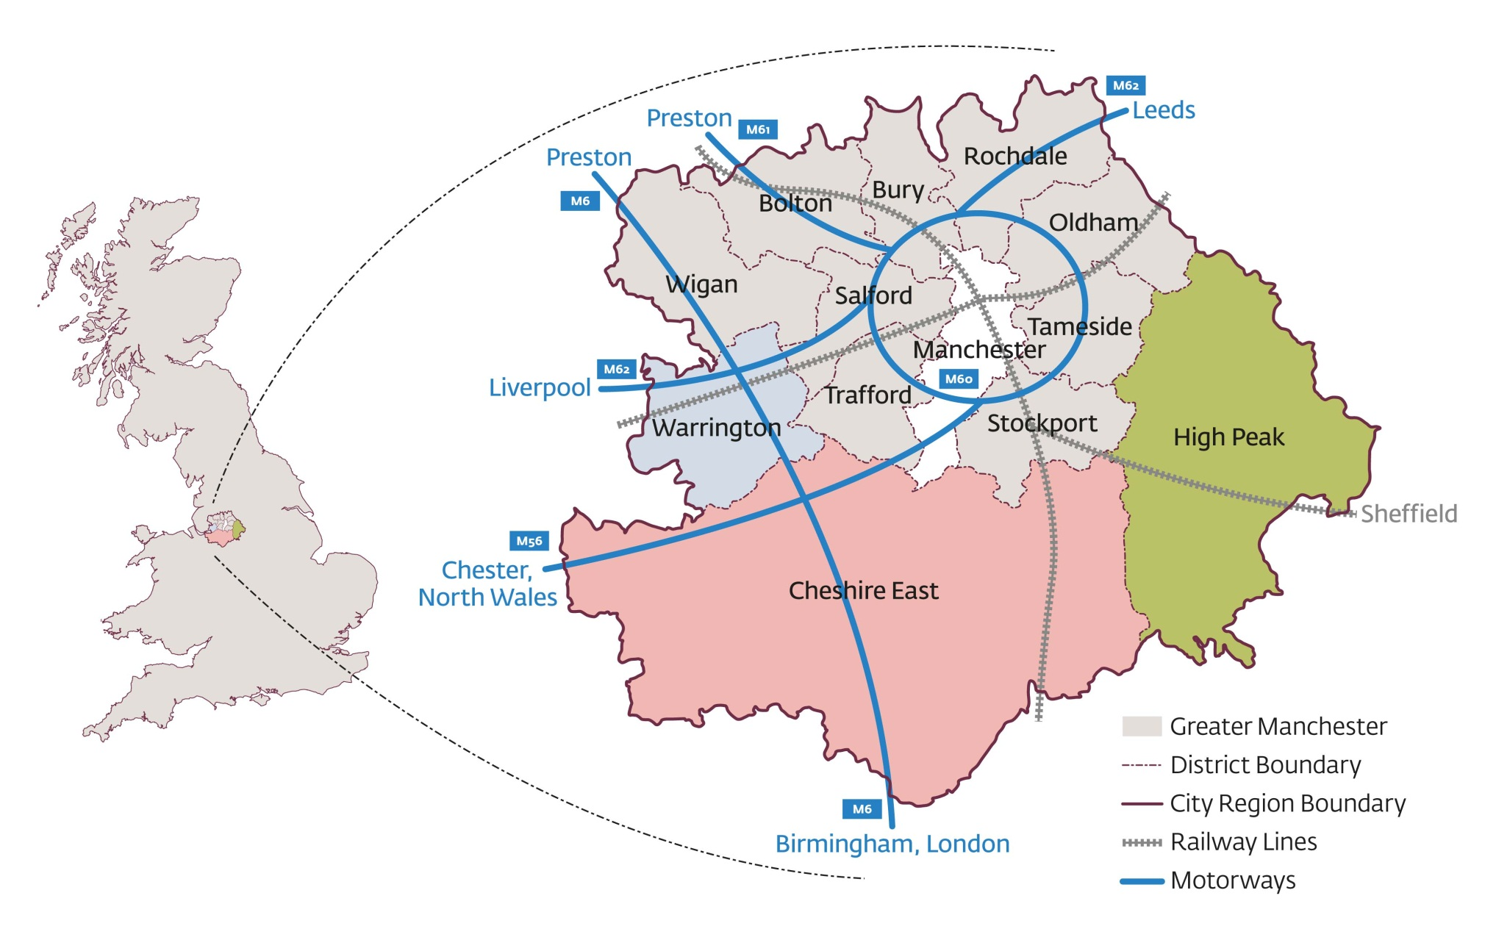
Manchester Spatial Context

Slide 16
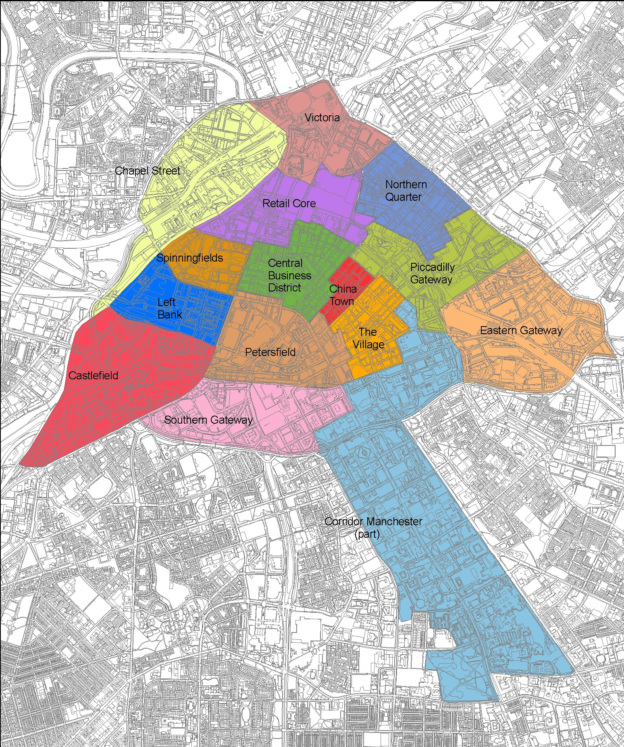
Manchester Central Area

Slide 17
Some Key Results
Given the information exchange characteristics of office occupier in both cities both locations are sensitive to cost considerations
Manchester to both labour and property costs, Reading to property costs
Actor characteristics and relationships broadly positive in both locations
Well capitalised national players with some local sector specialists
Facilitatory regulatory and policy contexts

Slide 18
Some Key Results
Path dependency legacies are broadly positive
Existing office agglomerations a very positive legacy as a basis for growth
Renewal or redevelopment of 1960s stock a key context in shaping development opportunities both locations
Significant renewal of residential and retail space in both locations – the amenity bundle offered by central areas of both locations has been considerable enhanced in recent years
Competition for space with alternatives uses a negative

Slide 19
Some Key Results
Timing a positive in Manchester and a negative in Reading
Take-up in Manchester very resilient despite a negative economic climate.
Manchester more vulnerable to current economic circumstances due to dependence on the public sector
Significant competitive pressures from competing locations in both cases – Manchester more vulnerable

Slide 20
Concluding Remarks
Paper provides a clear rationale for office based urban development strategies
But success depends on
The need to understand the information exchange characterises of the office based services which have to be accommodated or attracted and their consequent sensitivity to price (cost ) vs. location.
Institutional capacity of local property markets not just actor relationships but also path dependency legacies
Timing but also an understanding of competing locations

