Slide 1
Analysis of the interrelationship between listed real estate share index and other stock market indexes The Swedish stock market 1996-2011
Svante Mandell*, Han-Suck Song*, Abukar Warsame*
and Mats Wilhelmsson* **
*Royal Institute of Technology (KTH), Stockholm, Sweden
** Institute for Housing Research (IBF), Uppsala University, Sweden

Slide 2
Aim of this paper
To gain a better understanding of the relationships between different Swedish stock market indexes.
Here we focus on time-varying correlations in daily returns between following three indexes:
OMX Stockholm Real Estate (Real Estate)
OMX Commercial Banks (Commercial Banks)
OMX Stockholm.
Source: NASDAQ OMX Nordic, Stockholm Exchange.
Data from1995-12-29 to 2011-04-03 (daily price index series).

Slide 3
Understanding covariance and correlation structures between sector indexes is important.
Portfolio selection
Pricing
Risk management and hedging
Many ways to invest in (real estate) sector indexes.
Diversified holding of listed real estate stocks,
Mutual Funds, REITs
Exchange Traded Funds (ETF:s), MINI futures

Slide 4
Examples of interesting research questions
How big are correlations in daily return series?
How and why do correlations vary over time?
How do correlations vary over different sector index returns?
Are correlations higher during bear markets?
Do correlations increase when volatilities increase?
Predicting correlations
in the short-term?
In the long-run?

Slide 5
Time-varying correlations and volatility transmissions: Examples of research findings.
Correlations are higher in bear markets.
Longing and Solnik (2001): Extreme correlations of international equity markets
Ang and Chen (2002): Asymmetric correlations of equity portfolios.
Inci, Li and McCarthy (2011): Financial contagion: A local correlation analysis

Slide 6
Time-varying correlations and volatility transmissions: Examples of research findings.
High degree of volatility transmission over time and across sectors.
Hassan and Malik (2007): Multivariate GARCH modeling of sector volatility transmission
Lower diversification benefits of securitized real estate markets during bear markets.
Yang, Zhou and Leung (forthcoming): Asymmetric Correlation and Volatility Dynamics among Stock, Bond, and Securitized Real Estate Markets

Slide 7
Time-varying correlations and volatility transmissions: Examples of research findings.
Financial institution returns are highly sensitive to REIT returns
Elyasiani, Mansur and Mansur (2010): Real-Estate Risk Effects on Financial Institutions’ Stock Return Distribution: a Bivariate GARCH Analysis.
The developed securitized real estate markets are more integrated with their local stock market while weakly integrated with the global stock and global real estate markets
Liow (2010): Integration between Securitized Real Estate and Stock Markets: A Global Perspective

Slide 8
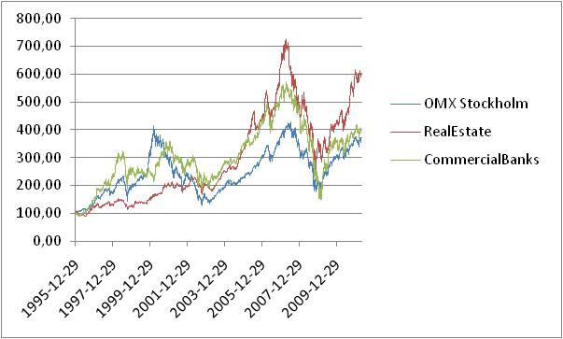
Daily price index series: 1995-12-29 to 2011-05-03
MAX index levels:
OMX: 427.24 (July 16, 2007)
Real Estate: 727.19 (April 17, 2007)
Commercial Banks: 572.82 (April 20, 2007)
Notes:
Utlåning från banker och bostadsinstitut till hushåll enligt finansräkenskapen

Slide 9
Real Estate: Time-varying volatility and volatility clustering
Jan-96 Jan-98 Jan-00 Jan-02 Jan-04 Jan-06 Jan-08 Jan-10

Slide 10
Commercial Banks: Time-varying volatility and volatility clustering
Jan-96 Jan-98 Jan-00 Jan-02 Jan-04 Jan-06 Jan-08 Jan-10

Slide 11
OMX Stockholm: Time-varying volatility and volatility clustering
Jan-96 Jan-98 Jan-00 Jan-02 Jan-04 Jan-06 Jan-08 Jan-10

Slide 12
Unconditional correlations
Overall sample period: 1995-01-02 to 2011-05-03
Real estate long bull market trend period: 1995-01-02 to 2007-04-17
Sample period: 2007-04-18 to 2011-05-03 (bear market & recovery)

Slide 13
Unconditional correlations - further investigation
Real estate sharp bear market period: 2007-04-18 to 2008-11-21
Real estate strong recovery period: 2008-11-22 to 2011-05-03

Slide 14
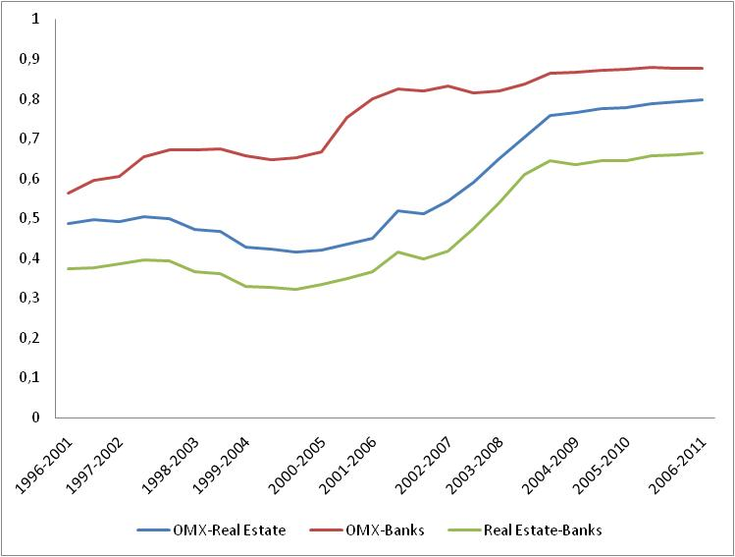
Unconditional Correlations Moving Windows of 1400 trading days (5.6 years)
Next:
20-22 and 252 days moving windows

Slide 15
TSE (2000) test for constant correlation
The 0.000 p-values show that correlations are not constant over time (Data for entire sample period: Jan 95 to May 2011)
Therefore the next step is to estimate DCC-GARCH
Tse, Y.K. (2000). A Test for Constant Correlations in a Multivariate GARCH Model, Journal of Econometrics, 98, 107-27.

Slide 16
Estimation of bivariate DCC-GARCH(1,1) model Real Estate – OMX Stockholm: Overall sample period
Jan-96 Jan-98 Jan-00 Jan-02 Jan-04 Jan-06 Jan-08 Jan-10
The conditional correlations vary substantially.
Engle, R. F. (2002). Dynamic conditional correlation - a simple class of multivariate GARCH models. Journal of Business and Economic Statistics, 20, 339–350.

Slide 17
Estimation of bivariate DCC-GARCH(1,1) model Real Estate – Commercial Banks: Overall sample period
Jan-96 Jan-98 Jan-00 Jan-02 Jan-04 Jan-06 Jan-08 Jan-10

Slide 18
Estimation of bivariate DCC-GARCH(1,1) model OMX Stockholm– Commercial Banks: Overall sample period
Jan-96 Jan-98 Jan-00 Jan-02 Jan-04 Jan-06 Jan-08 Jan-10

Slide 19
Conclusions
The unconditional as well as the conditional correlations vary over time.
Correlations seem to increase over the sample time period.
Persistent or will correlations revert to some mean?
Important for evaluating financial investment strategies, valuation using CAPM, etc.
Using constant correlations can lead be misleading.

Slide 20
Further work…
Including more sector sector indexes as well as asset classes.
Understanding the factors that cause changes in correlations.
Correlations and different lag structures.
Other frequency (weekly, monthly,…)
Moving windows correlations with different time periods (e.g. 22 days, 250 days,…)
Other DCC models.
Forecasting and empirical performance.

