Slide 1
Measuring the impact of energy certification on office prices in the UK
Jorn van de Wetering, Franz Fuerst, Peter Wyatt

Slide 2



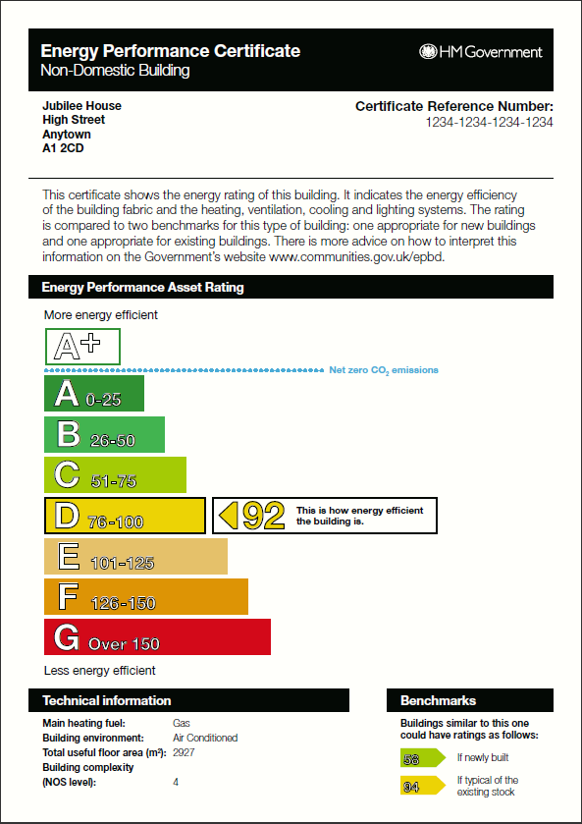
Agenda
Introduction
Literature review
Methodology
Models
Results
Conclusion & recommendations

Slide 3
Introduction/Motivation (1)
PhD focuses on energy efficiency, eco efficiency and pricing
  Second year of PhD
PhD Hypothesis
There is a price premium for energy efficient existing office buildings and new buildings that are energy efficient and/or have a green rating.
Main Question
How does an asset rating (EPC) impact on the pricing levels of commercial office space in the UK?

Slide 4
Introduction/Motivation (2)
Several developments explain shift towards green agenda
  Eco-efficiency – reducing pressure on the environment
  Increasing energy intensity per capita
  Energy security - energy resource depletion
  Political action: local, national and international (EPBD in Europe)
Various initiatives in the UK that assess energy and/or environmental performance of buildings
  Energy Performance Certificates (EPCs) which convey an asset rating that shows intrinsic performance of the building; rating A-G
  Display Energy Certificates (DECs);
  Carbon Reduction Commitment (CRC);
  Building Research Establishment Environmental Assessment Method (BREEAM);
  IPD Environment Code, ISPI index, LES-TER, Upstream, etc.

Slide 5
Literature Review (1): EPC Certificate
Address Information
Certificate reference number
Energy Performance Asset Rating
Technical Information
  Main heating fuel
  Building environment
  Total useful floor area
Benchmarks

Slide 6
Literature Review (2)
Increase in sustainability interest and awareness
  GVA Grimley (2010); Upstream (2004)
Extra cost for going green is most commonly cited barrier
  Kats et al. (2003)
Cost savings vs. added value are often confused
  RICS (2005)
Intangible benefits for green buildings
  Fuerst & McAllister (2011a); Yates, (2001)
EPCs can provide information basis for allocation of resources of market participants
  Fuerst & McAllister (2011b)

Slide 7
Literature Review (3) - SC Breakdown
Source: Jones Lang LaSalle OSCAR 2006/2007
Significant proportion of service charge is energy
  13.4% - 17.4% in air conditioned office space
  9.1% - 15.4% in non air conditioned office space

Slide 8
Literature Review (4)
Current research mostly uses CoStar data in U.S.
  Also uses EnergyStar and LEED® ratings
  OLS and 2LS regression used to uncover premium
Various papers, e.g.:
  Miller, Spivey, & Florance, 2008; Eichholtz, Kok & Quigley (2009, 2010); Fuerst & McAllister (2011a, 2011c); Wiley, Benefield & Johnson (2010); Pivo & Fisher (2010)
EPC research in the Netherlands
  Domestic: (Brounen and Kok, 2010)
  Non-domestic: (Jennen and Kok, 2011)
Yet relatively little research exists in this area in the UK
  Chegut, et al. (2010)
  Fuerst & McAllister (2011b)

Slide 9
Methodology (1): Data requirements
SPR (1995) specified a fourfold test in which data had to be
  accurate;
  complete;
  up to date, and
  accessible.
Data requirements (RICS paper Fuerst et al. 2010)
  Market Prices
    e.g. asking rents, achieved rents, sales, etc.
  Environmental and/or energy performance of buildings
    e.g. energy labels, BREEAM, ISPI, etc.
  Information on property attributes
    e.g. age, location, construction quality, vacancy rates, etc.
  Building management
    e.g. building performance, changes in performance, etc.

Slide 10
Model 1: Achieved rent (log-linear)
=
Achieved rent as dependent variable
Independent variables:
  Dummy variables for EPCs (A-F)
  Vector of coefficients: Logs for Age, No. of floors, RBA, Rates, Service charge; dummy for Refurbs (0-5 yrs), Building Class
  Vector of coefficients: Dummy for Asking Rent, Lease Length, Lease type, Rent free period, Event yr (2008-10)
  Vector of coefficients: Dummy for Central London, Region
  Interaction term Age and EPC “F” rating

Slide 11
Model 2: Asking rent (log-linear)
=
Asking rent as dependent variable
Independent variables:
  Dummy variables for EPCs (A-F)
  Vector of coefficients: Logs for Age, RBA, Rates, Service charge; dummy for Refurbs (0-5 yrs), Building Class
  Vector of coefficients: Lease type, Event yr (2008-10)
  Vector of coefficients: Region and Central London (to be added)

Slide 12
Model 2: Service charge (log-linear)
Service charge as dependent variable
Independent variables:
  Dummy variables for EPC (A-F)
  Vector of coefficients: Logs for Age, No. of floors, RBA, Rates, Service charge; dummy for Refurbs (0-5 yrs), Building Class
  Vector of coefficients: dummy for Central London, Region

Slide 13
Results (1): Sample distribution EPCs
Good performance for decade 2001-2010
Performance in sample declines over the years

Slide 14
Results (2): UK distribution EPCs
Relatively many “B” EPC ratings region “North”

Slide 15
Results (3): Model 1: Achieved Rent
EPC rating | Coefficient | Std. Error | t-Statistic | Prob.
EPC B | -0.029580 | 0.089747 | -0.329595 | 0.7419
EPC C | 0.030455 | 0.086948 | 0.350266 | 0.7264
EPC D | -0.020920 | 0.089338 | -0.234173 | 0.8150
EPC E | -0.200161 | 0.098580 | -2.030452 | 0.0431**
EPC F | -1.478097 | 0.578653 | -2.554376 | 0.0111**
Discount for “E” and “F” ratings compared to “A” rating
  Other variables: Age, No. of floors, RBA, Rates, Service charge, Refurbs (0-5 yrs), Building Class, Asking Rent, Lease Length, Lease type, Rent free period, Event yr (2008-10), Central London, Region
  Regression based on 361 observations
  R² of 73 percent

Slide 16
Results (4): Model 2: Asking Rent
EPC rating | Coefficient | Std. Error | t-Statistic | Prob.
EPC B | -0.155222 | 0.090007 | -1.724564 | 0.0853*
EPC C | -0.067170 | 0.086125 | -0.779916 | 0.4359
EPC D | -0.124617 | 0.088083 | -1.414761 | 0.1579
EPC E | -0.167143 | 0.097882 | -1.707603 | 0.0884*
EPC F | -0.412629 | 0.132093 | -3.123768 | 0.0019***
Discount for “B”, “E” and “F” ratings compared to “A” rating
  Other variables: Age, RBA, Rates, Service charge, Refurbs (0-5 yrs), Building Class, Lease type, Event yr (2008-10), Region
  Regression based on 458 observations
  R² of 64 percent

Slide 17
Results (5): Model 3 - Service Charge
EPC rating | Coefficient | Std. Error | t-Statistic | Prob.
EPC B | -0.159555 | 0.144752 | -1.102265 | 0.2709
EPC C | 0.274580 | 0.141545 | 1.939870 | 0.0530*
EPC D | 0.374488 | 0.145160 | 2.579826 | 0.0102**
EPC E | 0.363100 | 0.157359 | 2.307468 | 0.0215**
EPC F | 0.676900 | 0.245524 | 2.756956 | 0.0061***
EPC G | 0.849680 | 0.289390 | 2.936112 | 0.0035***
Increase in service charge for “C”, “D”, “E” “F” and “G” ratings compared to “A” ratings
  Other variables: Age, No. of floors, RBA, Rates, Service charge, Refurbs (0-5 yrs), Building Class, Central London, Region
  Regression based on 503 observations
  R² of 65 percent

Slide 18
Conclusions & Recommendations
Results:
  Results indicate achieved rent premium for “A” ratings compared to “E” and “F” ratings (or discount vice versa)
  Results indicate asking rent premium for “A” ratings compared to “B”, “E” and “F” ratings (or discount vice versa)
  Service charge increases as EPC performance gets worse
Recommendations
  Better, more detailed information is required to improve results
  More transparency in EPC assessment process
  Future changes in use, display and availability of EPCs

Slide 19
Thank you
Questions?
Jorn van de Wetering
PhD Researcher
School of Real Estate and Planning
Henley Business School
Tel: +44 (0)118 378 4018
E-mail: J.T.VanDeWetering@pgr.reading.ac.uk

