Slide 1
What price sustainability?
Bob Thompson & Qiulin Ke

Slide 2
CSR distracts from the economic role of businesses
"there is one and only one social responsibility of business – to use its resources and engage in activities designed to increase its profits.”

Slide 3
corporations make more long term profits by operating with a social perspective
“social responsibility objectives need to be built into the strategy of a business, rather than merely be statements of good intentions”

Slide 4
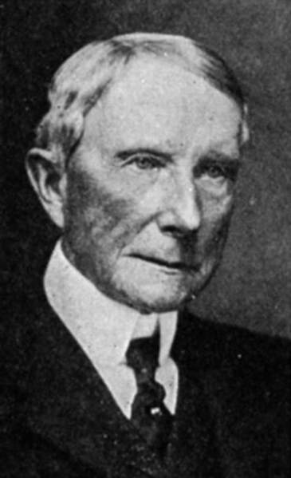
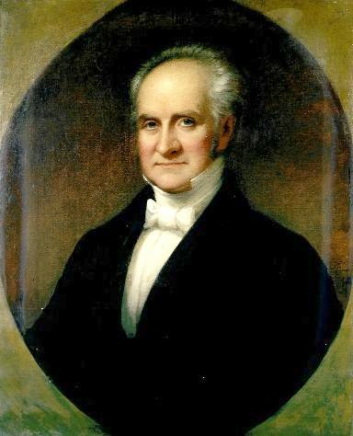
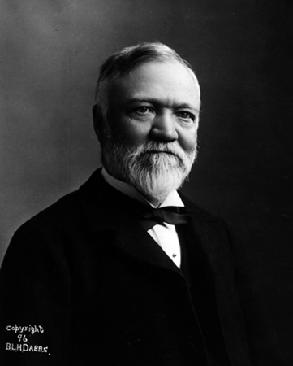
Philanthropy

Slide 5
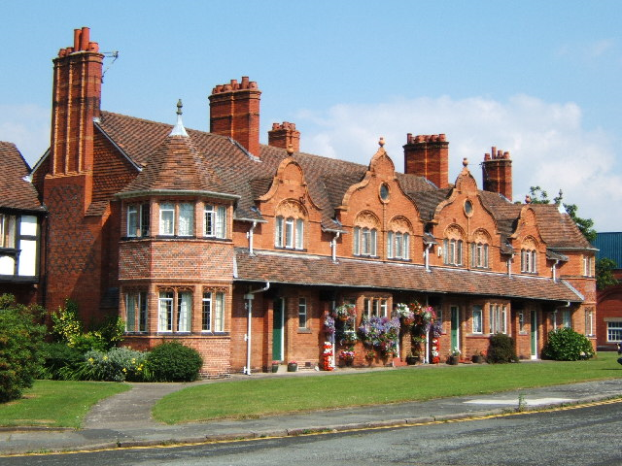
Port Sunlight

Slide 6
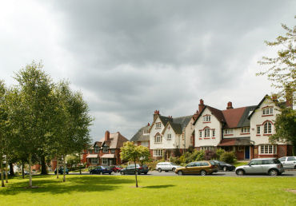
Bournville

Slide 7
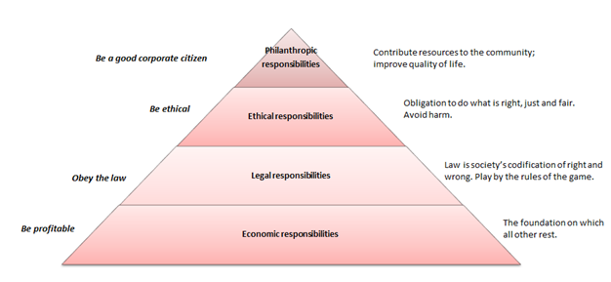
Carroll’s pyramid

Slide 8
Management style
 | Shareholders | Employees | Customers | Community
Immoral | Shareholders are minimally treated and given short shrift. | Employees are viewed as factors of production | Customers are viewed as opportunities for personal or organisational gain. | Exploits community to fullest extent
Amoral | Communication is limited to that required by law | Employees are treated only as the law requires | Management does not think through the ethical consequences of its decisions and actions | Community, like employees, is a factor of production
Moral | Shareholders' interest (long and short term) is the central factor. | Employees are a human resource that must be treated with dignity and respect. | Customer is viewed as an equal partner in a transaction | Seeks to be a leading citizen and to motivate others to do likewise.

Slide 9
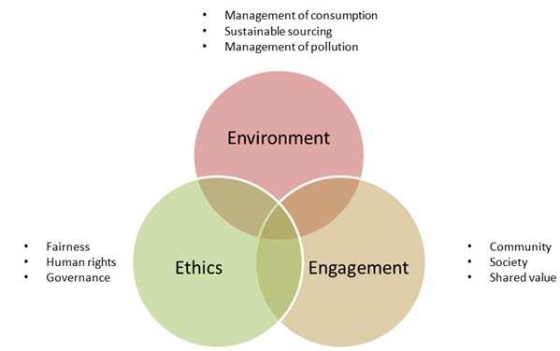
Modern CSR

Slide 10
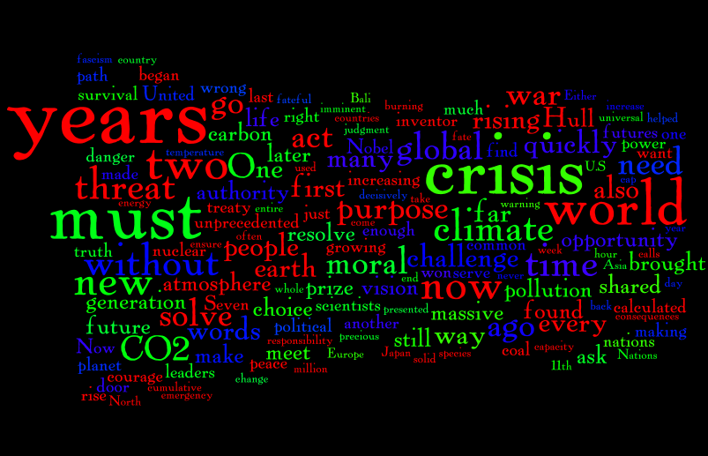
Word Frequency Analysis

Slide 11
CSR Vocabulary
CSR Vocabulary
Bream, leed
Carbon, CO2
Climate, climatic
Community
Emissions, emitted
Energy
Environment, environmental
Ethical, ethics
Governance
Green
Social, society, societal
Sustainability
Waste
Water

Slide 14
Correlation tests
 | GREEN | CSR | SIZE | GEAR | RETURN | RISK | INST
CSR | 0.49 | 1
SIZE | 0.23 | 0.25 | 1
GEAR | -0.01 | 0.02 | 0.07 | 1
RETURN | 0.36 | 0.21 | 0.12 | 0.17 | 1
RISK_ | -0.43 | -0.24 | 0.05 | 0.21 | 0.8 | 1
INST | 0.14 | 0.5 | -0.02 | -0.13 | -0.09 | -0.07 | 1
ROA | 0.05 | 0.06 | 0 | -0.41 | -0.23 | -0.15 | -0.12

Slide 15
Regression tests
 | CSR | GREEN
SIZE | 0.01 | 0.01
 | (2.94)*** | (2.37)**
GEAR | 0.01 | 0.01
 | (1.45) | (1.88)*
RETURN | 0.01 | 0.01
 | (2.61)*** | (4.61)***
RISK | -0.01 | -0.01
 | (-0.46) | (-1.4)
INST | 0.01 | 0.01
 | (5.61)*** | (1.16)
ROA | 0.01 | 0.01
 | (1.18) | (0.48)
C | -0.04 | -0.02
 | (-2.14)** | (-1.86)*
Adjusted R-squared | 0.20 | 0.23
F-statistic | 9.26 | 6.87
Prob(F-statistic) | 0 | 0

Slide 16
Conclusions – so far
Talking the talk
Walking the walk
Market risk
The clients view
Increased incidence of CSR vocabulary
CSR is part of good governance for larger firms
No significant relationship
institutional investors appear willing to invest in companies with strong CSR

