Slide 1
THE IMPAIRMENT RISK OF CORPORATE PROPERTIES
Strategic and operational approaches to analyze some mismatches between the physical and the economical function of the buildings
Authors:
arch. Luisa INGARAMO
arch. Stefania SABATINO
26° june 2010
1

Slide 2
OUR PAPER AIMS TO…
Offer Companies a synthetic approach to optimize Corporate Property Management
The synthetic approach suggested may be particularly useful in countries where :
the Real Estate strategies are just developing
property Managements need a support to optimize the relations between the book value, the use value and the market value of Assets.

Slide 3
KEY POINTS
THE CENTRAL ROLE OF REAL ESTATE PROPERTIES AT BALANCE SHEET
THE RISK MANGEMENT PHYLOSOPHY START UP
TWO CHANGES IN THE ITALIAN PROPERTY MANAGEMENT AND FALL OUTS:
IAS-IFRS N. 16
TECHNOLOGICAL ENHANCING OF BUILDINGS AND PLANTS
THE ACCOUNTING VARIABLES TO LOOK UPON AT BALANCE SHEET
THE IMPAIRMENT RISK IN PRACTICE
IMPAIRMENT RISK CLASSIFICATION
OUR SYNTHETIC PROPOSAL: A 3 STEPS ANALYSIS:
THE REDEFINITION OF THE SERVICE LIFE OF SPECIAL PURPOSE PROPERTIES TO PREVENT IMPAIRMENT RISK : THE EXPO DISTRICTS
CONCLUSIONS

Slide 4
THE CENTRAL ROLE OF CORPORATE PROPERTIES AT BALANCE SHEET
LONG LIFE-CYCLE IMMOVABLE INVESTMENTS
INFLUENCE THE LONG-TERM MANAGEMENT
TENDS TO LOSE PERFORMANCE
ARE CONSIDERED THE 2° MOST ONEROUS ASSET
PROPERTIES EXPOSE COMPANIES TO HIGH RISKS
BIND COMPANIES STRATEGIES

Slide 5
THE RISK MANGEMENT PHYLOSOPHY START UP
’50s
‘70s
‘80s
U.S.A. → first studies developed by Insurance Companies
U.K. & Germany → diffusion of the Risk Management in Europe
The Earliest Corporate Risk Taking Approaches started to be applied
The first Multi-level models appeared
‘90s
ITALY → the introduction of innovative asset management tools
(Spin Off, Securitizations, etc…) motivated the interest
2000

Slide 6
TWO MAIN CHANGES IN THE ITALIAN PROPERTY MANAGEMENT
However in Italy the interest in managerial tools useful to monitor, plan, rationalize the Corporate Real Estate follows two main changes:
1
2
INTERNATIONAL ACCOUNTING STANDARD N. 16
TECHNOLOGICAL ENHANCING OF BUILDINGS AND PLANTS
Moving from this fact the paper is intended as an operative contribution to a synthetic multi-level approach aimed to manage different impairment risks, above all for Companies that need large buildings (Shopping Malls, Expo Districts and other Special Purpose Buildings)

Slide 7
TWO MAIN CHANGES IN THE ITALIAN PROPERTY MANAGEMENT
1
THE IAS 16 ENFORCEMENT (2003) AND IMPACT ON CORPORATE PROPERTIES
THE ITALIAN
TRADITIONAL
ACCOUNTING CRITERIA
IAS 16
Buildings, Plants
and Equipments
MAIN FALL OUTS
HISTORIC COST CONCEPT
FAIR VALUE OPTION
BOOK VALUE
PURCHISING COST
MARKET VALUE
THE NET PROFIT EXPOSURE TO TAX
DEPRECIATION OF BUILDING AND LAND AS A WHOLE
COMPONENT APPROACH
DEPRECIATION RATE
REDUCTION
DEPRECIATION ALLOWED ONLY FOR BUILDINGS

Slide 8
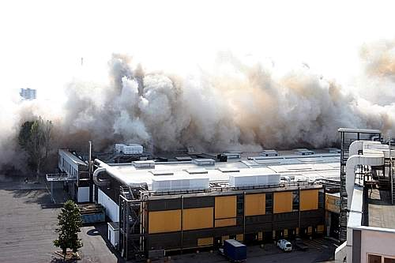
TWO MAIN CHANGES IN THE ITALIAN PROPERTY MANAGEMENT
ONLY A SHELTER
TANGIBLE QUALITY
INTANGIBLE ASPECTS
2
PERFORMANCES ENHANCING OF BUILDINGS AND PLANTS
CORPORATE BRAND VISIBILITY
ENVIRONMENTAL RESOURCES RESPECT
DESIGN QUALITY
ENERGY EFFICIENCY
SECURITY
TECHNOLOGICAL SERVICES
MAIN FALL OUTS
MAINTENANCE RATES INCREASE
EXTRAORDINARY COSTS INCREASE
Milan Expo District : Last old pavillons being demolished (2010)
Milan Expo District : The new pavillons (2006)

Slide 9
THE ACCOUNTING VARIABLES TO LOOK UPON AT BALANCE SHEET
1
ASSETS & LIABILITIES ACCOUNT
INCREASING TAX EXPOSURE
Depreciation rate
Book value
Net Profit
INCOME STATEMENT
2
Maintenance
& extraordinary
costs
Revenues

Slide 10
THE ACCOUNTING VARIABLES TO LOOK UPON AT BALANCE SHEET
1
ASSETS & LIABILITIES ACCOUNT
Balancing
INCREASING TAX EXPOSURE
Book value
Depreciation rate
FAIR VALUE REPOWERING
Net Profit
INCOME STATEMENT
2
The co-operation of the changes requested contribute in re-balancing the Balance Sheet variables as well as to improve the management result.
Maintenance
& extraordinary
costs
Revenues
A MORE CORRECT BUDGET
LONGER SERVICE LIFE & INCREASING REVENUES

Slide 11
THE IMPAIRMENT RISK IN PRACTICE
SOME DATA FROM A 700 SAMPLE – BUILDINGS (Athena Institute, 2004)
DEMOLITION CAUSE | Detailed cause | FREQUENCY [detailed %] | FREQUENCY [total %]
Land use transformation | Area transformation | 34,8% | 35,2%
 | Land value variation | 0,4%
Physical obsolescence | Ordinary maintenance missing | 23,8% | 25,2%
 | Material or structural deficit | 3,5%
Technical or functional obsolescence | Inadequacy in present requirements | 22% | 22,9%
 | Inadequacy for human fruition | 0,9%
Unpredictable physical damages | i.e. fire | 7% | 7%
A lack in design adjustments | Expensive modernizations | 1,8% | 5,7%
 | Expensive maintenance | 0,4%
 | A fall in the bran image | 3,5%
Other causes | - | 1,8% | 1,8%
Structure type | Useful service life expected [YEARS]
BRICKS | 77,5
WOOD | 51,6
CONCRETE | 87,2
IRON | 77,3
Demolition age [YEARS] | Demolition frequency
0-25 | 11,65%
26-50 | 45,63%
51-75 | 17,48%
76-100 | 18,45%
100+ | 6,80%
…The main impairment risk is by evidence NOT PHYSICAL

Slide 12
THE IMPAIRMENT RISK NATURE AND CLASSIFICATION
Type of impairment risk
Causes
1
POTENTIAL IMPAIRMENT AT BALANCE SHEET*
ACQUAINTITED
IAS 16
2
STRATEGIC COMPETITIVNESS RISK*
QUITE PREDICATBLE
Urban developments
3
PHYSICAL OBSOLESCENCE RISK *
HIGHLY PREDICTABLE AND TO BE MANAGED
Use, time, type of building
4
PHYSICAL DAMAGE RISK**
UNPREDICTABLE AND TO BE INSURED AGAINIST
Accidents
INTANGIBLE IMPAIRMENT RISK**
QUITE PREDICATBLE AND TO BE MANAGED
Competitors actions
5
*In literature: for example S. Simons’ suggestion in “A note on Identifying Strategic Risk, Harward Publishing, Boston, 1999”.
**Our proposal

Slide 13
THE IMPAIRMENT RISK NATURE AND CLASSIFICATION
Type of impairment risk
Causes
1
POTENTIAL IMPAIRMENT AT BALANCE SHEET*
ACQUAINTITED
IAS 16
2
STRATEGIC COMPETITIVNESS RISK*
QUITE PREDICATBLE
Urban developments
3
PHYSICAL OBSOLESCENCE RISK *
HIGHLY PREDICTABLE AND TO BE MANAGED
Use, time, type of building
4
PHYSICAL DAMAGE RISK**
UNPREDICTABLE AND TO BE INSURED AGAINIST
Accidents
INTANGIBLE IMPAIRMENT RISK**
QUITE PREDICATBLE AND TO BE MANAGED
Competitors actions
5
The managment of the 2° and 3° risk, as previously argued, helps in rebalance the 1°
*In literature: for example S. Simons’ suggestion in “A note on Identifying Strategic Risk, Harward Publishing, Boston, 1999”.
**Our proposal

Slide 14
OUR SYNTHETIC PROPOSAL: A 3 STEPS ANALYSIS
THE REDEFINITION OF THE SERVICE LIFE OF SPECIAL PURPOSE PROPERTIES TO PREVENT IMPAIRMENT RISK : THE ITALIAN EXPO DISTRICTS
2002
PRIVATIZATION
EXPOSED TO COMPETITORS
2004
STARTED TO BE QUOTED
IAS 16
Italian Expo districts have been requesting for:
Structures renewal
Budget strategies revisions
(an AEFI* survey of 2006 revealed that they underestimate the maintenance costs)
IAS 16 assistance
Awareness against Competitors strategies
* Association of Italian Expo Districts

Slide 15
OUR SYNTHETIC PROPOSAL: A 3 STEPS ANALYSIS
THE REDEFINITION OF THE SERVICE LIFE OF SPECIAL PURPOSE PROPERTIES TO PREVENT IMPAIRMENT RISK : THE ITALIAN EXPO DISTRICTS
At the time-being:
They underestimate the real maintenance cost incidence (actual values: 1% - 6%)
Their building expected service life at Balance Sheet is never longer than 30 – 40 years.
As a consequence the depreciation rate is around 2%-3%.
(Under IAS 16 provision the depreciation rate is supposed to decrease)
As a consequence the service life should increase

Slide 16
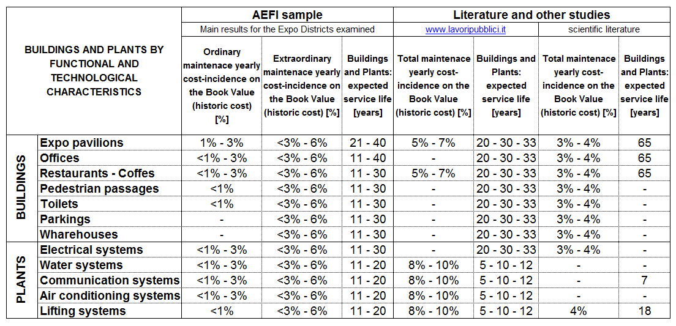
OUR SYNTHETIC PROPOSAL: A 3 STEPS ANALYSIS
THE REDEFINITION OF THE SERVICE LIFE OF SPECIAL PURPOSE PROPERTIES TO PREVENT IMPAIRMENT RISK : THE ITALIAN EXPO DISTRICTS

Slide 17
OUR SYNTHETIC PROPOSAL: A 3 STEPS ANALYSIS
THE REDEFINITION OF THE SERVICE LIFE OF SPECIAL PURPOSE PROPERTIES TO PREVENT IMPAIRMENT RISK : THE ITALIAN EXPO DISTRICTS
3* out of the 5 risk typologies can be related to 3 levels of “staying power”, depending on the impairment risk nature:
SPECIFIC VARIABLE
SECTOR VARIABLE
GENERAL VARIABLE
security, design adjustments, environmental and energy consumption respect and so on…
3
2
Strategic competitiveness risk
Physical obsolescence risk
1
*are excepted the 1°(ACCOUNTACY) and the 4° (UNPREDICTABLE DAMAGES)
EXPECTED SERVICE LIFE

Slide 18
OUR SYNTHETIC PROPOSAL: A 3 STEPS ANALYSIS
THE REDEFINITION OF THE SERVICE LIFE OF SPECIAL PURPOSE PROPERTIES TO PREVENT IMPAIRMENT RISK : THE ITALIAN EXPO DISTRICTS
DESTINATION AND USE | CONSTRUCTION TECHNOLOGY | LIFE SPAN (years) |  |  | PRUDENTIAL SERVICE LIFE
 |  | General variable | Sector variable | Specific variable
COMMERCIAL | concrete | 80 - 90 | 60 - 70 | - | 60
OFFICIES | concrete | 80 - 90 | 60 - 70 | 40 | 33
 | iron | 70 - 80 | 50+ | 35 | 33
ACCESSORY | Iron/concrete | 60 + | 40+ | - | 40
On average it is higher than the actual setting

Slide 19
CONCLUSIONS
The prudential service life can be longer than the present settings only if the depreciation rate have been reduced (see IAS 16) and the budget expenditure increased (see the enhancing performances requested).
ONLY A SHELTER
INSTRUMENTAL ASSET & STOCK RESERVE
INCOME FACTOR
the physical and the economical function of the buildings are, as a consequence, preserved at the same time

Slide 20
Thank you for your kind attention!
OUR CONTACTS
Arch. Stefania.Sabatino: stefania.sabatino@polito.it
Arch. Luisa Ingaramo: luisa.ingaramo@polito.it

