Slide 1

Defining FM in the Malaysian Perspective
ERES Conference 2010
Wednesday, 23 June 2010
Nazali Noor
School of the Built Environment
Liverpool John Moores University
UK

Slide 2
Presentation Outline
Research Overview
FM dilemma and scenario in Malaysia
Rationale in defining FM in the Malaysian perspective
Research design, strategies, analysis and findings
Defining FM in the Malaysian perspective

Slide 3
Key Research Problems
There is no common FM definition that is established for Malaysian FM market.
The importance and application of innovation management in the delivery of FM services by the FM providers in Malaysia is yet to be gauged
Collaborative innovation throughout the entire FM supply chain is a new concept in Malaysia
Notes:
Following an extensive literature review, the study identifies key research problems with proposed research:
There is no common FM definition that is established for Malaysian FM market. FM is practiced by several built environment dominants that labelled themselves as FM service providers. The stakeholders are still confused between FM, property management, asset management and building maintenance.
The importance and application of innovation management in the delivery of FM services by the FM providers in Malaysia is yet to be gauged. Since uplifting maintenance culture for the physical assets is set as a national agenda, the ability for the FM providers to embrace innovation in the delivery of exceptional quality in FM services is of paramount importance.
Collaborative innovation throughout the entire FM supply chain is a new concept in Malaysia. Relationship between the main FM service providers and the suppliers are mainly established on transactional basis, with cost as the main criteria for selection. The application of relevant collaborative tools to assess the significance of the suppliers and placing them as either strategic partner, operational alliance or arm-length contractors are extremely rare.

Slide 4
Research Questions?
What is the most suitable FM definition for the Malaysian FM market?
What is the perception of the Malaysian FM stakeholders about innovation in FM practices?
Is ‘integrate to innovate’ (i2i) supply chain model applicable to deliver effective FM services for public office buildings in Malaysia?
Notes:
1.2 Research Questions
A.What is the most suitable FM definition for the Malaysian FM market?
Who are the FM stakeholders in the Malaysian FM market?
What is the level of understanding of the Malaysian FM stakeholders in regards to FM practices?
What is the current scenario of FM practice in Malaysia?
What is the perception of the FM stakeholders about FM in Malaysia?
What are the common issues and problems that surround the implementation of FM in Malaysia?
B. What is the perception of the Malaysian FM stakeholders about innovation in FM practices?
How do the Malaysian FM stakeholders perceive generic innovation in the practice of FM?
Is innovation management a critical element in the Malaysian FM practice?
What types of innovation management those are relevance to FM practice in Malaysia?
How FM innovation in the FM supply chain management is managed and implemented in the delivery of FM services in Malaysia?
C. Is ‘integrate to innovate’ (i2i) supply chain model applicable to deliver effective FM services for public office buildings in Malaysia?
What are the current practices of procuring and delivery of FM services for public office buildings in Malaysia?
How do FM service providers collaborate to assure effective delivery of FM services for public office buildings in Malaysia?
How do the FM service providers for public office buildings in Malaysia implement innovation strategies in their collaboration?
Is the application of ‘i2i’ supply chain model able to aid the FM providers to deliver FM services effectively to the occupiers of the public office buildings in Malaysia?

Slide 5
Research Aim and Objectives
The development of collaborative innovation framework with focus on i2i supply chain management model in FM service delivery for public office buildings in Malaysia
To identify FM definition that suits the Malaysian FM market.
To explore the context of generic innovation management in the Malaysian FM market.
To critically review, understand, test and validate the concept of collaborative innovation focussing on the i2i supply chain management and adapting them in the delivery of FM services for public office buildings in Malaysia.
Notes:
1.3 Aim and Objectives
The objective is to research on these research questions in order to prove its validity, and this will be achieved by the following aim and objectives:
The development of collaborative innovation framework with focus on i2i supply chain management model in FM service delivery for public office buildings in Malaysia
To identify FM definition that suits the Malaysian FM market.
To explore the context of generic innovation management in the Malaysian FM market.
To critically review, understand, test and validate the concept of collaborative innovation focussing on the i2i supply chain management and adapting them in the delivery of FM services for public office buildings in Malaysia.

Slide 6
Theoretical framework and Research Methodology
Stage 1
Defining FM in the Malaysian perspective
Methodology - Qualitative/Quantitative
Stage 2
Innovation Management in FM service delivery
Methodology - Quantitative
Stage 3
Collaborative Innovation in the FM SCM
Methodology - Qualitative/Quantitative
Stage 4
Instrument -Workshop/Seminar/Survey
Instrument - Online survey
Instrument- Interviews/Survey/Workshop
Development of collaborative innovation framework for the delivery of FM services for public office buildings in Malaysia

Slide 7
Focus of the presentation
Stage 1
Defining FM in the Malaysian perspective
Methodology - Qualitative/Quantitative
Stage 2
Innovation Management in FM service delivery
Methodology - Quantitative
Stage 3
Collaborative Innovation in the FM SCM
Methodology - Qualitative/Quantitative
Stage 4
Instrument -Workshop/Seminar/Survey
Instrument - Online survey
Instrument- Interviews/Survey/Workshop
Development of collaborative innovation framework for the delivery of FM services for public office buildings in Malaysia

Slide 8

FM definition
Resisted universal definition
Crisis of identity
  New discipline as compared to other classical management discipline (Yiu, 2008)
  Evolving discipline thus it is hard to generalise a universal definition (Bell (1992), Goyal (2007), Nutt (1999))
FM paradigm in the last decade – incline towards ‘value adding’ elements rather than merely coordination or non-core and physical property related activities

Slide 9
FM definitions overviewed
Organisation | Definition of FM
Chotipanich (2004) | The support function coordinating physical resources and workplace, and support services to user and process of works to support the core business of the organisation.
Pitt and Tucker (2008) | The integration and alignment of the non-core services, including those relating to premises, required to operate and maintain a business to fully support the core objectives of the organisation.
RICS ( 2009) | A discipline that improves and supports the productivity of an organisation by delivering all needed appropriate services, infrastructures, etc. that are needed to achieve business objectives.
Noor and Pitt (2009) | Creating a cohesive environment to carry out an organisation’s primary operations, taking an integrated view of the infrastructure services and using it to give customer satisfaction and value for money through support as an enhancement of the core business.
IFMA (2010) | Facility management is a profession that encompasses multiple disciplines to ensure functionality of the built environment by integrating people, place, process and technology.
BIFM ( 2010) BSI (2007) (known as BS EN15221-1:2006) | Facilities management is the integration of processes within an organisation to maintain and develop the agreed services which support and improve the effectiveness of its primary activities.
Kamaruzzaman and Zawawi (2010) | A balance between technical, managerial and business acumen that may be related to operational, tactical and strategic decision-making processes.

Slide 10

Defining FM
“Creating a cohesive environment to carry out an organisation’s primary operations, taking an integrated view of the infrastructure services and using it to give customer satisfaction and value for money through support as an enhancement of the core business.”
(Noor & Pitt, 2009)

Slide 11
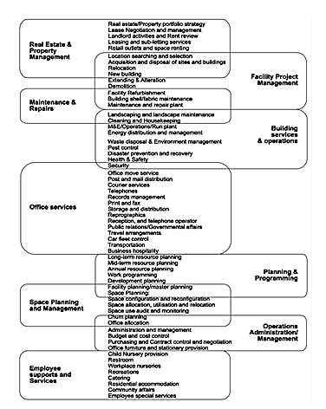
Cluster of support services
(Chotipanich, 2004)

Slide 12
Key Facts!
Defining FM is critical – How can FM be practiced in the absence of any definition as to what it is being practiced (de Bruijn et al, 2001)
FM resists a universal definition! (RICS, 2009)
Different support arrangement offered by FM are required in different business sectors, in different types of organization, different countries and culture (Chotipanich and Nutt, 2008)

Slide 13

Why local definition is important?

Slide 14
Research Methodology
Phase
Phase
Phase
Phase
Phase
- Compilation and overview of FM literature
Workshop with local FM experts representing various FM stakeholders
4 Preliminary proposal on FM definitions
Formulation of survey questionnaire
Distribution of survey to Malaysian FM stakeholders
Analysis and findings
- Presentation of findings of the Malaysian FM definition to CIDB
- Dissemination to all FM stakeholders
Adopted from
Pathriage et al. (2008)

Slide 15
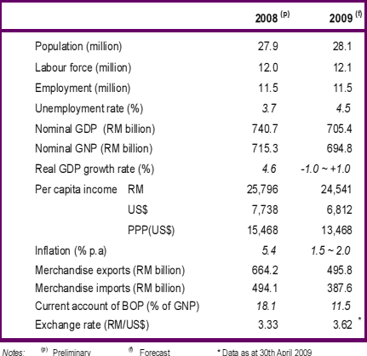
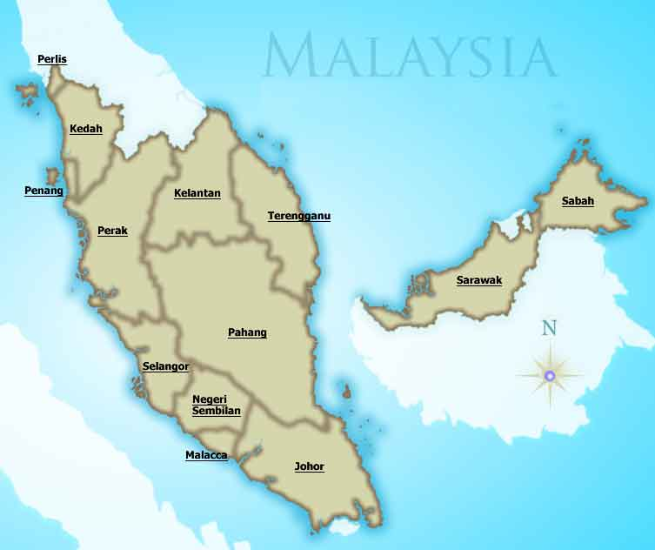
Malaysia – Brief introduction

Slide 16
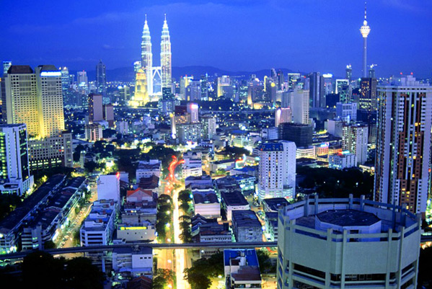
The Malaysian FM Market – An Overview
Similar to other countries in South East Asia
Reckoned as second wave market by the FM industry (Moore and Finch, 2004)
Property and assets are currently commonly managed by an in-house, out-source or combination.
26 million Sq meters of existing stock of commercial properties as at Q3 2009 (NAPIC, 2009)
FM revenues of USD 268.1 million in 2006
Estimated to reach USD 535 millions in 2013.

Slide 17
FM evolution in the Malaysian market
6th Malaysian Plan (1990-1995)
- Rapid development and privatisation agendas.
- Increase in demand for services mainly in the operations and maintenance of physical assets.
Services are provided by individual contractors offering specific trade services to government agencies and private companies
7th Malaysian Plan (1996-2000)
- Increased demand for maintenance contractors with completion of mega projects – KLIA, Twin Towers, Putrajaya.
- Prompted the market to improve service delivery.
- Focus on quality, reliability and value.
- Inception of IFM in Malaysia
- FM outsourcing and privatisation of FM
8th & 9th Malaysian Plan (2001-2005 & 2006-2010)
- FM outsourcing gain popularity
- FM outsourcing in the institution of higher learning
- Public Work Department implemented Comprehensive Facilities Management Service contract for Putrajaya Federal Government Buildings
- FM outsourcing flourish
Source:(CIDB, 2009)

Slide 18
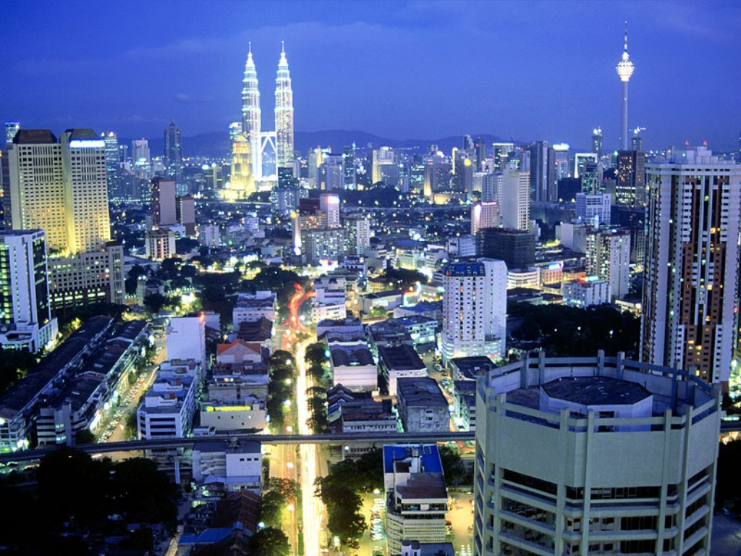
Malaysia has……
World-class specifications
World-class materials
World-class Architects
World-class Engineers
World-class Standards & Codes
World-class Contractors??
World-class infrastructure?
Where do things go wrong ?

Slide 19
John Wilson in NAFAM 2007
Developers/Contractors/Financiers work to lowest costs to maximise short-term returns
Site Supervisors –where are they hiding?
Contract Supervision –who reads the contract?
Testing and Commissioning –job’s not finished!
Reluctance to pay for quality -FM & MM
A general lack of formal industry training and education
Facility Managers should be on design team

Slide 20
The Malaysian FM challenges and dilemma
Defining FM in the Malaysian Perspectives
Confusion over FM practices – Asset, Facilities, Maintenance and Property Management
First Class Infrastructure – 3rd Class mentality
Lack of awareness on FM
Lack of local expertise
FM positioning in the asset life cycle

Slide 21


Defining FM in the Malaysian context

Slide 22
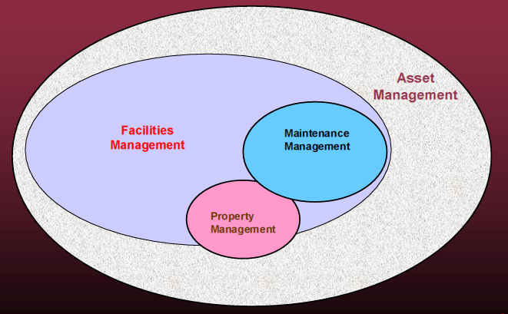
FM paradigm - John Wilson in NAFAM 2007

Slide 23

FM in Malaysia?
AM?
MM?
FM?
PM?
Study conducted by Construction Industrial Development Board (2009)
Duplication and redundancy by four (4) main built environment dominants
Confusion over FM identity:
  Facilities Management?
  Assets Management?
  Maintenance Management?
  Property Management?

Slide 24
FACILITIES MANAGEMENT
ASSET MANAGEMENT
EVENT MANAGEMENT
EMERGENCY MANAGEMENT
ENVIRONMENT / SUSTAINABILITY
DISASTER RECOVERY / BUSINESS CONTINUITY
SUPPLY CHAIN MANAGEMENT
COMPLAINT HANDLING
SAFETY & HEALTH
INVESTMENT
FUNDING & FINANCING
TAXATION
APPRECIATION / DEPRECIATION
ASSET REGISTER / TRACKING
LIFE CYCLE COSTING
DISPOSAL
SPACE PLANNING
OPERATION
PLANNED SHUTDOWN
PARTS MANAGEMENT
TASK COORDINATION / WORK ORDER
MAINTENANCE
CONTRACT MANAGEMENT
ACQUISITION
NEGOTIATION
ROOT CAUSE ANALYSIS
CONDITION MONITORING
EQUIPMENT DATA ANALYSIS
TESTING & COMMISSIONING
SITE SUPERVISORY
VALUATION
MARKETING
TENANCY
LEASING
RENTAL
EVICTION
MAINTENANCE MANAGEMENT
PROPERTY MANAGEMENT

Slide 25
SWOT analysis of the Malaysian FM Market
Strengths:
- Supported by the Government and industry
- University initiatives on FM education at under/post graduate level
- Good built assets infrastructure
- Significant part of employment
-Cooperation of professional associations – MAFM, MAPMA, PAM, MIEM, ISM
- Substantial FM market (USD 535 millions - 2013)
Weaknesses:
- Confusion over FM definition
-Lack of recognition as a profession
- Practised by several FM dominants that termed themselves as FM
- FM contacts are merely awarded being costs as the main detrimental factor
- Lack of research in FM
- Lack of innovation in the delivery of F M services
- Lack of collaboration in the FM Supply Chain
- Lack of enforcement in FM regulatory framework
Opportunities:
- Strategic collaboration with the government – 10th Malaysian Plan (2011-2015)
- High market influence of the government sector
- Potential collaboration with Malaysian Association of Facilities Managers (MAFM)
- Open to FM Innovation agendas in the 10th Malaysian Plan (2011-2015) – Outsourcing/PFI
- Lack of local expertise in FM – Avenue for best practice transfer and collaboration agenda
Threats:
- Competition among service provider being price as key factor.
- High reliance on foreign worker (supporting FM staff)
- Knowledge and gap in FM practices within other countries in the South East Asia region – i.e Singapore and Hong Kong

Slide 26
Research survey
Respondents?
Participants of seminar on development of assets and FM by CIDB
Questionnaire?
Identify respondent profile
Variables?
Nominal and ordinal questions for demographic related questions (independent variables)
Postal to FM stakeholders in the Government agencies
245 surveys distributed
122 returned and analysed
Measure perception of FM
Identify common current practice of FM
Rate of response 49.8%
Identify common issues and problems on implementing FM
Measure acceptable definition of FM in the local arena
Perception – 5 point interval attitudinal scales (strongly agree – neutral-strongly disagree)
Feedback section for opinion
Nominal scale on FM competencies, opinion and regulating FM profession

Slide 27
Research survey (Contd..)
Analysis?
Descriptive analysis to classify and prioritise different response
Respondents profile?
FM practitioners from private limited companies (43.4%)
Variables?
Nominal and ordinal questions for demographic related questions (independent variables)
Non-Parametric Test (Kruskal-Wallis Test) to identify any significant differences between the groups of respondents in defining FM in the Malaysian perspective.
Perception – 5 point interval attitudinal scales (strongly agree – neutral-strongly disagree)
Feedback section for opinion
Nominal scale on FM competencies, opinion and regulating FM profession
FM from the state government (17.2%)
FM- Government agencies (9.8%)
FM – Public listed companies (9.0%)
Federal Government (6.6%)
Others (4.9%)

Slide 28
Survey analysis and results

Slide 29
Existing understanding, current and workplace experience of FM
Findings:
Sufficient understanding on FM (82% combines good + acceptable)
Only 50% currently practicing good FM (significant 27% practicing bad and poor FM)
Only 45% satisfied with their FM experience in their workplace with substantial 29% having ‘bad’ and ‘poor’ experience.
Notes:
Apart from the scoring result, the radar chart shows close relationship or similarity between the organisation’s current practices with the experience they faced.
The radar chart demonstrates that most organisations that are not exercising good practices face unfavourable experiences in their workplaces.
However, the radar chart shows that the level of understanding does not closely correspond to the quality of practices in the workplace. This could suggest that there are organisations that are deliberately not exercising good Facility Management practice despite their adequate level of understanding.

Slide 30
Defining FM in the Malaysian Perspective
Definition | Proposed definition
A | A strategic and integrated management of facilities to continuously meet the requirements and performance standards of stakeholders.
B | A multi-discipline profession ensuring continual satisfactory functionality of asset by integrating people, processes, work place, technologies & environment.
C | An integration of multi-disciplinary activities to develop, maintain and sustain the agreed services of facilities.
D | The management of multi-disciplinary activities to ensure continuous functionality of the built environment by linking and integrating people, place, processes and technology.

Slide 31
Analysis procedures
Kolmogorov-Smirnov one sample test (to test the normality of the distribution of data)
Frequency distribution and cross tabulation tests (to identify the trends in percentage among categorical variables)
Kruskal-Wallis Test (to identify any significant differences between the groups of respondents in defining FM)
Data not normally distributed. High significant level (p<.0.05) → non-parametric inferential analysis.

Slide 32
Frequency distribution and cross tabulation tests
 |  | Definition %
Scale |  | A | B | C | D
Positive | Strongly Agree | 16.4 | 23.9 | 18.1 | 28.4
 | Agree | 60.3 | 69,2 | 66.4 | 65.6
 | Total | 76.7 | 93.1 | 84.5 | 94.0
Neutral | Neither Agree or Disagree | 17.2 | 5.2 | 12.1 | 4.3
Negative | Disagree | 6.0 | 1.7 | 3.4 | 1.7
 | Strongly Disagree | 0 | 0 | 0 | 0
 | Total | 6.0 | 1.7 | 3.4 | 1.7
Notes:
Five attitudinal interval scales that are used in the survey (strongly agree to strongly disagree) were reclassified into three perception groups of positive, neutral and negative.
The highest percentages of positive scale (combination percentages of agree and strongly agree) will be used as the most acceptable definition for the Malaysian market.
Based on the analysis in Table 9, it is identified that definition D is acknowledged as the most acceptable FM definitions by a marginal difference of 0.9% as compared to definition B.

Slide 33
Proposed FM definition in the Malaysian perspective
Definition | Proposed definition
A | A strategic and integrated management of facilities to continuously meet the requirements and performance standards of stakeholders.
B | A multi-discipline profession ensuring continual satisfactory functionality of asset by integrating people, processes, work place, technologies & environment.
C | An integration of multi-disciplinary activities to develop, maintain and sustain the agreed services of facilities.
D | The management of multi-disciplinary activities to ensure continuous functionality of the built environment by linking and integrating people, place, processes and technology.

Slide 34
Any significant difference in opinion between classification of respondents?
Kruskal-Wallis Test Result | Definition A | Definition B | Definition C | Definition D
Chi-Square | 10.145 | 4.463 | 3.596 | 12.534
df | 6 | 6 | 6 | 6
Asymp. Sig. | .108 | .614 | .731 | .051
It is evidence since all of the statistical significance values are more than .05.
No significant difference in opinion on FM definition in Malaysia.

Slide 35
Research Methodology
Phase
Phase
Phase
Phase
Phase
- Compilation and overview of FM literature
Workshop with local FM experts representing various FM stakeholders
4 Preliminary proposal on FM definitions
Formulation of survey questionnaire
Distribution of survey to Malaysian FM stakeholders
Analysis and findings
- Presentation of findings of the Malaysian FM definition to CIDB
- Dissemination to all FM stakeholders
Adopted from
Pathriage et al. (2008)

Slide 36
Conclusion
Research Overview
FM dilemma and scenario in Malaysia
Rationale in defining FM in the Malaysian perspective
Research design, strategies, analysis and findings
Defining FM in the Malaysian perspective

Slide 37



