Slide 1
Sustainable & Responsible Property Investment in Malaysia: Setting the research agenda
Ainoriza Mohd Aini
Phd Candidate
Kingston University London
Producing Leaders Since 1905

Slide 2
Presentation Outline
Background on SRPI
Literature Map
What questions do I seek to answer?
Research Aims
Contribution to knowledge
Proposed Methodology

Slide 3
What Is SRI?
THE HISTORY
Religious movement
Rise of popular civil rights, women’s right and growth of environmentalism
..investment where social, environmental and ethical (SEE) factors are taken into account in the selection, retention and realisation of investment, and the responsible use of the rights (such as voting rights) that are attached to such investments. (Mansley,2000)
..Investment approach that integrates social and environmental considerations into the investment process and also called the “triple bottom line” investing. (ASRIA,2001)

Slide 4
Property Investment Drivers
TRADITIONAL DRIVERS
EMERGING DRIVERS
Risk & return
Stability
Opportunities to outperform
Business advantage
Cost avoidance
Peer activity
Stakeholder pressure
achieve more sustainable development (Lorenz & Lutzkendorf, 2008)
Legislation & regulation (Sayce et al, 2007)
Increasing energy prices
Changing lease pattern
VS

Slide 5
How the Property Investment is changing…
Pressures for changes..
Communities
Government Bodies
Investors/ shareholders
Activists/ Opinion formers
PROPERTY INVESTORS
Customers/ Policyholders
NGOs
Employees
Business Partners/ Suppliers
Adapted from McNamara 2005

Slide 6
The relevance of SRPI
Property both contributes to and is affected by many environmental and social issues.
25-40% total energy use*
30-40% of solid waste generation*
30-40% of global greenhouse emission*
16% of global water consumption**
*UNEPSBCI, 2006
Asian countries accounts for 50% additional worldwide energy demands & 50% new buildings being in Asia
Asia Business Council, 2007

Slide 7
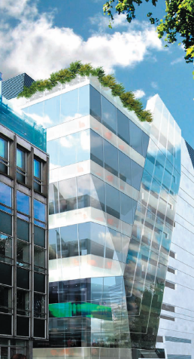
Sustainable & Responsible Property Investment (SRPI)
“maximizing the positive effects and minimizing the negative effects of property ownership, management and development, on society and the natural environment in a way that is consistent with investor goals and fiduciary responsibilities.”
(Pivo & McNamara,2008) ¹
1 In Pivo & McNamara (2005, p.129), used the term Socially Responsible Property Investment

Slide 8
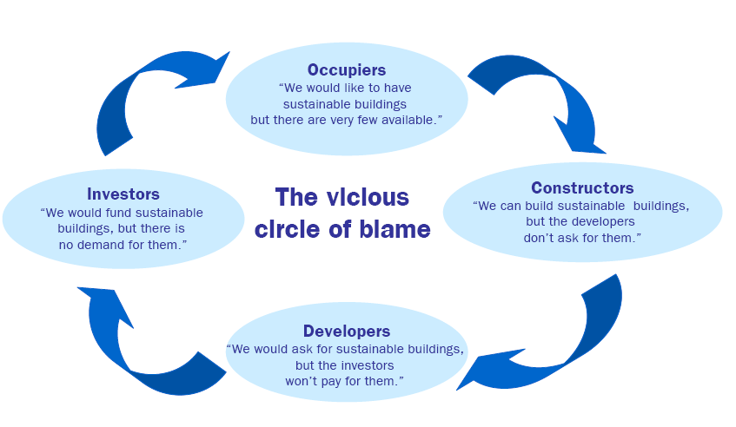
WHY SRPI NOT YET A MAINSTREAM? ……
Source: UPSTREAM

Slide 9
RPI lies in the nexus of…
responsible property investing (RPI)
socially responsible investing (SRI)
Sustainable cities & buildings
corporate social responsibility (CSR)
real estate investing
Pivo (2007) RPI has roots in CSR & SRI
Rosen et al (1991) CSR has strong links with SRI & CG
Source: Pivo, 2007

Slide 10
Literature Map
SUSTAINABLE & RESPONSIBLE PROPERTY INVESTMENT
INVESTORS ATTITUDE
Sayce et al (2007), GVA Grimley (2007)
RPI CRITERIA
UNEPFI (2007), Pivo, G. (2008)
SUSTAINABILITY CRITERIA
Ellison & Sayce (2007)
SRPI PERFORMANCE & RETURN
Pivo & Fisher (2008) , Hebb, Wood and Hamilton (2009), Wiley, Benefield, Johnson (2008)
DRIVERS
Sayce, et al (2008), Nelson, A.J. (2007)
VALUATION/ WORTH
Ellison & Sayce (200X), Lorenz, D. & Lutzkendorf, T. (2008, Lutzkendorf, T. and Lorenz, D. (2005)

Slide 11
10 Dimensions of RPI
Elements of RPI
Energy conservation conservation, retrofitting, green power generation and purchasing, energy-efficient design Environmental protection water conservation, solid waste recycling, habitat protection Voluntary certification green building certification certified sustainable wood finishes Public transport oriented developments transit oriented development, walkable communities, mixed-use development Urban revitalization and adaptability infill development, flexible interiors, brownfield redevelopment Health and safety site security, avoidance of natural hazards, first aid readiness Worker well being plazas, childcare on premises, indoor environmental quality, barrier-free design Corporate citizenship regulatory compliances, sustainable disclosure and reporting, independent boards, adoption of voluntary codes of ethical conduct, stakeholder engagement Social equity and community development fair labour practices, affordable/social housing, community hiring and training Local citizenship quality design, minimum neighbourhood impacts, considerate construction, community outreach historic preservation, no undue influence on local governments
Adapted from UNEPFI Property Working Group (2007)

Slide 12
WHY MALAYSIA ?

Slide 13
Why Malaysia? Why Not Malaysia?
Previous SRPI research has been largely emphasized on mature economies.
Integrating sustainability in property investment is even urgent priorities in emerging countries.
Lack of research in every aspect of property market
To date, no attempt has been made to develop a framework for SRPI in Malaysia

Slide 14
Main Research Questions
What is the link between Socially Responsible Investment (SRI) & Sustainable & Responsible Property Investment (SRPI)?
How has the Malaysia property market changed and will change in the future?
Can emerging property market like Malaysia progresses/embraces SRPI?
If so,
What are the adaptations and deployment required for SRPI concept to be practiced in Malaysia?

Slide 15
Research Objectives
To develop a deep understanding of theory of SRPI and its relationship with SRI
To understand the changing paradigm of property investment in Malaysia
To establish a theoretical framework for sustainable and responsible property investment
To apply/ test the framework against the investment practice in Malaysia and develop a set of principles for implementation of SRPI in Malaysia.

Slide 16
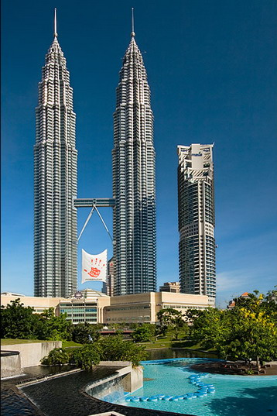
Contribution To Knowledge
Add to literature regarding sustainable & responsible property investment.
Conceptual Framework / model for SRPI adaptation in emerging market particularly Malaysia.

Slide 17
Proposed Research Design
+ Quantitative
+ Investors in Malaysia
+ Output: Current practice contributing to SRPI, ESG issues concerning these investors and action with regards to their property portfolio
Survey
Content Analysis
In-Depth Interview
+ Secondary Data
(Annual report, CSR Report, etc)
+Output: CSR/ SRPI policy , action with regards to their property portfolio
+Qualitative
+Property Sector Stakeholder
+ Initiative to diffuse SRPI in M’sia
3-Phase triangulated research methodology

Slide 18
Thank You
k0750727@kingston.ac.uk
Acknowledgement:
Producing Leaders Since 1905

