Slide 1
A GENERIC PROPERTY INTEREST INVESTMENT VALUATION MODEL
With particular applications to properties subject to leases (leased fee), leaseholds
– occupational & ground leased interests.
A Doctoral Session Research Proposal
Prepared for presentation at the
European Real Estate Society Conference, Stockholm, Sweden,
24 June 2009
Rodney L Jefferies
Agricultural Management and Property Studies Department,
Commerce Faculty, Lincoln University, Canterbury, New Zealand
P.O. Box 84, Lincoln University, Lincoln 7647, New Zealand

Slide 2
Why and where from?
I’ve oscillated between being a professional valuer & an academic for over 45 years and am doing this PhD as a “capstone” to my career.
I’ve had an on-going passion for valuation theory and developing valuation models that work in practice.
I’ve developed “real value” valuation models only to find others before me have done similarly and so need to reconcile these so as to further develop the concept into the 21st Century.

Slide 3
What is … a generic property interest investment model?
A generic property interest investment model is built on investment models emerging from conventional valuation theory, philosophies and models developed in the United Kingdom (UK) and United States of America (USA) and Australasian (AU) practices over the 19th and 20th centuries.
The generic model developed is a "real value" one, being a variant of some of the older models, but of inherent simplicity with general application to real property where forecasted future cash flows drive estimating present values.
It is generic in that it is seminal in essence, so that it can adapt to all situations, tenures, and countries with simple modifications

Slide 4
The basic research questions
Are exploratory in nature:
A. To what extent are established and historic property investment valuation models valid and/or appropriate in the 21st Century?
B. If not, is there a better, more logical, generically applicable "modern" model that could "or should" be applied under modern property market conditions?
C. If so, how widely applicable is such a model to all types of property tenure (freehold, fee simple, leasehold, partial interests, etc.); and how internationally applicable and transportable under shifting conditions of uncertainty and globalisation of the property industry?
D. Can such a model comply with and/or further develop or“mould” international valuation standards?
Does such an exploratory Thesis need hypotheses?

Slide 5
Firstly - Literature is reviewed
The literature is reviewed and critiqued, providing an extensive history of the development of property investment valuation models – primarily capitalisation methodologies.
Over 730 articles and texts have been sourced and perused (so far) and theses obtained from overseas (UK & Aus) and being indexed read and studied.
No New Zealand academic work has been done on “real value” models (except myself).
Little academic work has been done on “real value” models in the USA, where nominal value mortgage-equity and DCF investment valuation models have dominated.

Slide 6
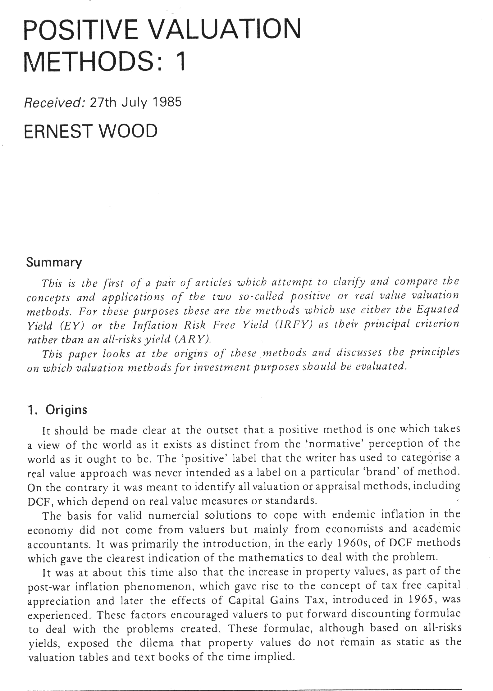
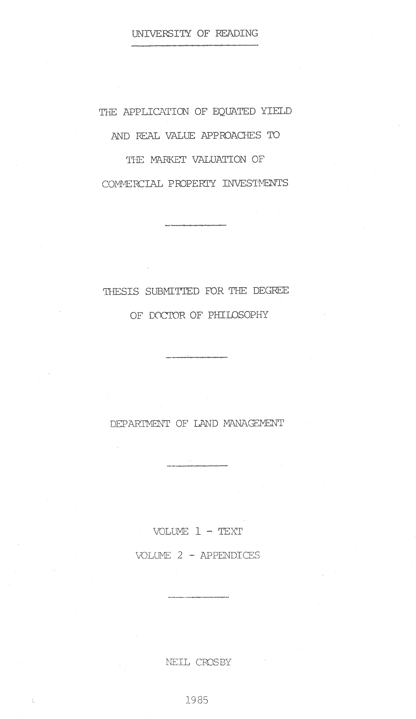
Based on Wood E. (1972) ‘Property Investment : A Real Value Approach’, Unpublished PhD Thesis, Reading University.
1985
1048pp!

Slide 7
Historical literature milestones in investment property valuation modelling
Property
Investment Valuation
Models
United Kingdom
1617 – Clay
1667 – Phillips
1811 – Inwood
1972 – Wood
1976 – Marshall
1985 – Crosby
Australia/NZ
1985 – Robinson
1993 – Rowland
1995 – Whipple
1995 – Jefferies
2004 – Fischer
United States
1924 – Ely
1933 – Babcock
1937 – Ross
1967 – Ellwood
1972 – Ratcliff
1974 – Graaskamp
1983 – Blackadar
This history is expanded upon in my paper to be presented in Session 7-H at this Conference
“A short history of income capitalisation valuation models – The 17th to 21st Century”

Slide 8
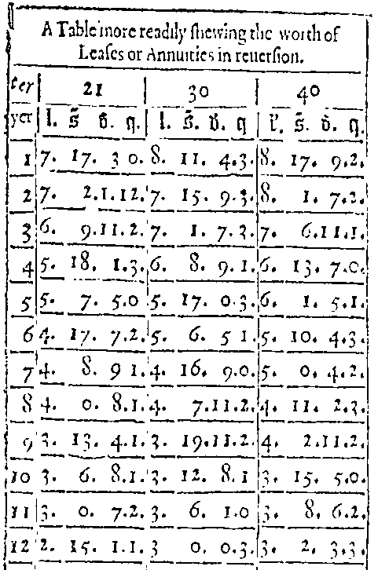
Clay’s 17th Century Valuation Model
Based on 30 years purchase @ 3.33% p.a.

Slide 9
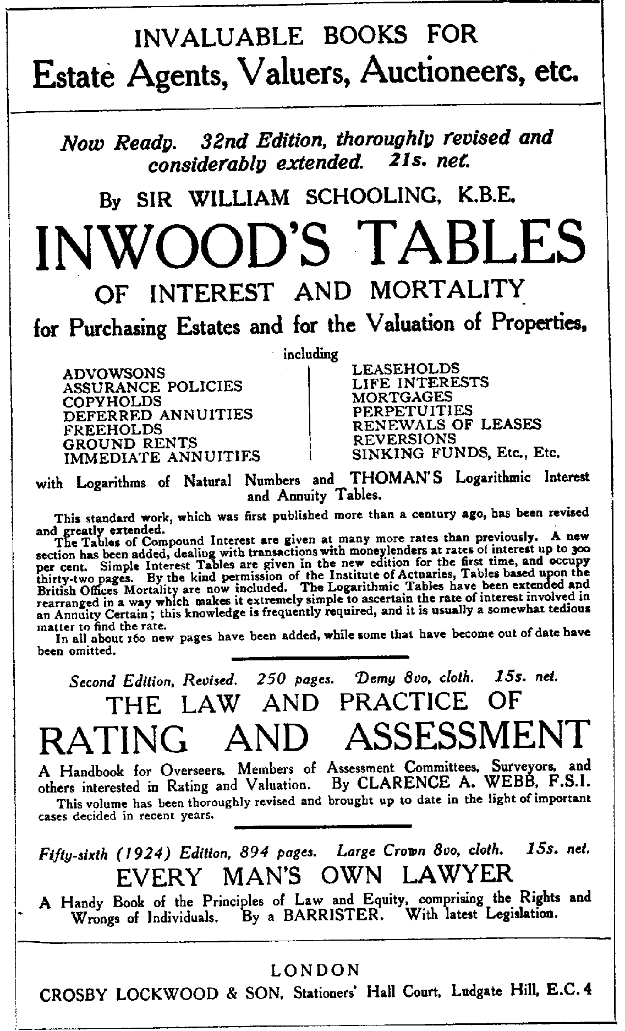

Slide 10
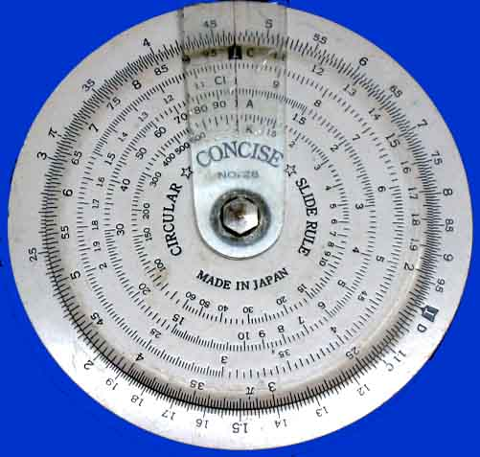
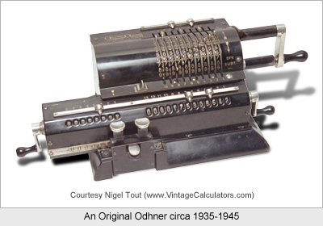
Influence of technology on progress
Author's slide rule from the 1960's
Odhner Mechanical Calculator circa 1935-45 as used by Author in Dunedin in 1964

Slide 11
What is … a ‘real value’ property investment valuation model?
A ‘real value’ property investment valuation model is built on investment models emerging from conventional valuation theory, philosophies and models developed in the United Kingdom (UK) and United States of America (USA) practices over the 19th and 20th centuries.
The author’s generic "real value" model was independently developed in 1996/7, but found to be similar to some UK Models (Wood 1973, Crosby 1985), but of inherent simplicity by comparison, with general application to real property where forecasting future cash flows drive estimating present values.

Slide 12
The real value model
The fundamental simplification of a real value concept is − the current market value of an investment property is the real present value of all future ownership benefits.
This basic, even trite, axiomatic doctrine is that in real terms the market price of an asset will represent what buyers and sellers agree to exchange that property asset interest in current dollar terms, representing what other real things can be exchanged for that current monetary value.
A paper presented at the recent PRRES Conference at Sydney sets out a history of real value models and fully describes this generic real value model: Jefferies, R. L. (2009, 18-21 January ). A brief history and development of ‘real value’ valuation models – The last four decades. http://www.prres.net/papers/Jefferies_A_Brief_History_And_Development_Of.pdf

Slide 13
The real value model
Current market rentals will represent in real terms what the periodic occupancy benefits are worth both now and in the future, the latter to be discounted to present value at a real discount rate.
Similarly, current and future expenses and capital expenditure, and any future net resale value, are expressed in current present ‘real value’ terms.
It’s not necessary to escalate (or inflate) future rents, costs and values in nominal terms allowing for currency inflation, and then to discount those future values back to PV’s @ nominal discount rates incorporating the same expected inflation component. SO why do it?
One needs only to discount the forecast future real cash flows using real required rates of returns, allowing for relative risks.

Slide 14
The generic model
A generic model is developed mathematically utilising universal economic and financial principles, in a short-cut discounted cash flow format and then applied in user-friendly spreadsheet template formats applicable to various tenures.
In its simplest generic form as a function:
A simplified real value model derived from a conventional DCF valuation model.
The use of the symbol ⇐ indicates that investment value is derived from cash flows and is not reversible.
“Effective investment value” at date of valuation, subject to an existing lease, is defined as V_{e};
PV is defined as “present value”; Y_{o} is the overall (nominal) investment yield
A conventional generic DCF valuation model in nominal monetary terms follows:
V_{e} ⇐ PV of future periodic cash flows + PV of reversionary or terminal value
[Discounted at a nominal or monetary rate of return i.e., investment yield rate, Y_{o}]
{i.e. discounted @ Y_{o} annually (p.a.); or y_{o} per period (p.p.)}

Slide 15
The generic model cont’d
A conventional DCF valuation model re-expressed in real terms where I is the expected inflation rate is:
V_{e} ⇐ PV of future periodic cash flows + PV of reversionary or terminal value
[Each cash flow is first discounted at the expected inflation rate, I ]
{i.e. discounted @ I annually (p.a.); or i per period (p.p.) }
Which produces cash flows in real terms:
V_{e} ⇐ PV of future periodic real cash flows + PV of future real reversionary value
[Discounted at a real rate of return i.e. real yield rate, net of growth, Y_{n} ]
{i.e. discounted @ Y_{n} annually (p.a.); or y_{r} per period (p.p.)}
A real value generic DCF valuation model, where G_{o} is the nominal growth rate made up of the real growth rate G_{r} and the inflation rate I as: G_{o} = [(1+ G_{r})(1+I)] -1
And as: Y_{o} = [(1+ Y_{n})(1+ G_{r})(1+I)] –1; and Y_{n} = [(1+ Y_{o})/(1+ G_{r})(1+I)] –1.
V_{e} ⇐ PV of future periodic known (contract rental) cash flows
[Discounted at a nominal or monetary rate of return i.e. investment yield rate, Y_{o}]
+ PV of deferred current real reversionary (i.e. terminal value in real terms)
[Discounted at a net (of growth) real investment yield rate, Y_{n} ]
{i.e. discounted @ Y_{n} annually (p.a.); or y_{n} per period (p.p.)}
Where: C_{a} = PV of the contract rental cash flow ; V_{r} = real value (@ market rental)
V_{e} ⇐ C_{a} + V_{r}(1+y_{n}) ^{–t} (Where: t = periods to run until next review)

Slide 16
The generic model in a spreadsheet model format

Slide 17
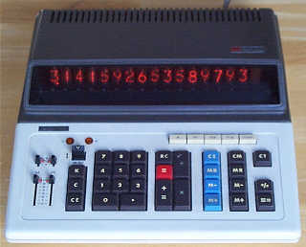
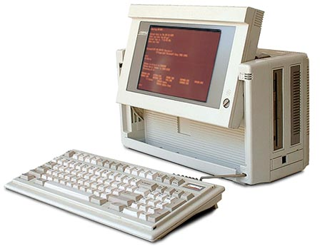
Technology becomes – electronic
& then small and portable
Vintage Compaq Portable II -1986
As used by Author 1986-1995
Vintage Sharp Compet 364R Calculator
As used by Author ex 1973 & still on his desk

Slide 18
Underpinning philosophy
Whilst all valuations are of either a lessor’s interest (leased fee) or of a lessee’s or sub-lessee’s interest (leasehold interest);
Each “Interest” has a separate value.
With investment property – “freehold investment value” is an oxymoron (assuming no lease exists).
Further, the sum of the lessor’s and lessee’s interests do not add up to the “freehold value” .
  (Neither can a lesser interest be derived from a “freehold value” by deducting the value derived for the counter-part "interest" – i.e. by a residual method).

Slide 19
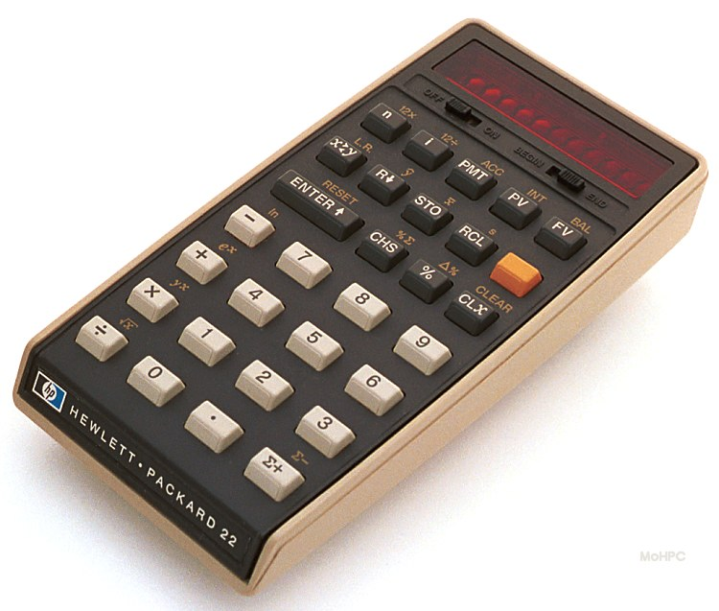

Technology becomes electronic
& portable
The Author ‘s Hewlett Packard HP22
Financial calculator 1974 !!!
Laptop technology,
As used by Author to produce this proposal presentation

Slide 20
Empirical testing & application
The generic model is applied to commercial occupational leased properties and ground leaseholds.
Empirical research and practical testing in applications valuing ground lessor’s and ground lessee’s interests:
In addition:
  Analysing investment yields, and
  Developing ground rental methodology as applicable in New Zealand.

Slide 21
Conclusions (Hopefully!)
That the generic valuation model is both economically and financially valid, based on this empirical research and practical testing.
The model's versatility and practical relevance in market analysis and valuation applications are intended to be universally and internationally applicable.
Will meet and enhance current International Valuation Standards and practice.
Limitations of the examples reflecting the author's base of experience in New Zealand.

Slide 22
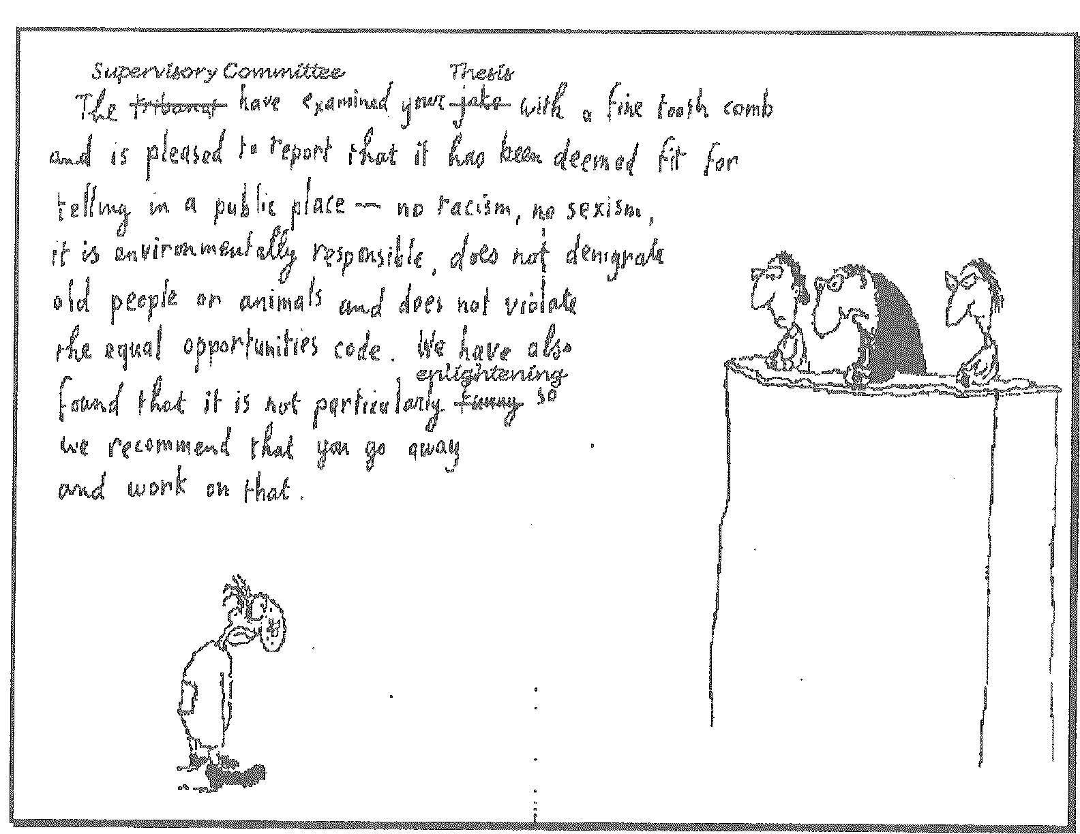

Slide 23
The End
Questions
Suggestions
Thankyou

