Slide 1
Prime London Housing: Submarkets Residential Research Knight Frank LLP James.culley@knightfrank.com

Slide 2
introduction: notes on methodology
Who am I:
Presentation Outline:
Prime London market
Identifying submarkets by historic house price behaviour
Identifying submarkets by housing characteristics
Testing through hedonic modelling
James.Culley@knightfrank.com

Slide 3
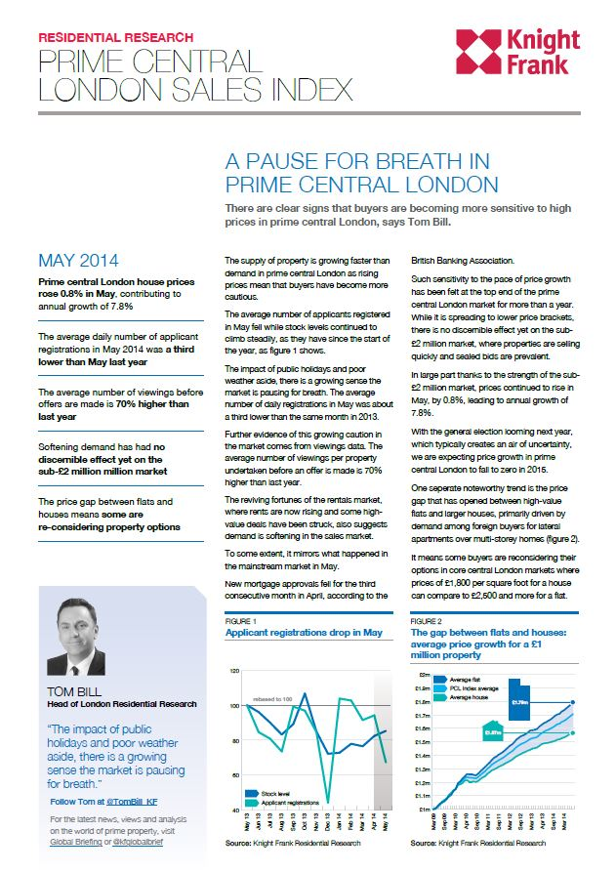
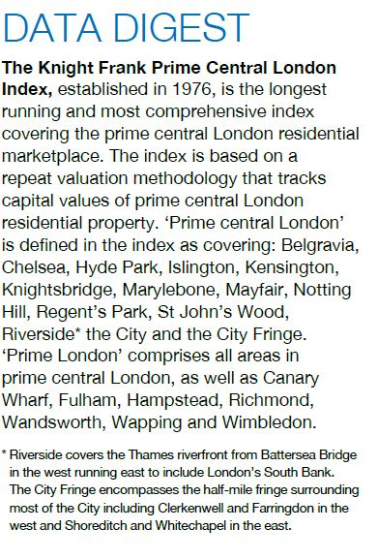
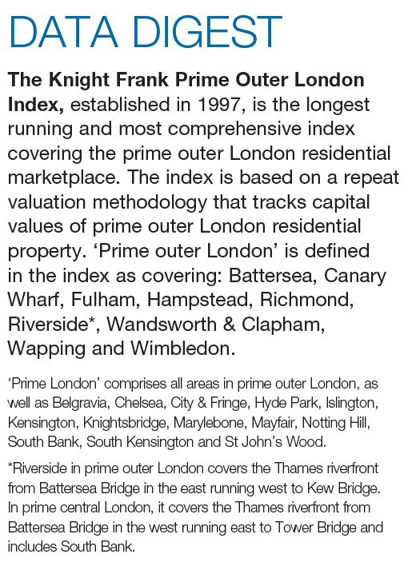
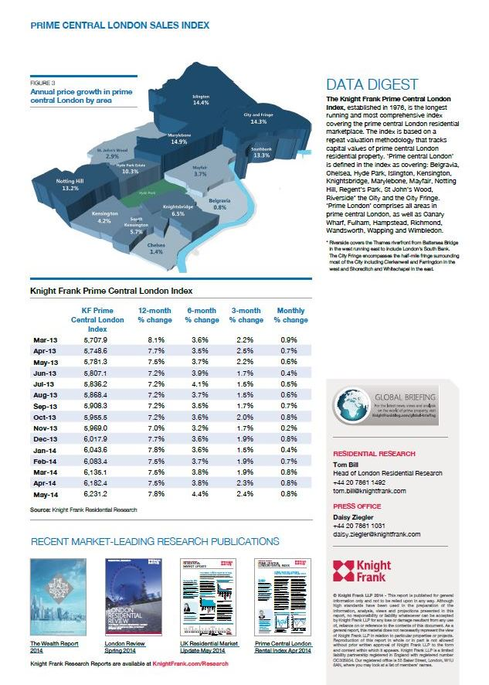
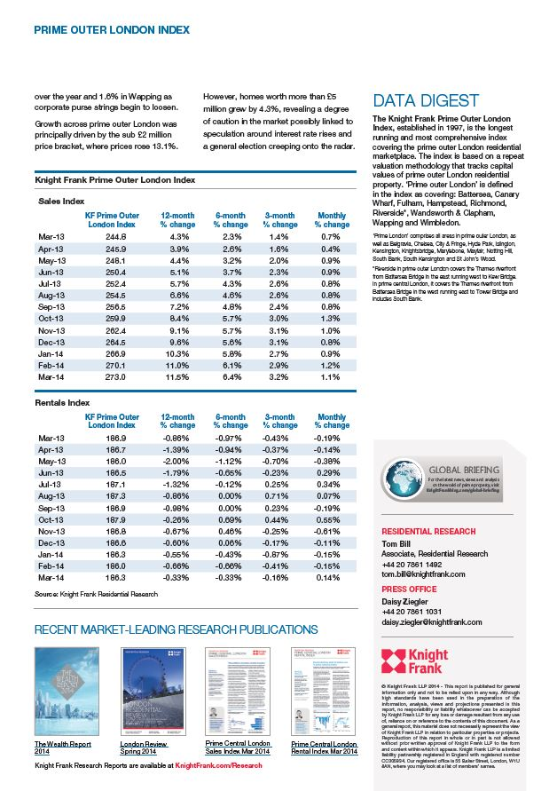
Use of PCL and POL:
Widely used in research and marketing: -
Definitions of Prime Central London and Prime Outer London are used for a multitude of research, analysis and reporting actions
James.Culley@knightfrank.com

Slide 4
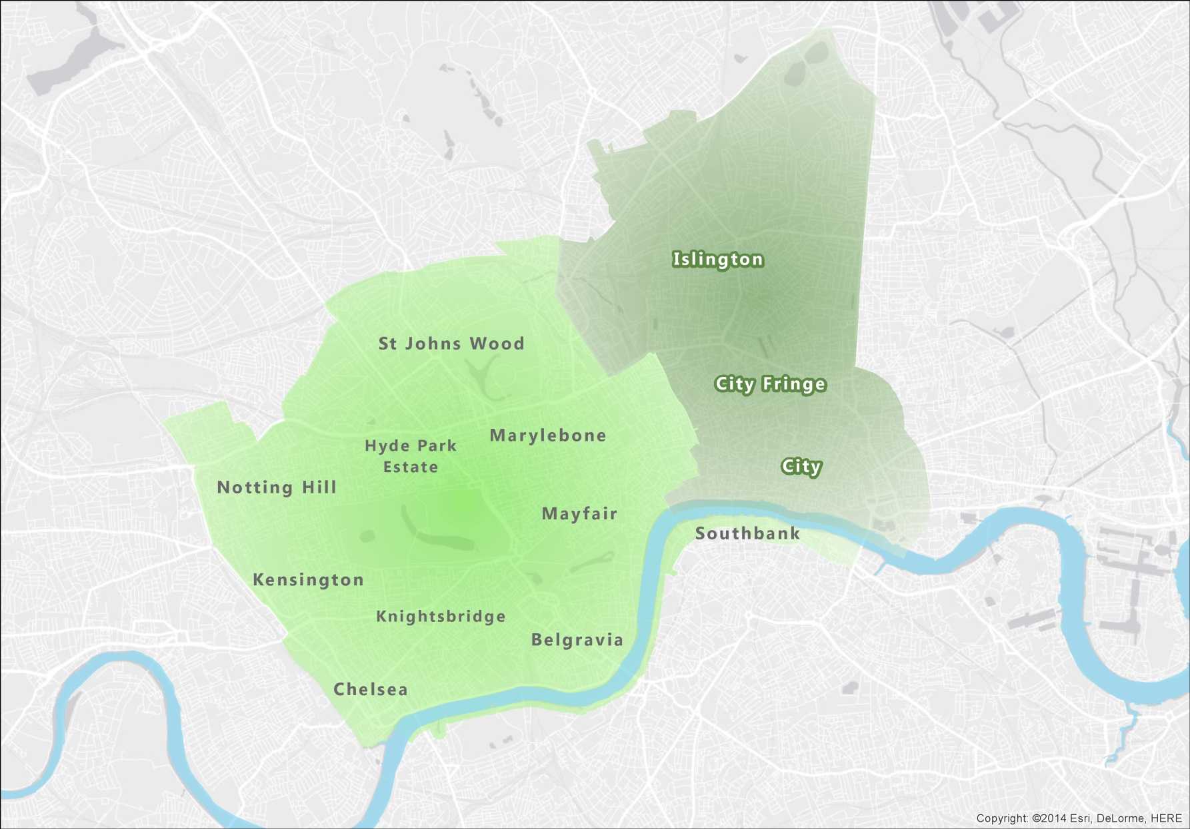
PCL Deffinition
James.Culley@knightfrank.com

Slide 5
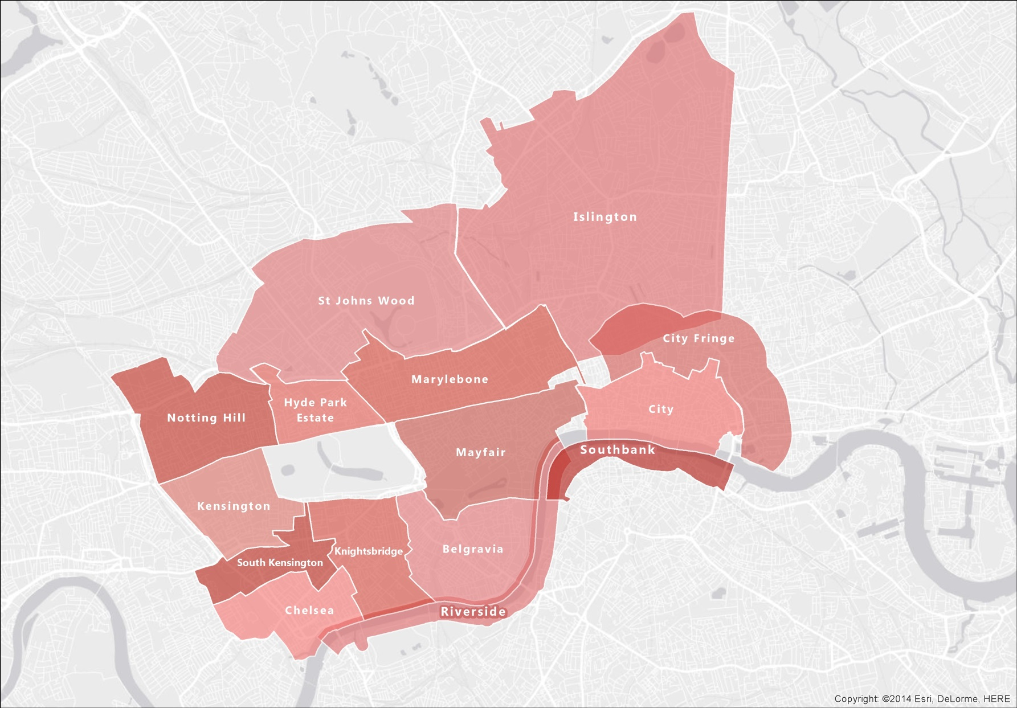
PCL Deffinition
James.Culley@knightfrank.com

Slide 6
Exploring alternative Definitions

Slide 7
Approach
We used two different approaches to try and define the submarkets and Prime Central London through a more quantitative, data-driven approach
Define submarkets by:
Areas where the housing market have behaved in similar manner historically
Areas where dwellings share similar characteristics
James.Culley@knightfrank.com

Slide 8
Historic Price behaviour Clustering

Slide 9
Repeat Sales Regression
Provide an estimation method based on price changes of houses sold more than once.
Has been argued that a repeat sales provides an accurate assessment of house price changes
Controls for the attributes of dwellings since it is based on appreciation rates of the same dwelling
Requires much less data on housing transactions as only requires exchange price, dates of first and second sale and the address.
Criticisms include difficulty in accounting for changes in house characteristics over time and measurement bias from different types of dwellings differing in their turnover rates.
James.Culley@knightfrank.com

Slide 10
Repeat Sales Regression
Method used by Land Registry for their Local Authority indexes. Land Registry Data used in this study.
Formula:
$p_{it} − p_{iτ}= \sum_{t=1}^{T}{G_{it}α_{t}+ η_{it}}$
Where:
$p_{it}$ = log of resale price in time t
$p_{iτ}$ = log of resale price in previous time τ ( t > τ)
$G_{it}$ = time dummy equal to 1 in period resale occurs, -1 in period first sale occurs or 0 otherwise
James.Culley@knightfrank.com
Notes:
Considered GWr but computational and methodological considerations to be made

Slide 11
mw Repeat Sales Regression
To gain an understanding of local house price behaviour needed to create an index at locations spread across the study area (Greater London)
Used a Spatial Moving Window Regression to create these localised index
i2
i1
James.Culley@knightfrank.com

Slide 12
mw Repeat Sales Regression
Used centroids of Lower Super Output Areas as the regression points n= 4582
Computational limitations
Once we had done extensive data pre-processing, filtration and exploratory analysis we had a population of 1.15 million repeat sales events for the period 1995 to 2014
We used an adaptive bandwidth to select the sample events for each regression location
The sample size for each location was 4000 points as this number ensured each time period was adequately represented at each location
James.Culley@knightfrank.com

Slide 13
mw RSR Clustering
MW RSR resulted in 4582 separate indexes
Wanted to identify areas where house prices had exhibited similar behaviour historically
First we needed to normalise each index, otherwise any cluster method would group by magnitude rather than behaviour
Indexes were then clustered using k-means clustering
James.Culley@knightfrank.com

Slide 14
mw RSR Clustering Results
Results of Moving Window RSR
 | Min | Max | Mean | Std Dev
R2 | 0.79 | 0.97 | 0.93 | 0.02
Price change 95 to 2014 | 201% | 864% | 403% | 125%
Land Registry 95 to 2014 | 223% | 672% | 373% | 121%
It was found after careful consideration that 14 clusters best described the normalised data
James.Culley@knightfrank.com

Slide 15
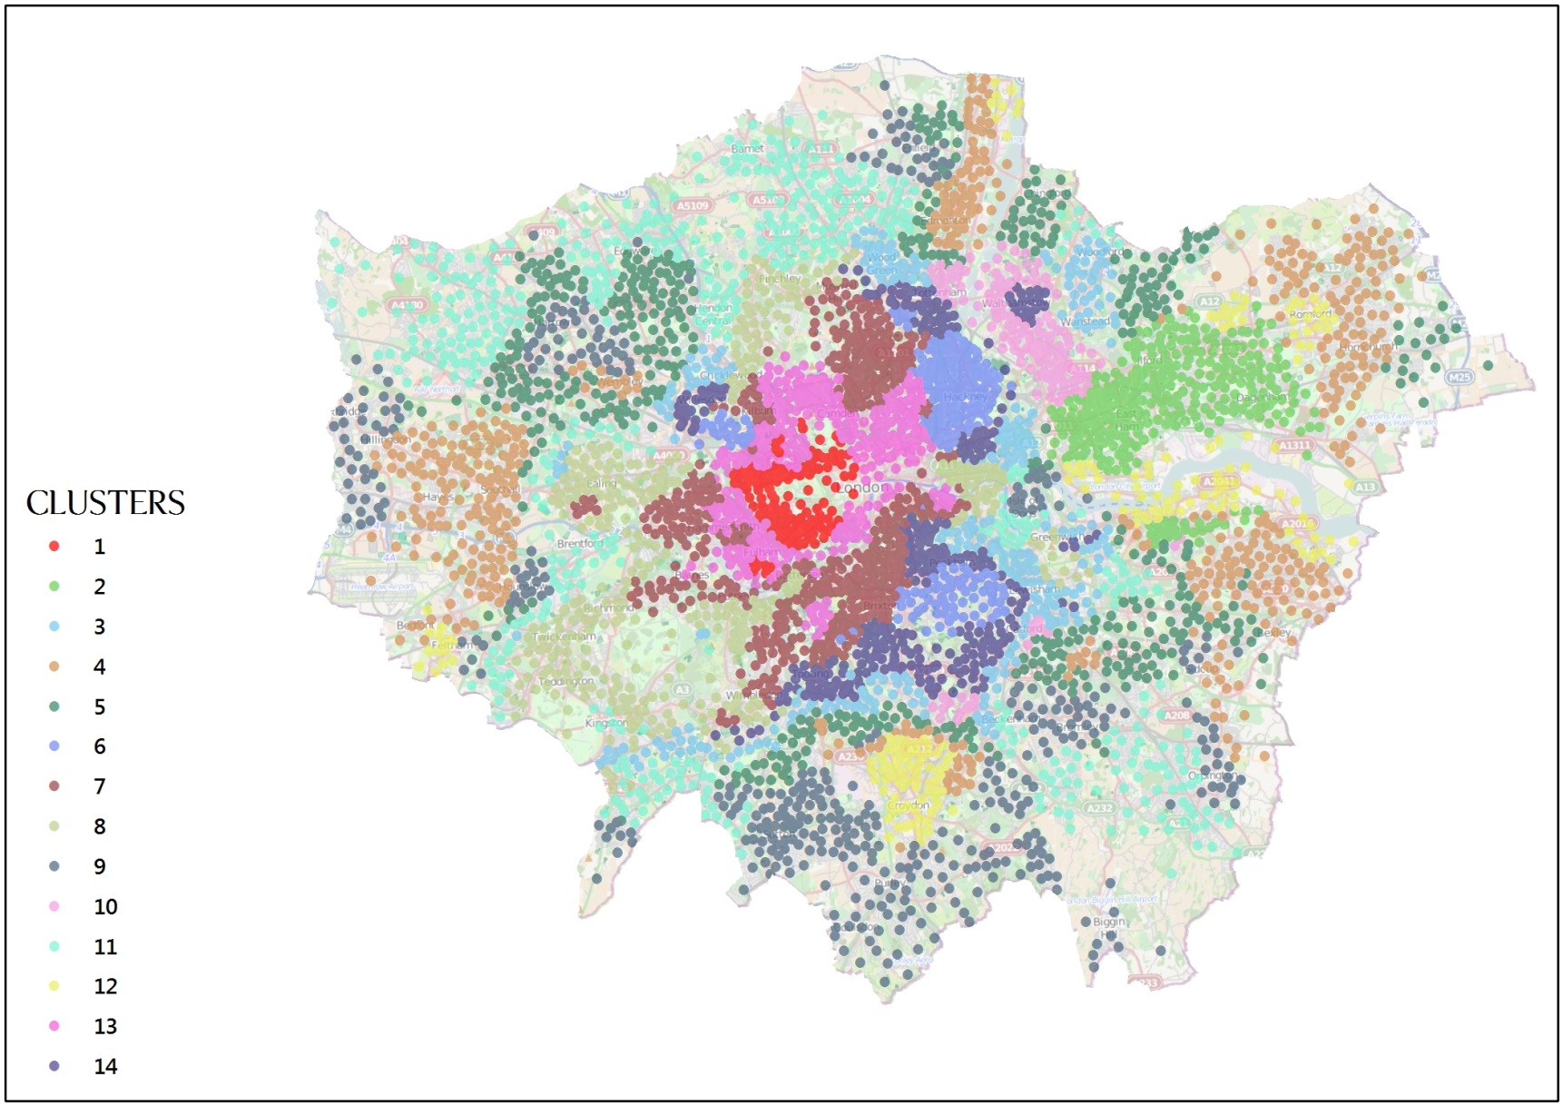
mw RSR Clustering
James.Culley@knightfrank.com

Slide 16
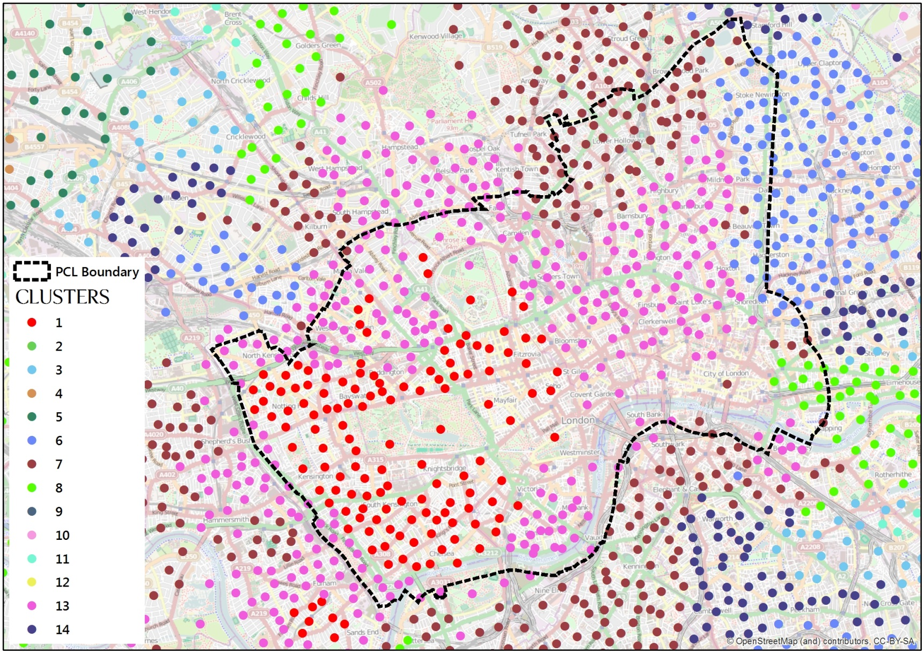
mw RSR Clustering
James.Culley@knightfrank.com

Slide 17
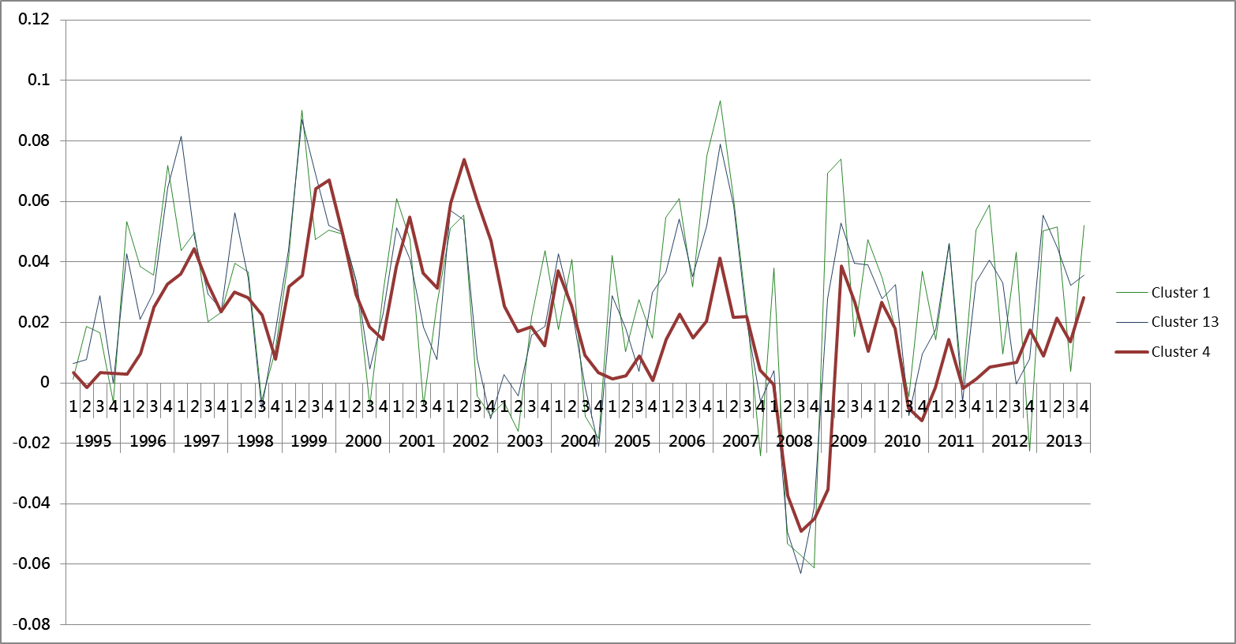
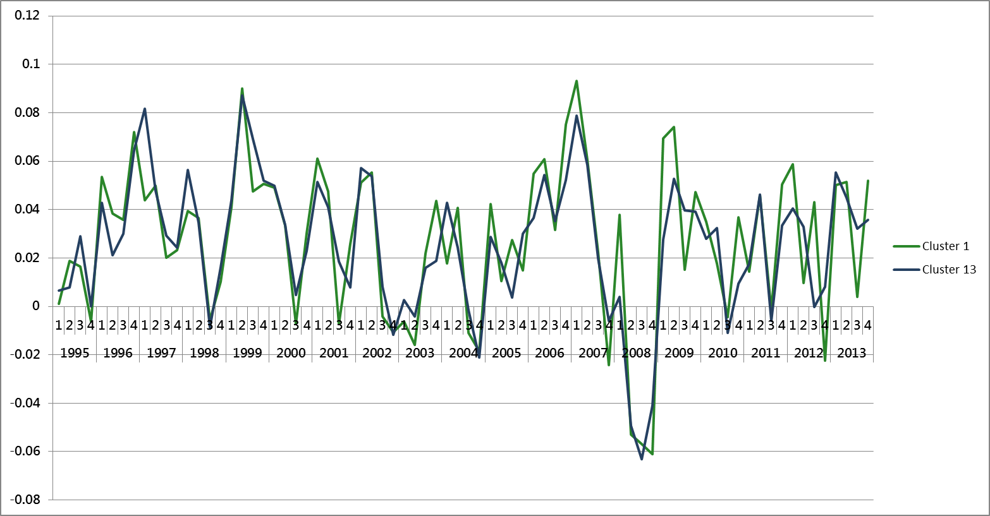
mw RSR Clustering
James.Culley@knightfrank.com

Slide 18
Dwelling Characteristics Clustering

Slide 19
Characteristic Clustering
An alternative method for defining the submarkets is to use housing characteristics
These can relate to the properties of the buildings themselves as well as aspects of their locations, such as socio-economic profiles
The resulting statistically generated submarkets consist of dwellings that share similar characteristics and so theoretically could act as suitable substitutes for each other.
James.Culley@knightfrank.com

Slide 20
Characteristic Clustering
Data on houses comes straight from Knight Franks propriety sales database
Contains data on all sales of prime property in London, including exchange price and date, size, number of bedrooms, type, features such as pool, balcony, porter etc…
After pre processing we had a sample of approx. 5500 sales since 2011.
In addition we used data sources such as NOMIS to gather low level information on social-economic status and general tenure statistics
James.Culley@knightfrank.com

Slide 21
Characteristic Clustering
Used a combination of statistical testing and expert opinion to select relevant data from these sources
Resulted in 64 variables representing characteristics of the property
Principal Component Analysis with Varimax rotation to extract the orthogonal factors from these characteristics
This resulted in 14 components of which the first 10 explain 86% of the total variance.
 | RC1 | RC4 | RC2 | RC3 | RC5 | RC6 | RC8 | RC12 | RC9 | RC7 | RC11 | RC10 | RC13 | RC14
Proportion Explained | 17% | 13% | 12% | 9% | 6% | 6% | 6% | 6% | 5% | 5% | 4% | 4% | 3% | 3%
Cumulative Proportion | 17% | 31% | 43% | 52% | 58% | 64% | 70% | 76% | 81% | 86% | 90% | 94% | 97% | 100%
James.Culley@knightfrank.com

Slide 22
Characteristic Clustering
K means cluster analysis was used on these 10 components with the addition of normalised and reduced X and Y coordinate of the houses
Without including X an Y there was a great deal of spatial contiguity in the results but we wanted to improve this slightly.
5 clusters where identified as best suiting the input data.
James.Culley@knightfrank.com

Slide 23
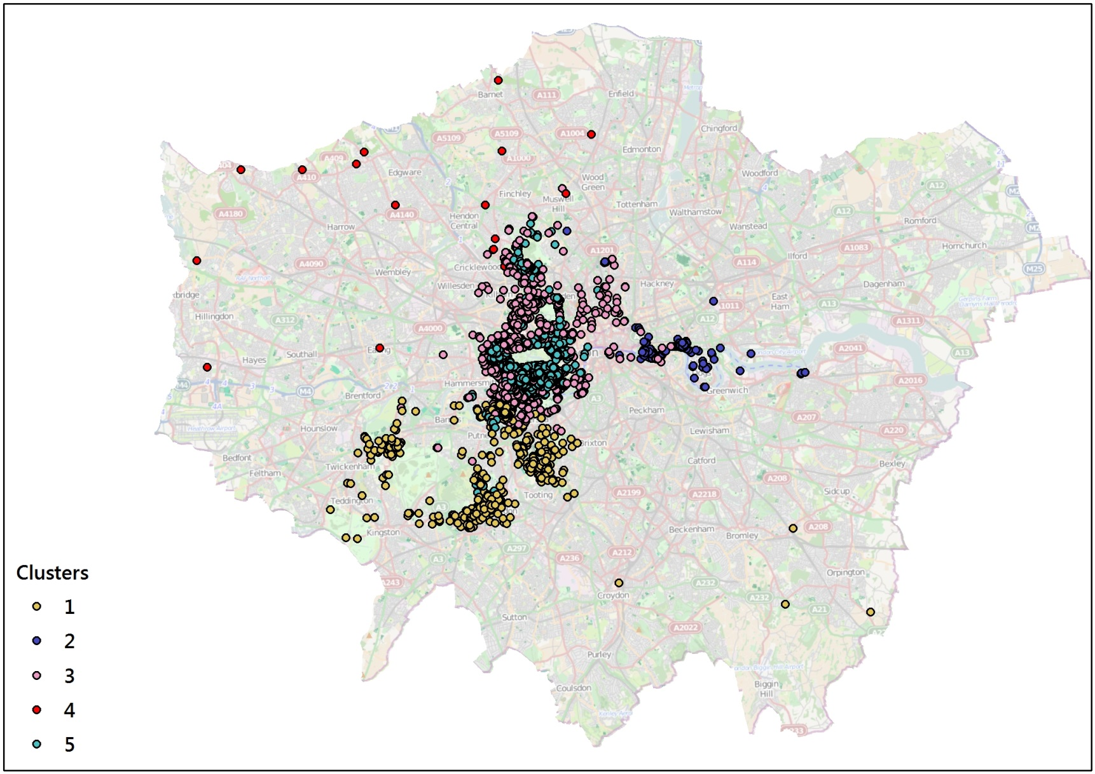
mw RSR Clustering
James.Culley@knightfrank.com

Slide 24
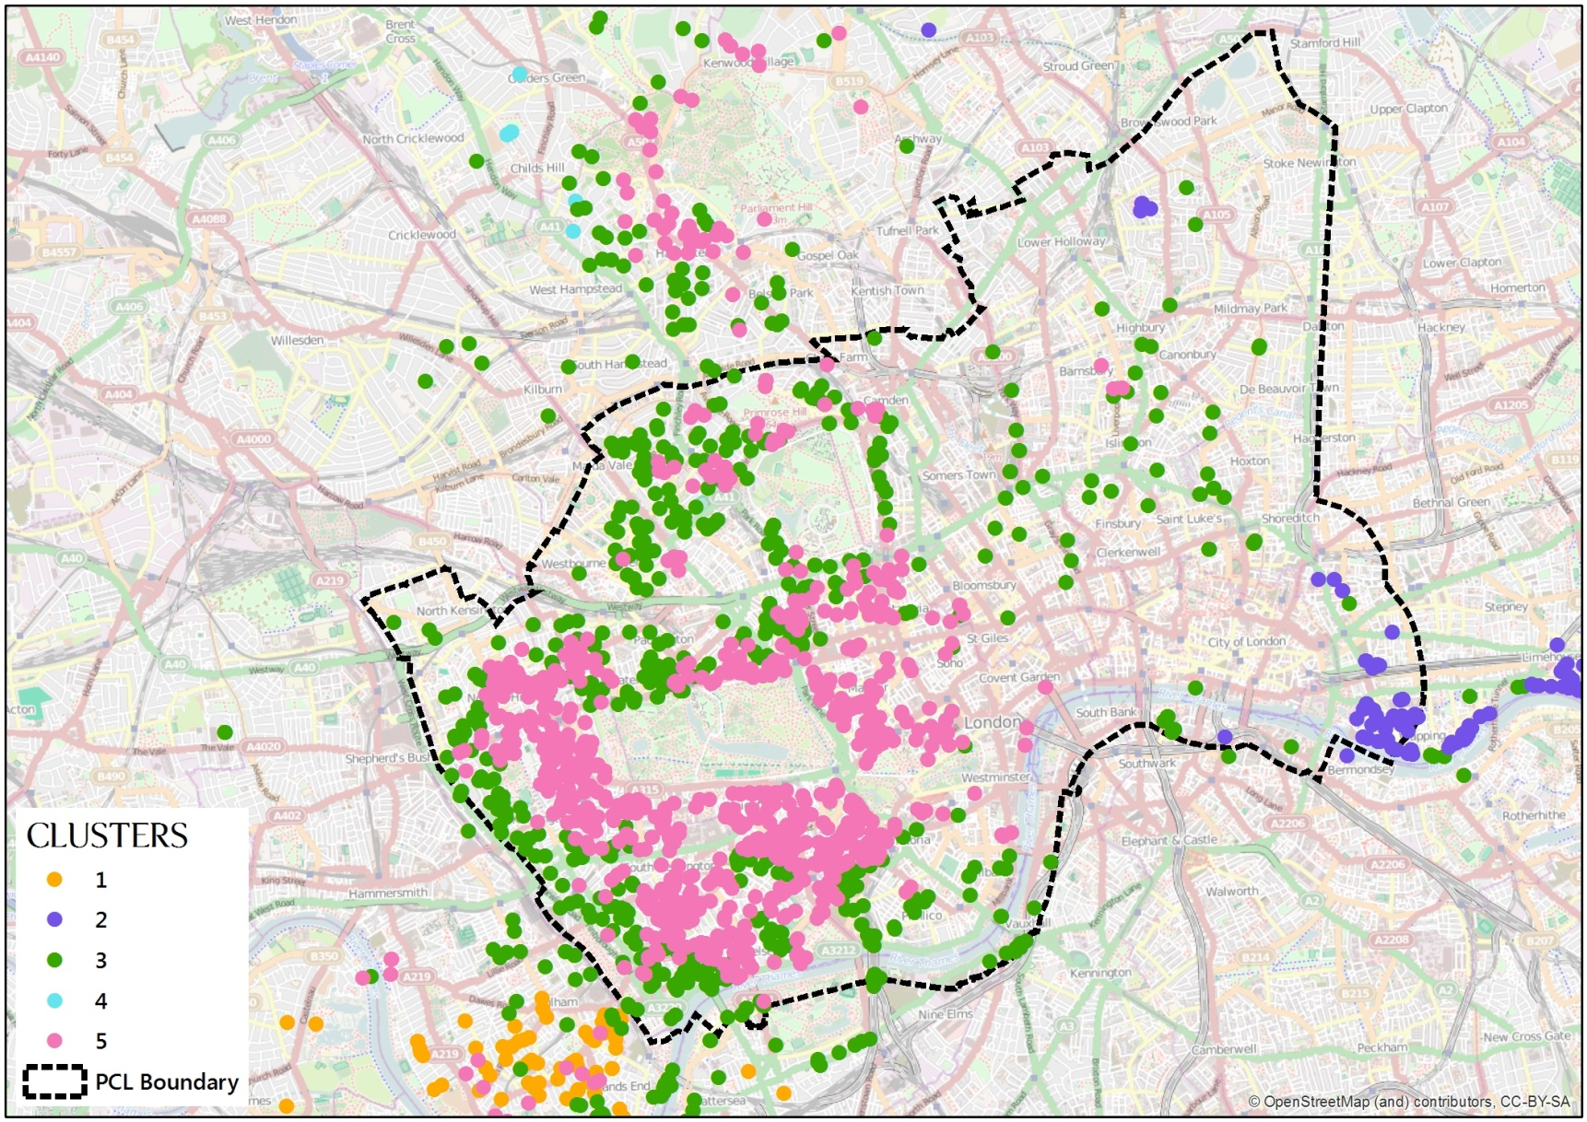
mw RSR Clustering
James.Culley@knightfrank.com

Slide 25
Testing Submarket Classifications

Slide 26
Testing CLusters
Created hedonic model using data from the Knight Frank Proprietary sales database
Initial hedonic model had 49 variables relating to aspects such as size, tenure, type, condition, age and additional benefits
We then added dummies for each of our submarkets identification techniques and reran the model
Properties were matched to their submarkets via a spatial join on their location.
James.Culley@knightfrank.com

Slide 27
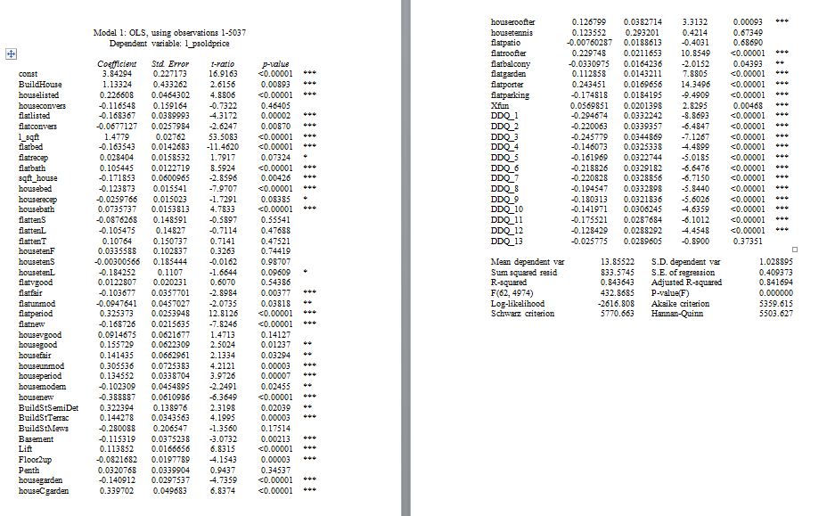
Testing CLusters
James.Culley@knightfrank.com

Slide 28
Testing CLusters
 | AdjR^2 | S.E. Regr | AIC | SIC | HQ
Base (mod 1) | 0.842 | 0.409373 | 5359.615 | 5770.663 | 5503.627
PCL (mod 2) | 0.900 | 0.325855 | 3061.967 | 3479.539 | 3208.265
HPC (mod 3) | 0.932 | 0.267727 | 1090.484 | 1560.253 | 1255.069
CC (mod 4) | 0.842 | 0.409146 | 5300.195 | 5736.605 | 5453.177
James.Culley@knightfrank.com

