Slide 1
Home equity conversion
The role of home equity in financing the costs of an ageing society

Slide 2
Cause
Elderly ‘equity rich, cash poor’ → increase income elderly
Increasing costs ageing society → role home equity covering costs

Slide 3
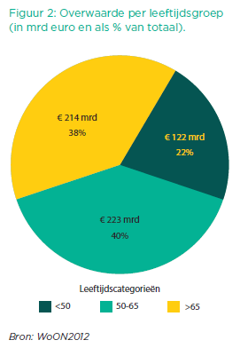
Cause (2)
Taskforce Verzilveren:
Tax assessed value
-/-
Outstanding mortgage debt

Slide 4
(Int.) Literature
Varying results w.r.t. potential of home equity (focus on individual wellbeing) Mayer & Simons (1994; +) Venti & Wise (1991; -)
Clear w.r.t. reluctance Venti & Wise (2001) Elsinga et al. (2010)

Slide 5
(Int.) Literature (2)
Reluctance HE conversion irrational? - liquidity home equity - bequest motives - mental accounting - complexity financial products

Slide 6
Setup study
Focus on staying in current dwelling
Focus on replacing risks from individual to investors

Slide 7
Home equity conversion
€
Investor
Seller
Bank/Insurer
€
€
Bank

Slide 8
Home equity conversion (2)
€
€
Investor
Owner
Renter
2012
65
Insurer
€

Slide 9
Central question:
Does home equity conversion result in a significant additional income for the converting household?

Slide 10
Assumptions

Slide 11
Results
Figures x € 1.000

Slide 12
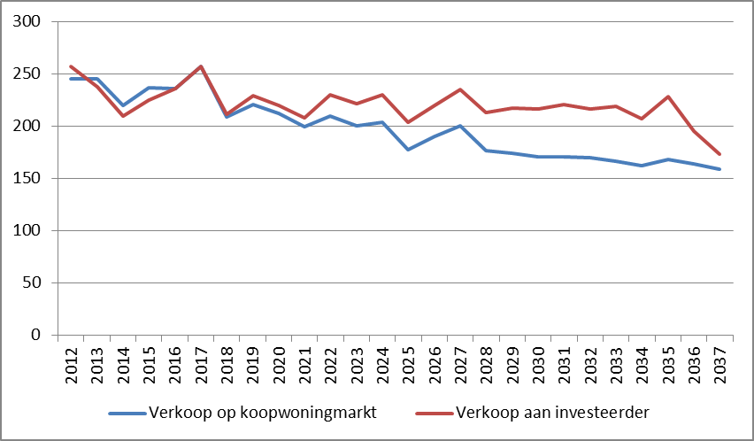
Results (2)
Notes:
Verzilver-vermogen

Slide 13
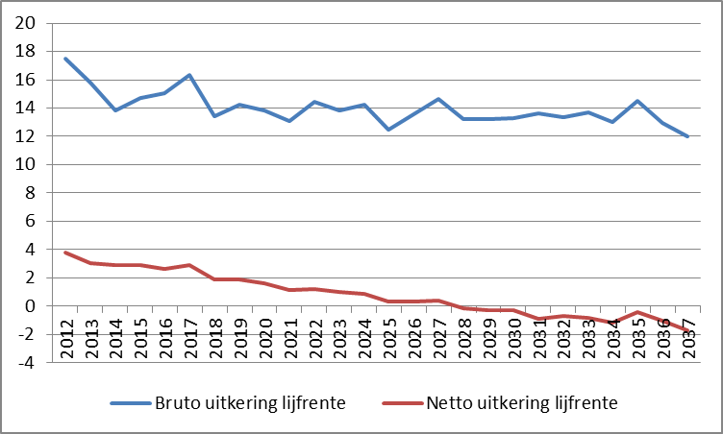
Results (3)
Notes:
Bruto en netto uitkering per jaar

Slide 14
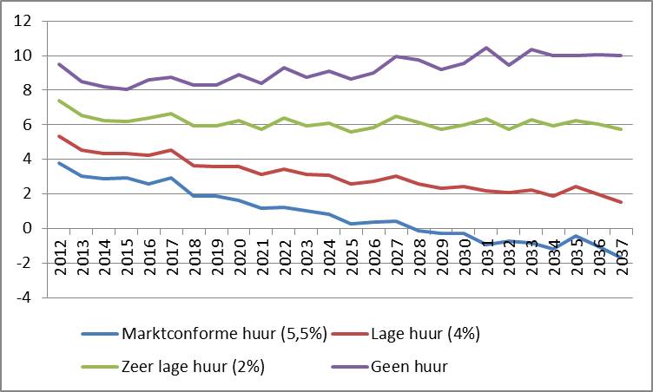
Results (4)
Notes:
Netto uitkering bij verschillende huurniveau’s

Slide 15
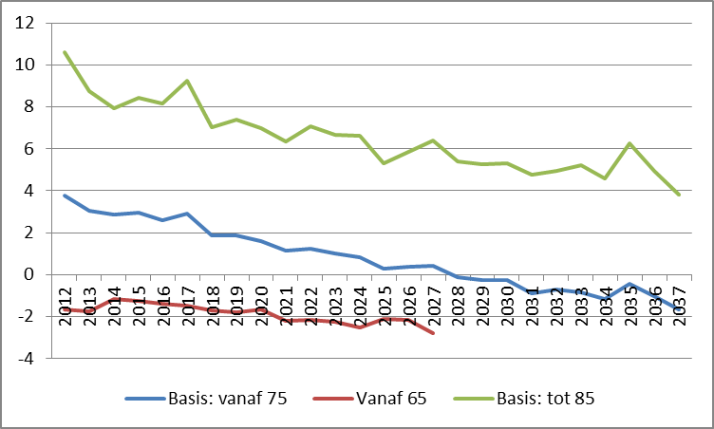
Results (5)
Notes:
Netto uitkering bij verschillende resterende levensduur

Slide 16
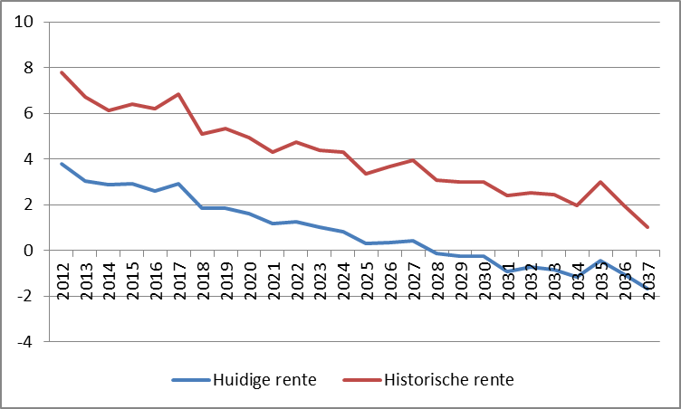
Results (6)
Notes:
Netto uitkering bij historische rente

Slide 17
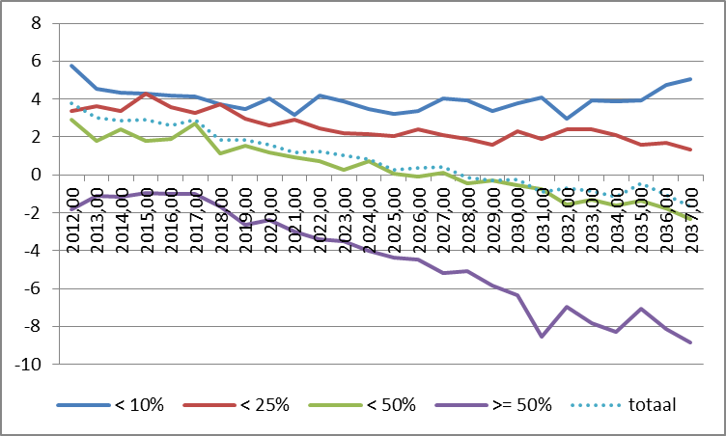
Results (7)
Notes:
Netto uitkering gesaldeerd met woonuitgaven naar LTV

Slide 18
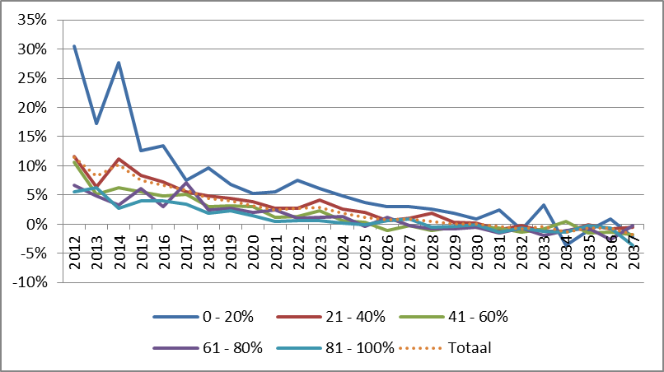
Results (8)
Notes:
Netto uitkering gesaldeerd met woonlasten naar inkomensklasse

Slide 19
Conclusions
Home equity conversion potentially interesting for individual households
Home equity conversion does not offer a fundamental basis for long-term additional income for society at large

