Slide 1
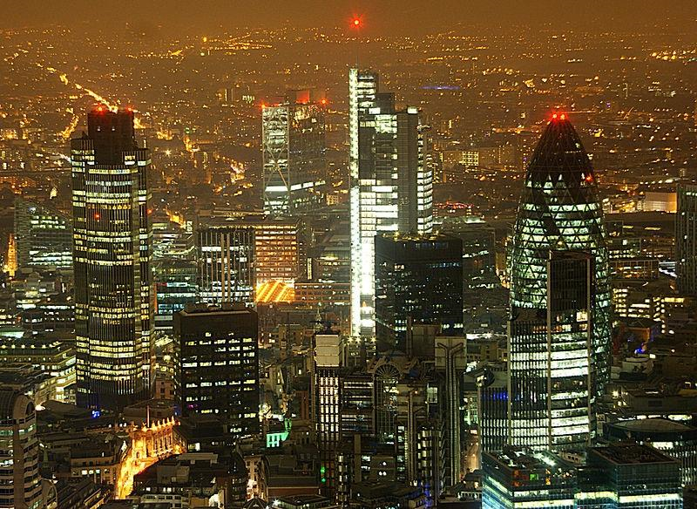
Is London a consistently safe haven for UK Real Estate during times of instability
Lynne Michael
London South Bank University
ERES Conference, Bucharest,
July - 2014

Slide 2
To assess the robustness of the London commercial property market in terms of volatility of capital flows

Slide 3
Why the specific interest in London?
This risk is exacerbated by rapid advances in financial innovation and the small number of IFCs.
IFC systemic risk potential with property investment vehicles aligned to portfolio investments feeding back into financial markets.
World or global cities and International Financial Centres with advanced service producer support network have been identified.

Slide 4
Does this therefore make London a more risky investment proposition in terms of volatility for an investment holding compared to the opportunity cost of investing in another UK city whose economic base is less dependant on the finance sector?

Slide 5
A greater volatility in the economic base activity for London posits the question of how this is reflected in the commercial property market which also forms a base for much of the financial transaction security.
To assess the volatility of capital flows into London commercial property, these flows were analysed over an extended period including pre and post global financial crisis (GFC).

Slide 6
London commercial R.E. risk v other UK commercial R.E.
London office market is correlated with the finance sector
Does this mean it is a higher risk investment
capital flows into London v UK cities with diversified economic base

Slide 7
Volatility of capital flows into City of London and West End compared to alternative selected UK cities 2001 – 2012.

Slide 8
And did the proportionate volume of investment capital into other UK cities studied increase post GFC.

Slide 9
Research methodology
City of London, West End, Birmingham, Bristol, Edinburgh, Leeds & Manchester commercial property transactions analysed using Real Capital Analytics (RCA)/Property Data figures 2001 – 2012
Annual commercial property transactions for each city was analysed as a percentage of total UK 2001 to 2012 for relative changes in UK share and s.d. for each city determined for volatility measure.

Slide 10
Research results

Slide 11
Empirical Analysis of capital flows into commercial property transactions
Ranked order in proportion of total UK commercial real estate transaction flows revealed:
City of London & West End consistently leads
City of London shows a range of advantage over the third largest recipient of commercial real estate funds
2001 City of London capital flows were 13.5 times larger than into Birmingham.
and 5.9 times greater than Birmingham in 2002

Slide 12
differences continued to fluctuate - 2012 capital flows into COL are 15 times greater than into Birmingham.
Birmingham was consistently 3rd largest recipient of capital flows except 2010 and 2011 when Manchester surpassed Birmingham.

Slide 13
Statistical analysis of volatility of capital flows into Commercial R.E.
Step 1
Step 2
Step 3
Standard deviation s.d. was used to measure volatility
s.d. for 2001-06, 2007-12 & overall 2001-12 were analysed using RCA data
Volatility for each area analysed was graphically represented in column charts

Slide 17
To sum up……
1. COL & West End show greater standard deviations over all periods
3. An increased volatility for London combined with an increased share of total UK commercial real estate transactions over the same time period.
4. An increased comparative demand for London despite the GFC downturn and economic exposure to the finance industry.
2. COL & West End standard deviations increased over 2007-12 period

Slide 18
However:
Traditionally, risk in the property market has been assumed to be measured in terms of volatility. But - City of London and West End present the highest risk commercial real estate markets of those analysed.
Considering the analysis undertaken, it may be argued that London does not appear to conform to the higher volatility higher risk theory?
Investors increasingly favour London despite lower yields and higher volatility.

Slide 19
London’s identity as an IFC creates liquidity which in turn attracts more business. A qualification of the effect of this status and the liquidity affect for investors cannot be estimated from analysis undertaken in this paper.
Further research into investor preference for London and their risk analysis criteria could extend the concept of risk dependence on volatility.

Slide 20
Thank you for your attention

