Slide 1
Chasing student satisfaction in the delivery of property higher education
Kathryn Robson RMIT University, Melbourne, Australia

Slide 2
Unique Characteristics of Higher Education
Higher Education is classified as a Services Marketing type of activity. This industry has four unique characteristics.
There are not many other products that take three or more years to mature.
This service has a tiered structure, which sees one section having to be successfully completed before moving on to the next. The final product, the degree, is not awarded until all the tiers are completed.
A third characteristic that is different for this product is the intensity of the experience, up to 15-30 hours a week in blocks of 11/15 weeks at a time.
Finally, within HE the producers of the service also assess the progress of the client and without this assessment the client cannot progress to the next stage.

Slide 3
Is a Student a Customer or Client?
Whether you call students a customer, or client there is no doubt that it is important to try to satisfy them:
Funding is linked to student satisfaction
Often promotion is linked to student satisfaction scores
The results are in the public domain and prospective student check
As students spend a lot of time in each others’ company it is important that they have clear expectations about what a university can deliver.
This paper is about comparing student expectations with student perceptions and uses higher education (HE) property students in Australia as a test case.

Slide 4
Methodology
The research methodology chosen for this paper is a combination of interpretivism and Critical Incident Theory (CIT).
The Critical Incident technique allows the respondent to describe their experiences in open-ended responses (Douglas et al, 2008). (See paper for range of comments)
There are ten Australian public universities offering property (real estate) related degrees and a questionnaire was delivered to every property undergraduate at these ten universities during 2014 and 2015.
In addition the author conducted 30 in-depth interviews with students who had indicated an interest in doing this.

Slide 5
Developing a Model of Gap Analysis

Slide 6
Proportion of Critical Incidents
Gap | Characteristics | Positive CI | Negative CI
1 | Misalignment between student expectation and the actual higher education experience | 0.21 | 0.17
2 | Student perceptions of L+T specifics | 0.53 | 0.46
3 | Student perceptions of delivery of L+T materials | 0.15 | 0.21
4 | The communication gap. Student perceptions of how all communication is handled by the university. | 0.11 | 0.16
TOTAL |  | 1 | 1

Slide 7
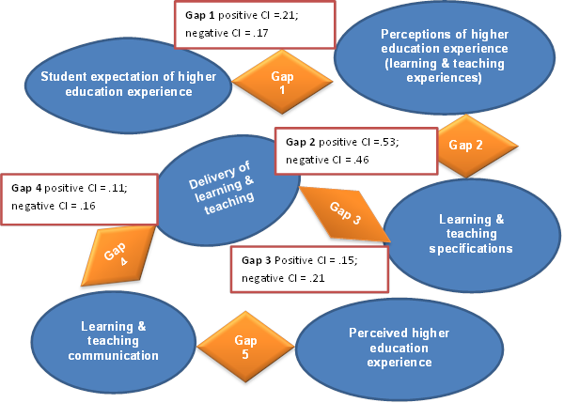
Model showing Proportion of Critical Incidents

Slide 8
Conclusions
When satisfaction is examined and gaps are found in experiences the individual problems may be addressed, but rarely does the intrinsic process change and the errors in service delivery continue.
Over a four year time period and at ten different universities it is the same problems that reoccur.
Higher education is more than services marketing, it is relationship marketing. Although there are classrooms, on-line materials, textbooks etc, the predominant experience is between the students, their administrators and lecturers.
A new slant on the student satisfaction issue would be to accept that student dissatisfaction is always present and instead of asking what students need, spend time offering strategic suggestions to improve the student experience.
Each university needs to examine their Gap 2 and 3 situations and make relevant changes. Together they make up nearly 70% of the complaints. Student perceptions of the L & T experience 46% and the delivery of the L & T at 21%.

