Slide 1

How to develop corporate real estate?
A decision support tool for CREM
ERES 28th June to 1st July 2017 Delft

Slide 2
Content
1. Problem and research question
2. Methodology
3. Current state of research
4. Results from case study and questionnaire
5. Development of a decision support tool
6. Next step and open questions

Slide 3
Real estate managers have to decide regularly between different procurement forms
New space demand
„Many European Companies currently own the freehold interests in most of their properties (e.g. Germany: 70%).“
„Real estate decisions often end up being some of the most complex a company can face.“
Project situation
Budget
Internal resources
Internal requirements
Targets
Organisation
Decision-making process for a procurement form
?

Slide 4
Research questions
What alternatives to property development are open to a company
and how do they differ from each other?
Which determinants have an influence on
procurement decisions in companies' CREM?
How should the corporate decision-making process specific to a project be structured for the selection of a suitable form of procurement?

Slide 5
Content
1. Problem and research question
2. Methodology
3. Current state of research
4. Results from case study and questionnaire
5. Development of a decision support tool
6. Next step and open questions

Slide 6
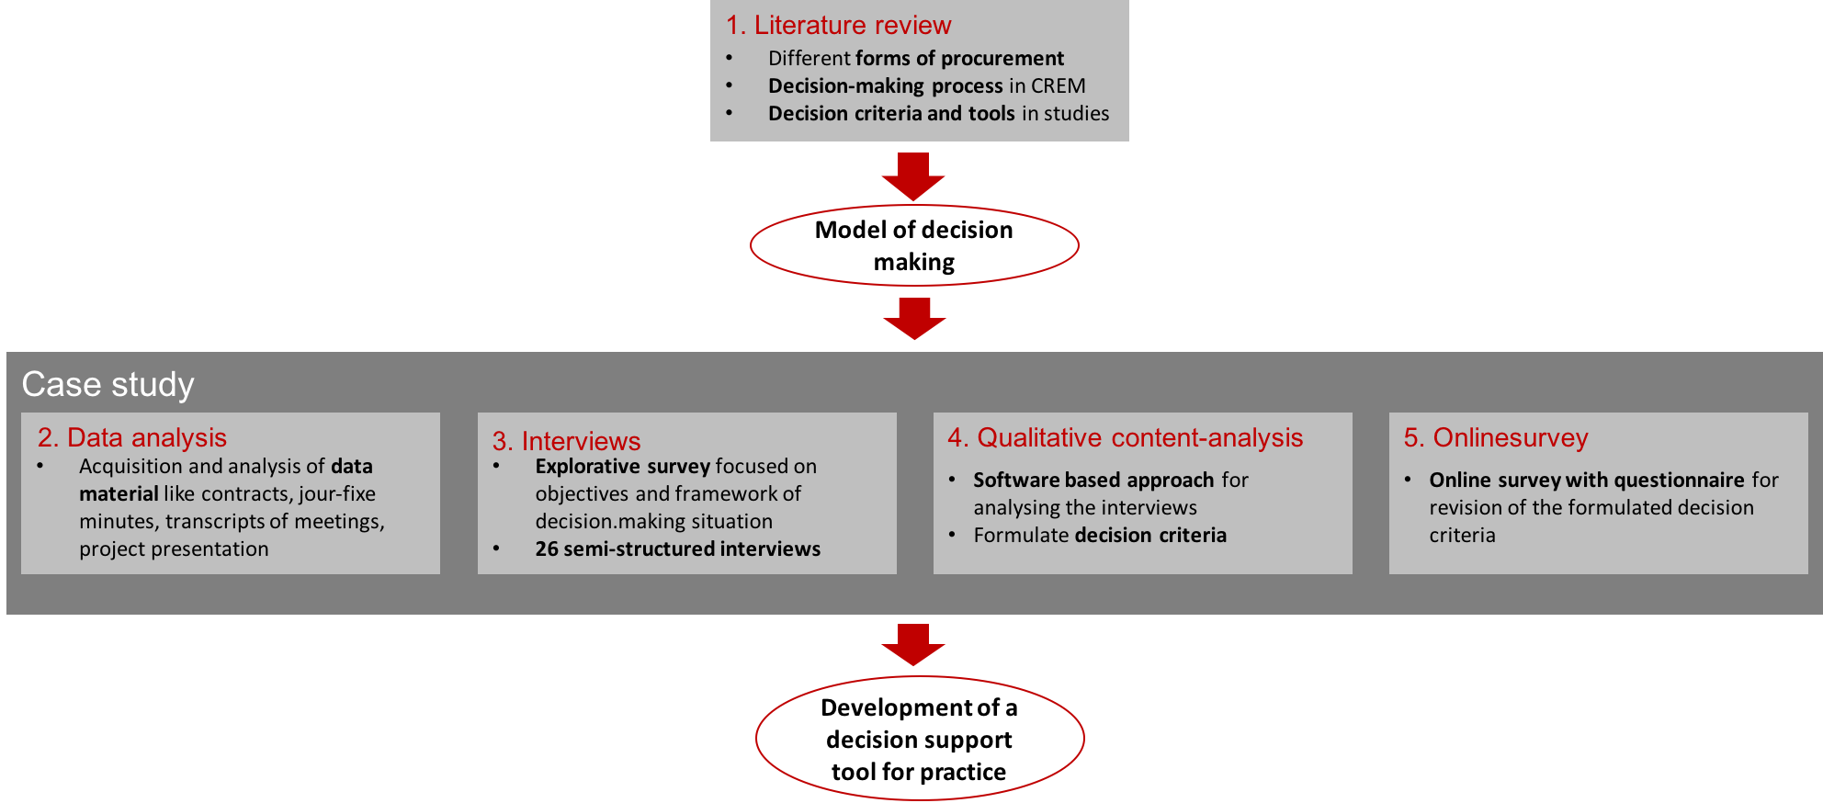
After the literature review there are 4 steps to develop a decision support tool
Source: Paper is accepted and will be published in Journal of Construction Engineering and Project Management

Slide 7
Case study: Project development of an office building
Project details:
Office building for an IT-unit of a chemical company
1,500 working places
38,000 m² total floor area
Project volume: € 70m
Project term: 2 years
Project targets:
Life-cycle approach
Modern, functional and energy-efficient offices
Stakeholders
Principal:
Chemical company
User: IT-unit of the principal
Total contractor: value-added partner
Investor
Town representatives

Slide 8
Content
1. Problem and research question
2. Methodology
3. Current state of research
4. Results from case study and questionnaire
5. Development of a decision support tool
6. Next step and open questions

Slide 9
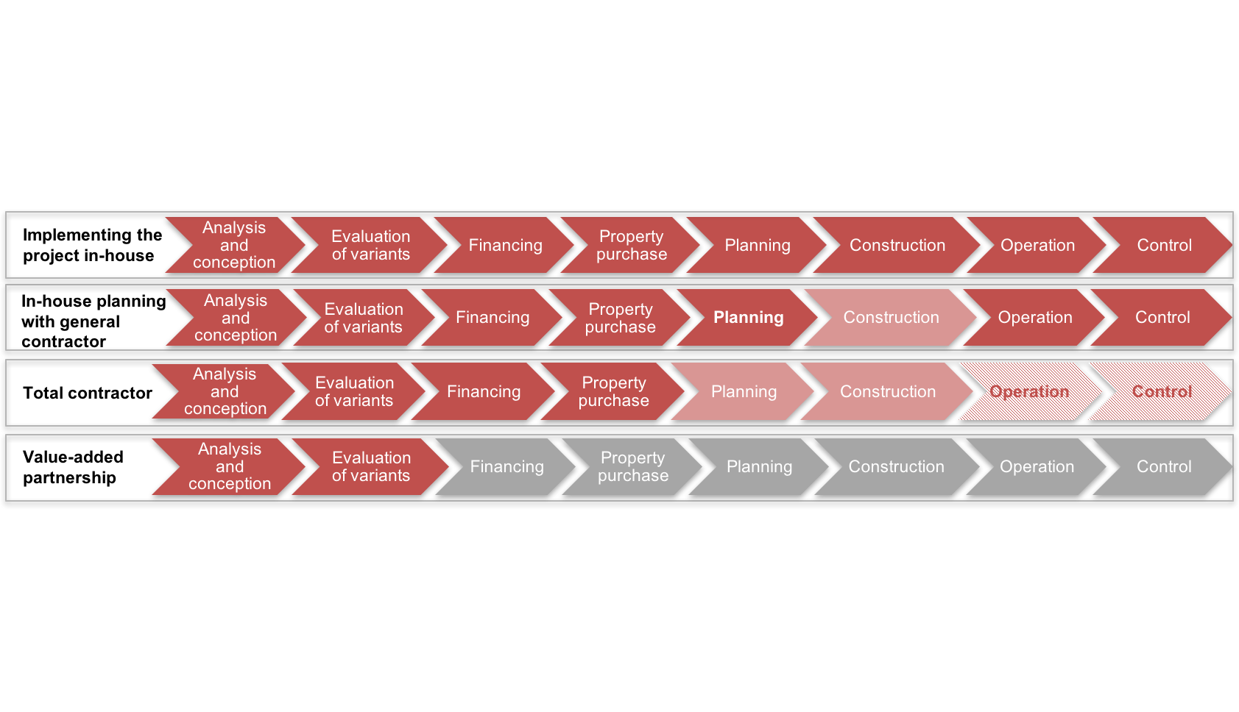
There are various differences between the allo-cation of responsibility in procurement forms
insourcing
outsourcing

Slide 10
  Objectives and influence factors in property development – an excerpt from literature
Source | Objectives | Influence factors
Asson (2002) | Reducing costs, increasing productivity, high customer satisfaction
Bajec (2010) |  | Own core competence and core activity
Cánez (2000) | Increasing responsiveness and quality, time certainty, procurement costs | Limited internal resources, limited availability of in- house technologies, lack of specialist staff, high complexity
Cox (1997) | Aspired degree of control | Internal resources, internal skills
Love (1998) | Speed of planning and construction, certainty of costs and timing, flexibility to requests for changes, quality, risk allocation, clear responsibilities, price competition and resolution of conflicts
McIvor (2008) | Reducing production and transaction costs | The necessary resources or capabilities internally
Ng (2002) | Speed, certainty of timing and price, level of quality, flexibility, responsibility and influence, complexity, price competition, risk allocation, design, investment costs/budget | Complexity, special management requirements
Padillo (1999) | Maximising strategic competitive performance, maximising management performance, minimising procurement risk, maximising financial performance

Slide 11
The decision for a procurement form depends on different factors
Targets:
Time
Costs
Quality
Flexibility
Choice of procurement alternative
Institutionalisation:
Resources and competences
Management requirements
Organisation
Project outcome
and project success
Project conditions:
Complexitiy
User requirements
Source: Paper is accepted and will be published in Journal of Construction Engineering and Project Management

Slide 12
Content
1. Problem and research question
2. Methodology
3. Current state of research
4. Results from case study and questionnaire
5. Development of a decision support tool
6. Next step and open questions

Slide 13
Interview results: 15 decision criteria can be classified in four categories
Control system
Transfer of time risks to the contractor
Transfer of cost risks to the contractor
Transfer of quality risks to the contractor
Reduction of interfaces
Creating transparency in the project with clear communication and sufficient information
Target system
Amount of the investment
Amount of the life cycle costs
Intent of a functional proposal
Intent of a detailed proposal
Organisational structure
Availability of planning resources
Availability of control resources
Planning competence for the specific building
Framework
Position of the building is onside
The corporate will be owner of the building
The corporate will rent the building
Additional input from group discussions
A consistent BIM process for digitisation
Transfer of the security risks to the contractor

Slide 14
Questionnaire results: Many criteria are important for decision makers in CREM
Source: Paper is accepted and will be published in Journal of Construction Engineering and Project Management

Slide 15
Content
1. Problem and research question
2. Methodology
3. Current state of research
4. Results from case study and questionnaire
5. Development of a decision support tool
6. Next step and open questions

Slide 16
The decision making process can be structured hierarchically
Decision problem
Choice of procurement form
Dominance criteria
Long-term programmable usage requirements
Availability of internal resources
Framework
Position on-site
Using internal resources
Transfer of the full responsibility for risks
Creating transparency in the project
Optimising cost factors
Determining degree of details
Criteria
Internal planning resources
Internal control resources
Time risks
Cost
risks
Quality risks
Safety risks
Reduc-tion of interfaces
Informa-tions and commu-nication
BIM for linked digiti-sation
Life-cycle costs
Invest-ment costs
Functio-nal call of tenders
Detailed call of tenders
Sub-criteria
Implementing the project in-house
In-house planning with general contractor
Total
contractor
Value-added partnership
Alternatives
Source: Paper is accepted and will be published in Journal of Construction Engineering and Project Management

Slide 17
With which method could the decision-making process be performed?
Decision problem
Choice of procurement form
Dominance criteria
Long-term programmable usage requirements
Availability of internal resources
Framework
Position on-site
Using internal resources
Transfer of the full responsibility for risks
Creating transparency in the project
Optimising cost factors
Determining degree of details
Criteria
?
Internal planning resources
Internal control resources
Time risks
Cost
risks
Quality risks
Safety risks
Reduc-tion of interfaces
Informa-tions and commu-nication
BIM for linked digiti-sation
Life-cycle costs
Invest-ment costs
Functio-nal call of tenders
Detailed call of tenders
Sub-criteria
Implementing the project in-house
In-house planning with general contractor
Total
contractor
Value-added partnership
Alternatives

Slide 18
There are different methods for the decision-making process
Methods from decision theory
Scenario Analysis
Simple multi-attribute rating technique (SMART)
Analytic hierarchy process (AHP)
Point allocation (PA)
Simple Additive Weighting (NWA)
Multiplicative Exponent Weighting
Technique for Order Preference by Similarity to Ideal Solution (TOPSIS)
Elimination and Choice Expressing Reality
(ELECTRE)
Conjoint Measurement
Fuzzy Method
Specific requirements:
Multiple criteria decision-making (MCDM) problem
15 different criteria need to be considered
Individual prioritisation of the criteria should be allowed (depending on corporate objectives, etc.)
The application should be transparent for the user (the CREM)

Slide 19
The method selection result: a combination of two methods
Method | Reason for/against exclusion
Simple Additive Weighting | Difficult distribution of 100 per cent across the 15 criteria
Multiplicative Exponent Weighting | Difficult distribution of 100 per cent across the 15 criteria
Conjoint Measurement | New alternatives can not be created
Fuzzy Method | Not necessary in this context
Analytic hierarchy process | Using this method enables a consistent, integrated weighting of all the criteria
TOPSIS | Using this method for evaluation is transparent and suitable in connection with AHP for prioritisation
ELECTRE | Lack of transparency for the user
SMART | Lack of transparency for the user
Point allocation | Difficult distribution of 100 per cent (100 points) across the 15 criteria
Scenario Analysis | Highly complex, particularly because of the multiplicity of scenarios required to accord with the different criteria

Slide 20
Three steps for using the decision support tool
1.
2.
3.
Dominance criteria
Checking if an alternative could be excluded because of such a criteria
Prioritisation with AHP
(Analytical Hierarchy Process)
Paired comparison of all (sub)criteria
Calculation of the relative weights
Scale:
Evaluation of the alternative procurement forms with TOPSIS
(Technique for Order Preference by Similarity to Ideal Solution)
The evaluation has to be set up for one time only
Scale:
Criteria A
Criteria B
Are there internal resources?
9
1
9
yes
A is much more important
B is much more important
x
no
1
3
5
low
high

Slide 21
1. Some alternatives can be excluded by answer-ing questions regarding dominance criteria
Question 1: For procurement of corporate real estate you have to decide between ownership and rental. Is your usage requirement and type of usage predictable for at least 5 years?
Question 2: For real estate development there are many different kinds of human resources necessary. Are resources for planning with the required competences available in your company?
Question 3: In many companies there are specific restrictions for working on-site. Is your project situated on-site?
yes
no
yes
no
yes
no
Some alternatives are excluded
(for example if there are no resources for planning in the company the project can not be implemented in-house)

Slide 22
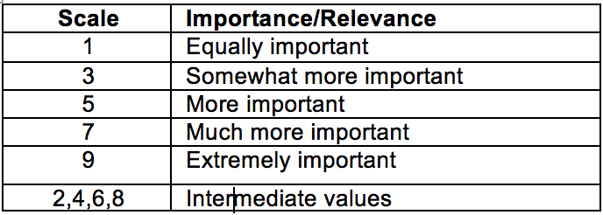
2. The prioritisation takes place in a paired comparison of the criteria
Use of internal resources
9
8
7
6
5
4
3
2
1
2
3
4
5
6
7
8
9
Transfer the responsibility for risks
Use of internal resources
9
8
7
6
5
4
3
2
1
2
3
4
5
6
7
8
9
Creating transparency of procedures
Use of internal resources
9
8
7
6
5
4
3
2
1
2
3
4
5
6
7
8
9
Optimising costs
Use of internal resources
9
8
7
6
5
4
3
2
1
2
3
4
5
6
7
8
9
Determining degree of detail

Slide 23
3. The evaluation of the alternatives by using TOPSIS
 | Implementing the project in-house | In-house planning with general contractor | Total contractor | Value-added partnership
Use of internal planning resources
Transfer the responsibility for time risks
Optimising the investment costs
...
Scale | Suitability
1 | Not suitable
2 | Rather not suitable
3 | Rather suitable
4 | Suitable
5 | Very good suitable

Slide 24
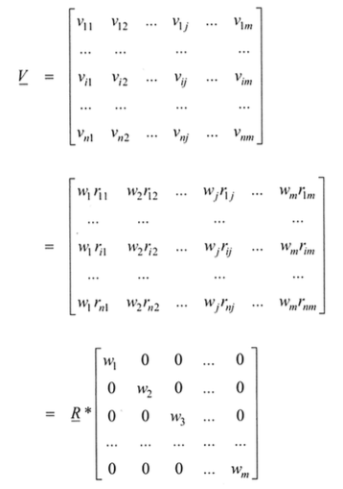
Finally the alternatives must be weighted up with looking on the efficiency measurements
w = weighting
r = value for suitability
vj⁺= best value for suitability for criteria j
vj⁻= worst value for suitability for criteria j
Decision-making by comparing the efficiency measures

Slide 25
Content
1. Problem and research question
2. Methodology
3. Current state of research
4. Results from case study and questionnaire
5. Development of a decision support tool
6. Next step and open questions

Slide 26

Next step ...
Extended survey to analyse the context and importance of identified criteria in the decision-making process of insourcing or outsourcing

Slide 27


Thank you for your attention!
Anne Dörr, M. Sc.
Researcher and PhD student at
Forschungscenter Betriebliche
Immobilienwirtschaft (FBI)
Tel.: +49 (0)6151 16-24513
Email: doerr@bwl.tu-darmstadt.de
Open questions
?
Prof. Dr. Andreas Pfnür
Leader of Forschungscenter
Betriebliche Immobilienwirtschaft (FBI)
Tel.: +49 (0)6151 16-24510
Email: pfnuer@bwl.tu-darmstadt.de
Information to our research center and other research projects
http://real-estate-research.org/

Slide 28
Sources
Some figures are taken from the article: Dörr, A.; Pfnür, A. „How to develop corporate real estate? A decision support tool for CREM“ accepted for publishing in Journal of Construction Engineering and Project Management
Asson, T. “Real Estate Partnership: A new approach to corporate real estate outsourcing“, Journal of Corporate Real Estate, vol. 4, No. 4, pp. 327-333, 2002.
Bajec, P.; Jakomin, I. “A Make- or Buy Decision Process for Outsourcing", Journal of Traffic and Transportation, vol. 22, No. 4, pp. 285-291, 2010.
Cánez, L. E.; Platts, K.W. ; Probert, D. R. “Developing a framework for make-or-buy decisions", International Journal of Operations & Production Management, vol. 20, No. 11, pp. 1313-1330, 2000.
Cox, A. „Business Success", Earlsgate Press, Boston, 1997.
Chan, A. P. C.; Scott, D.; Lam, E. W. M. “Framework of Success Criteria for Design/Build Projects", Journal of Management in Engineering, vol. 18, No. 3, pp. 120-128, 2002.
Fill, C.; Visser, E. “The outsourcing dilemma: a composite approach to the make or buy decision”, Journal of Management Decision, vol. 38 Issue: 1, pp. 43-50, 2000.
Griffith, A.; Headley, J. D. “Using a weighted score model as an aid to selecting procurement methods for small building works", Journal of Construction Management and Economics, vol.15, No. 4, pp. 341-348, 1997.
Hwang,C. L.,Yoon, K. “Multiple Attribute Decision Making – Methods and applications. A State of the Art Survey”, Springer, Berlin, 1981.
Kumaraswamy, M. M.; Dissanayaka; S. M. “Developing a decision support system for building project procurement", Journal of Building and Environment, vol. 36, pp. 337-349, 2001.
Love, P.; Skitmore, M.; Earl, G. “Selecting a suitable procurement method for a building project", Journal of Construction Management and Economics, vol. 16, No. 2, pp. 221-233, 1998.
McIvor, R. “What is the right outsourcing strategy for your process”, Euopean Management Journal, vol. 26, No. 1, pp. 24-34, 2008.
Ng, S. T.; Luu, D. T.; Chen, S. W. "Decision criteria and their subjectivity in construction procurement selection", Australian Journal of Construction Economics and Building, vol. 2, No. 1, pp. 70-80, 2002.
Padillo, J. M.; Diaby, M. “A multiple-criteria decision methodology for the make-or-buy problem", International Journal of Production Research, vol. 37, No. 14, pp. 3203-3229, 1999.
Pfnür, A. “Modernes Immobilienmanagement”, Berlin, Heidelberg, Springer, p. 450, 2011.
Image: http://www.decision-making-solutions.com/rational-decision-making.html

