Slide 1
Construction accident compensation: a structural equation model approach
Author: Rita Yi Man Li, Darren Tat Ki Fung, Beiqi Tang

Slide 2
1. Introduction
Literature review:
Construction safety issues have become important in research and practice in recent years due to the high accident and death rates in the construction industry (Guo, Yu, and Skitmore, 2017).
Li (2015) indicated that the construction accident rates are high in many places and this leads to higher compensation, loss in manpower, and extension of time.
Liao and Chiang (2015) did research on the Taiwan construction industry and found that workers involved in accidents during public projects did not receive enough compensation and the amount of compensation was different between site owners.

Slide 3
1. Introduction
Objectives:
To analyze the relationship between different factors (construction accident & compensation).

Slide 4
Structural Equation Modelling (SEM) approach
The structural equation modelling approach is a popular analysis technique because of the wide range of questions that it can help answer (Schreiber, 2008).
SEM can be used to estimate a cluster of dependent variables without upper limit in the model, which provides a flexible ability to construct the model (Wang & Wang, 2012).
SEM can handle complicated data like count and categorical outcome, non-normal outcome and censored outcome etc. (Wang & Wang, 2012)

Slide 5
Data collection and data analysis
Data was collected from 320 court cases dated from 1982 to 2015, which were all related to construction accidents in Hong Kong.
A latent variable (level of injuries – ‘Inj’) and 13 manifest variables (14 categories of information were recorded and used to construct the model)
Using SPSS AMOS to make the analysis

Slide 6
Data collection and data analysis
14 variables
1. The age of plaintiff (Age) | 2. The gender of plaintiff (Gender)
3. Plaintiff’s monthly income before accident (ME) | 4. Future loss of earning (Futureloss)
5. Pre-trial loss of earning (Pretrial) | 6. Loss of earning capacity (LossofEC)
7. Special damage (SD) | 8. Future treatment (FT)
9. Death of plaintiff (Death) | 10. Duration of judgment (Duration)
11. Level of court (LC) | 12. Contributory negligence (CL)
13. Pain, suffering and loss of amenities (PSLA) | 14. Level of injuries (Inj)

Slide 7
Data collection and data analysis
Detail of some variables
Name of the variables | Details
Pre-trial loss of earning | Financial losses incurred in accident such as medical expenses for cueing and loss of income.
Special damage | A kind of pre-trial loss compensation award related to financial loss such as expenses for wheelchair and crutches or compensation for family member as carer for the plaintiff.
Future loss of earning | A part of injury reward which is calculated according to the income of plaintiff prior to the accident. The calculation takes the expected future disability and the extent of disability due to the accident into account.
Loss of earning capacity | Another compensation award given to the plaintiff based on the probability of losing their job at some time in the future because of the injury suffered.
Pain, Suffering, Loss of Amenities (PSLA) | A kind of compensation award due to non-financial damage. It considers the physical pain and dispassionate to life due to injury. If plaintiffs’ ability to enjoy their life was diminished because of the accident, then it refers to loss of amenities, which can be compensated by the award of PSLA. The pre-accident life of the plaintiff will be examined in order to formulate the compensation amount.
Future treatment | Future treatment refers to the medical expenses expected to be used for recovery in the future.

Slide 8
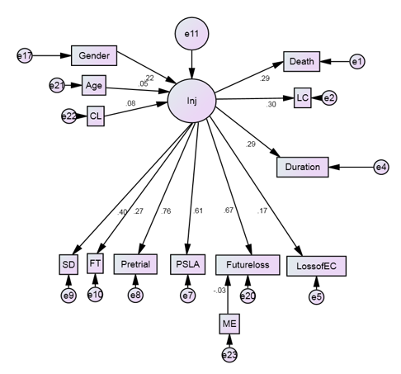
Data collection and data analysis
SEM with logical path distribution between 14 variables

Slide 9
Data collection and data analysis
Descriptive Statistic for variables in Base Model
Variables | Mean | Range
Gender | N/A | 0(Female) | 1 (Male)
Death | N/A | 0(Alive) | 1 (Death)
Contributory Negligence | N/A | 1 (Yes) | 0 (No)
Level of Court | N/A | 1 (CFA) | 3 (DC)
Age | 40.8 | 19 | 65
Monthly Earning Before Accident | $14,273 | $4,400 | $58,575
Future Loss of Earning | $496,619 | $47,040 | $3,990,060
Loss of Earning Capacity | $42,510.96 | $0 | $1,659,168
PSLA | $247,921.6 | $0 | $2,250,000
Pre-Trial loss of Earning | $382,583.2 | $5,460 | $2.335.904
Special Damage | $26,723.7 | $0 | $1,036,439
Future Treatment | $35,535,7 | $0 | $2,319,040
Duration of Judgment | 4.42 years | 2 years | 10 years

Slide 10
Data collection and data analysis
Parameter Estimate of Base Model
 |  |  | Estimates (Group number 1 - Default model) | Scalar Estimates (Group number 1 - Default model) | C.R. | P-value
Inj | <--- | Gender | 0.126 | 0.051 | 2.489 | 0.013
Inj | <--- | Age | 0.029 | 0.051 | 0.566 | 0.572
Inj | <--- | CL | 0.113 | 0.118 | 0.962 | 0.336
Death | <--- | Inj | 0.506 | 0.16 | 3.153 | 0.002
LC | <--- | Inj | 0.516 | 0.16 | 3.22 | 0.001
Duration | <--- | Inj | 0.544 | 0.17 | 3.196 | 0.001
SD | <--- | Inj | 0.307 | 0.073 | 4.23 | ***
FT | <--- | Inj | 0.166 | 0.056 | 2.979 | 0.003
Pretrial | <--- | Inj | 1.163 | 0.171 | 6.801 | ***
PSLA | <--- | Inj | 0.752 | 0.123 | 6.133 | ***
Futureloss | <--- | Inj | 1
LossofEC | <--- | Inj | 0.115 | 0.06 | 1.913 | 0.056
Futureloss | <--- | ME | -0.026 | 0.066 | -0.388 | 0.698

Slide 11
Data collection and data analysis
Good-fit index of base model
CMIN/DF | RMR | GFI | AGFI | TLI | CFI | RMSEA
2.577 | 0.074 | 0.863 | 0.808 | 0.523 | 0.603 | 0.099
GFI (goodness-of-fit index) and CFI (comparative fit index) are less then 0.9; while RMSEA is over 0.05.
Just fair for the linear fit

Slide 12
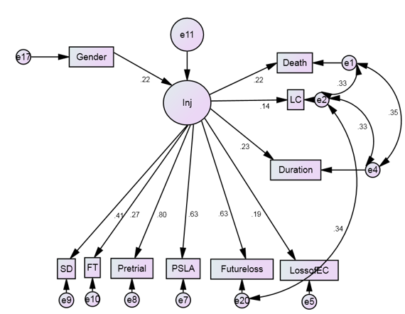
Data collection and data analysis
A modified model for the more accurate interpretative purpose

Slide 13
Data collection and data analysis
Parameter Estimate of modified Model
 |  |  | Estimate | Scalar Estimates(S.E.) | C.R. | P-value
Inj | <--- | Gender | 0.115 | 0.048 | 2.392 | 0.017
Death | <--- | Inj | 0.413 | 0.169 | 2.44 | 0.015
LC | <--- | Inj | 0.252 | 0.16 | 1.575 | 0.115
Duration | <--- | Inj | 0.457 | 0.18 | 2.538 | 0.011
SD | <--- | Inj | 0.335 | 0.078 | 4.274 | ***
FT | <--- | Inj | 0.177 | 0.059 | 2.975 | 0.003
Pretrial | <--- | Inj | 1.293 | 0.198 | 6.545 | ***
PSLA | <--- | Inj | 0.822 | 0.135 | 6.086 | ***
Futureloss | <--- | Inj | 1
LossofEC | <--- | Inj | 0.136 | 0.064 | 2.124 | 0.034

Slide 14
Data collection and data analysis
Good-fit index of modified model
CMIN/DF | RMR | GFI | AGFI | TLI | CFI | RMSEA
1.405 | 0.027 | 0.95 | 0.912 | 0.921 | 0.946 | 0.05
GFI (goodness-of-fit index) and CFI (comparative fit index) are over 0.9; while RMSEA is equal to 0.05.
Demonstrate a significant improvement for the linear fit

Slide 15
Data collection and data analysis
The amount of future loss of earning equates with the level of injury.
Higher level of injury lead to a decline in productivity and higher compensation should be used to ‘compensate’ the injured employee.
The level of injury exhibits a significant positive effect on duration of judgment.
When a worker suffered from complicated or multiple injury, which needs more time for healing, the increases the time for getting the medical report, and for evaluating the compensation that should be paid to cover the losses to plaintiff.

Slide 16
Contribution of the Model
The research provides a general highlight on the discovery of the relationship between various variables from the nature of accident to the total amount of compensation claimed.
As a reference for the others to analyze the issue of construction accident and compensation.

Slide 17
Limitation of constructing SEM
There is little exact economic literature that has previously discussed the relationship between the compensation items with accidental injuries.
The cross-sectional nature of the tested variables is also a limitation as all the cases are within Hong Kong.

Slide 18
End

