Slide 1
Assessing urban quality of life through activity modeling : A multidimensional approach in modelling and measuring Urban Quality Of Life
PhD Candidate: Lida Aminian
Supervisor: Harry Timmermans

Slide 2
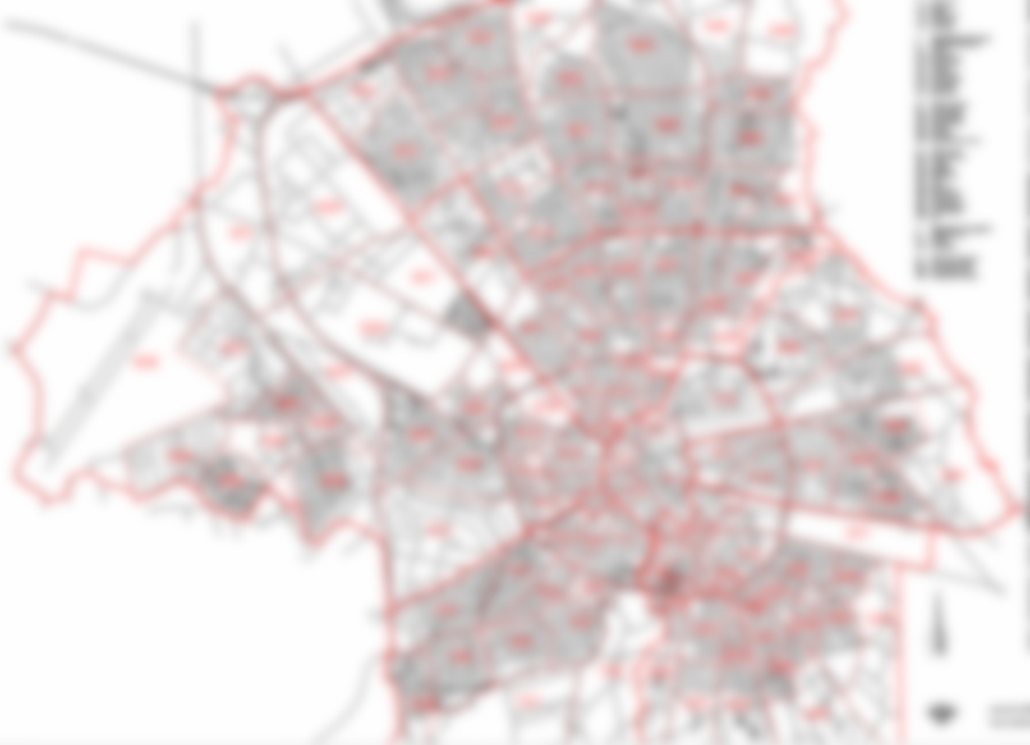
Motivation of the study Quality of life, a key concept in urban studies
The outputs from UQOL studies are useful for:
Policy evaluation (van kamp et al. 2003)
Rating of places (Pacione 2003)
Understand and prioritize the problems formulation of urban planning and management strategies(Marans 2008)
Diagnose previous policy strategies and to design future planning policies (Lee 2008)
Identify the problem areas, causes of dissatisfaction and people’s priorities in life (Tesfazghi et al. 2009).
UQOL can motivate residential choices, regional migration patterns and urban growth, therefore it is a research priority in urban planning from both academic and policy sides.

Slide 3
Activity modeling & QOL
The relationship between QOL and urban environment is complex , People have different evaluation system for their QOL in general and UQOL in particular based on their personal characteristics.
Hence, modeling the urban system with its components is the most rational way to capture the interconnection between people and their environment.
How people fits in the environment and how environment responses to residents needs is a multifaceted correlation, which requires detailed evaluation criteria and descriptions of evaluation methods
So, the satisfaction regarding built environment can be measured through behavioral indicators & daily activity schedules of households and individuals is one of the methods that provide opportunity to study the link between characteristics of urban form and micro –level behaviors.
Therefore, the purpose of this research is to provide an overview of this link and explore the relationship between the built environment and physical activity with more innovative and comprehensive spatial survey methods.

Slide 4
Conceptual model
People
Value
- House
- Office (work place)
- Neighborhood
Environment
Judgement
Space
Activity
Person
- Individual
Household
- At home activities
- At work activities
- Service activities
- Transport activities
- Leisure activities
- Social activities
Time
Day
Week
Year
Life

Slide 5
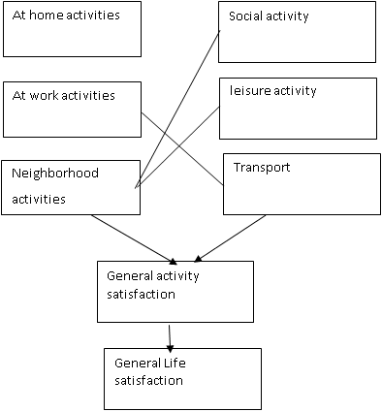
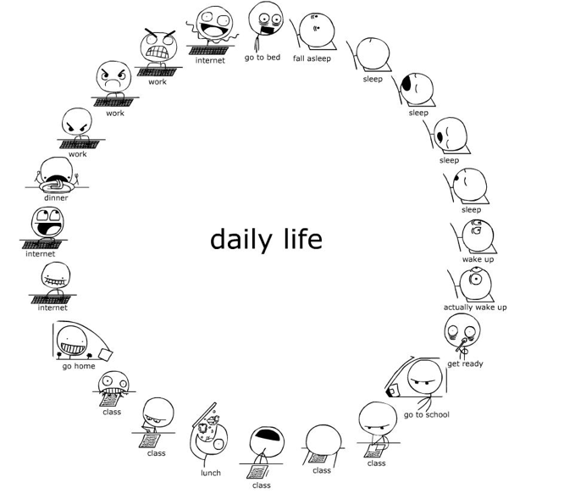
Survey design
Space
Activity
Person
Time

Slide 6
House-activity Survey
to evaluate the dwelling satisfaction it is good to see how much the features of the house are suitable for committing different activities.
In this regard, main aspects that increase the quality of space and also main activities at house should be defined.
For our study, size, light, privacy and layout of spaces are the main aspects and 6 group of activities have been listed. So the respondents have been asked to rate their satisfaction of each space aspect for performing different activities. On the other hand we also asked how much time respondent stay at home.

Slide 7
House-Activity satisfaction
Ownership 2
Ownership Satisfaction
Size3
Size Satisfaction
Reading-working
Reading-working size
Price6
Price Satisfaction
Reading-working layout
Taking shower-WC size
Taking shower-WC
Num of Bedrooms 4
Num of Bedrooms Satisfaction
Reading-working light
Taking shower-WC Privacy
Type of House Satisfaction
Reading-working privacy
House Activity satisfaction
Taking shower-WC light
Type of House 4
Age of house Satisfaction
Taking shower-WC layout
Age of house10
Sleeping-resting
Sleeping-resting size
Exterior Space7
Exterior Space Satisfaction
Sleeping-resting layout
Entertaining size
Entertaining
Sleeping-resting privacy
Entertaining layout
Energy3
Energy Satisfaction
Entertaining privacy
Sleeping-resting light
Design/ layout 2
Design/Layout Satisfaction
Entertaining light
Interior Quality7
Interior Quality Satisfaction
Sitting outside
Sitting outside size
Cooking-eating size
Cooking-eating
Safety security3
Safety security Satisfaction
Sitting outside Layout
Cooking-eating light
Sitting outside Privacy
Cooking-eating layout
View6
View Satisfaction
Sitting outside
light
Cooking-eating privacy
Parking ownership
Parking Satisfaction

Slide 8
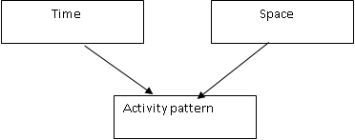
Neighborhood satisfaction
In addition to the dwelling attributes, the location of the house is also a potentially significant determinant in household satisfaction since it is associated with all other activity locations such as work, parks, restaurants, etc.
This clearly indicate that the possibility of engaging in different activities within a certain time horizon can be very much dependent on house location.
Residents usually think of the time it takes for them to reach to different facilities. So travel time to the different services is a significant factor and used as an attribute to
measure satisfaction.

Slide 9
Neighborhood-Activity satisfaction(1)
Neighborhood activities
Physical
activity
Service
activities
Walking
Biking
Grocery shopping
Visit Medical or Health Care
Visit sport center
Other shopping
Visit Park/green space
Going to cafe /restaurant
Educational activity
Quality of path
Streets cleanness
Size of the road
Safety/cars
Safety/ crime
Noise
Air quality
View(trees, greenery…)
crowdedness

Slide 10
Neighborhood-Activity satisfaction(2)
7 GROUP of activities and accordingly 7 important service spaces have been listed to see how people evaluate their satisfaction regarding the significant factors to commit the service activities at their area.
Activities
 | Satisfaction
 | Do not commit the activity often | Time schedule of service activity | Quality of facility | crowdedness | Parking availability | Travel time
Grocery shops | □
Medical or Health Care | □
Educational (schools, daycare) | □
Sport center | □
Other Shops | □
Park Green space | □
Café restaurant | □

Slide 11
Job satisfaction
Job satisfaction
Work situation
Work load
Quality of work
Work Location
Travel time
People at work
Salary
Access to public transport
Safety of area
Availability of shops restaurant
Work space
Access
Privacy
Noise
Furniture/tools, technology
Size

Slide 12
Transportation satisfaction
Peak hours
Cost
Travel time
Safety of roads
Private transport
Traffic congestion
Off peak hours
Parking availability
Parking cost
Transport
Peak hours
Cost
Public transport
Travel time
Waiting time
Off peak hours
Inside means quality
Walking-biking
Safety
Stop/station distance to home

Slide 13
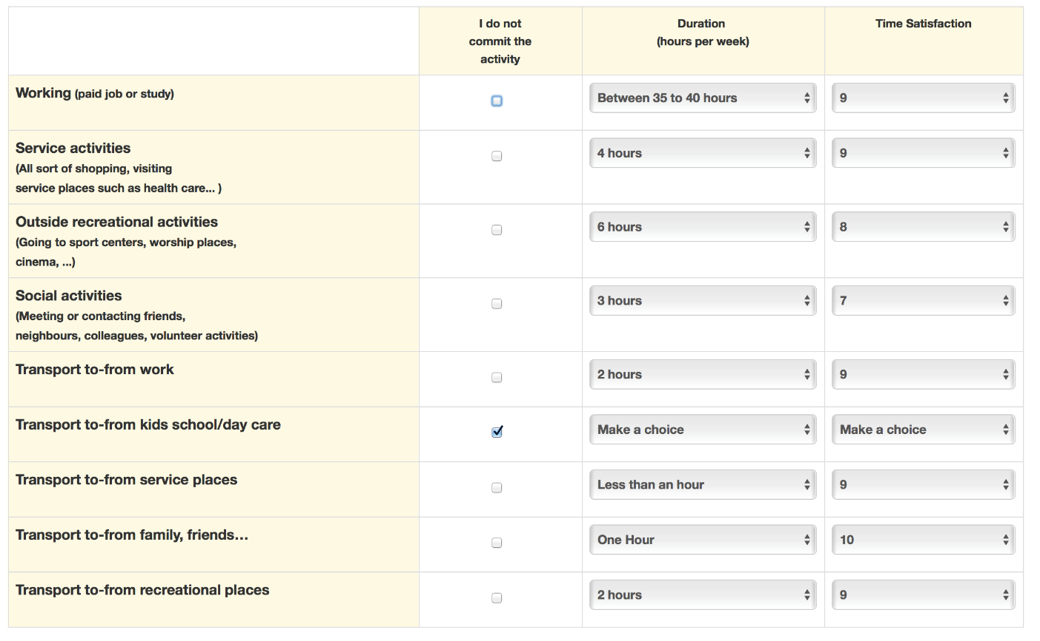
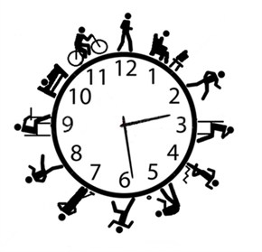
Activity-Time satisfaction

Slide 14
Thank you for your attention
Comments and questions?

