Slide 1
The determinants of European non-listed real estate funds’ performance
Giacomo Morri
Ugo Perini

Slide 2
Research Questions
How the amount of fees charged by a non-listed real estate fund, together with its duration, size and leverage, affects the performance of the fund?
Do the findings hold when conducting the research separately for core and value-added funds ?
Has the relationship between the independent variables and performance been affected by the Global Financial Crisis?

Slide 3
Fee structure in fund management industry
Distribution charges
Securities transaction fees
Shareholder transaction fees
Fund service charges
Shareholder communication expenses, connected to the costs of disclosure of prospectus, reports, or any documents relevant to the investors
Administrative expenses
Registration fees
Fees paid to external professionals, such as auditors and lawyers
Board of directors’ costs
Management fee
Performance fee
(Pozen and Hamacher, 2011)

Slide 4
Fee characterizing a real estate fund
Load Fees
Marketing Fees
Management Fees
Redemption Fees
Performance Fees
adapted from Pagliari, 2013
Notes:
Load Fees → subscription costs
Marketing Fees → intermediaries costs

Slide 5
Literature review
Several studies on mutual funds….
…but only a few on real estate funds
Different characteristics of real estate funds:
marketed only to institutional investors
investors’ decision is often preceded by a direct contact with the management company
real estate assets are less liquid than other financial assets
real estate assets require active management

Slide 6
Literature review: fees
The majority of the studies provide evidences about the existence of a negative relationship between the fees charged by a fund and its performance:
Gruber (1996) revealed that the expense ratio for the best performing mutual funds increases more slowly than that of the worst performing ones
Carhart (1997) confirms the existence of a negative relationship between fee and performance
Elton et al. (1993) found that rationale investors should avoid picking those charging the higher fees since these will systematically underperform other funds by an amount proportional to the difference between the fees
Morningstar (2015) confirmed the existence of a negative relationship between fees and return

Slide 7
Literature review: fees
Other studies showed that the relationship between the fees applied by a mutual fund and its performance may vary based on the geographical location of a fund (Ferreira et al., 2012, Otten and Barms, 2002)
The relationship between fees and performance may be affected by some specific characteristics of a fund, such as investment style or its size (Garyn-Tal, 2015, Khorana et al., 2008)

Slide 8
Literature review: fees
Even if the majority of the studies discovered that there exists a negative correlation between the two elements, some studies produced slightly different evidences:
Ippolito (1989) established that funds charging higher costs are the ones that generate higher returns
Zheng (1999) suggests the existence of a positive relation between the charges of a fund and its return
Grinblatt and Titman (1994), found no significant correlation between fees and performance
Berk (2005) claims that the fees charged by a fund appear to be proportional to the extra value generated by an active portfolio manager

Slide 9
Literature review: leverage in Real Estate
The use of leverage for listed real estate investments such as REITs is not truly beneficial
Howe and Shilling (1998), the absence of specific tax benefits makes difficult for REITs to compete for debt, and so they tend to favour equity
Alcock et al. (2013), leverage is not an effective long-term strategy to enhance the return a REIT is able to deliver, while it can bring marginal benefits in the short term
Baum et al. (2011), the use of leverage has a negative impact on the performance of listed real estate funds
The effect of leverage on the performance seems to vary based on the investment style adopted by a fund
Shilling and Wurtzebach (2010), the performance of core and value-added funds is boosted by the use of leverage
Fuerst and Marcato (2009) discovered that leverage is particularly effective in improving the performance of core open-ended funds

Slide 10
Literature review: size in Real Estate
Most of the studies reported that the relationship between the size and the performance of a fund is positive
Kaushik and Pennathur (2012), during the period 1990–2008, found that larger funds earned a greater return than smaller vehicles
Chous and Hardin III (2013) explained the existence of the extra performance generated by larger funds with the presence of economies of scale, allowing to reduce the costs per unit and, as a consequence, enhancing the return of the fund
Lin and Yung (2004) found that larger dimensions are associated with better fund returns by the presence of economies of scale and also by the evidence that the larger founds have greater financial resources enabling them to afford better portfolio managers and enable better research

Slide 11
Sample
Blind data at fund level provided by Inrev
363 funds (Core and Value Added)
around 83% of the European non-listed vehicles active in the period
between 2001 and 2014
the large time extension allows to avoid any potential survivorship bias
funds that changed their fee policy during the time interval are excluded
unbalanced panel of data consisting of 2,540 individual observations
the number of observations collected for each fund is based on its duration that varies from one vehicle to another

Slide 12
Methodology
Y_{ij =} B₁ + B₂X_{2ij} + … + B_{p}X_{pij} +e_{ij}
Notes:
random intercept model is appropriate:
Wald test
Hausman’s test
the normality check on the level-1 and level-2 residuals show that hypothesis of normal distribution are respected
[Wald test to test the hypothesis that the coefficients of the cluster means are all zero]

Slide 13
Variables statistics

Slide 14
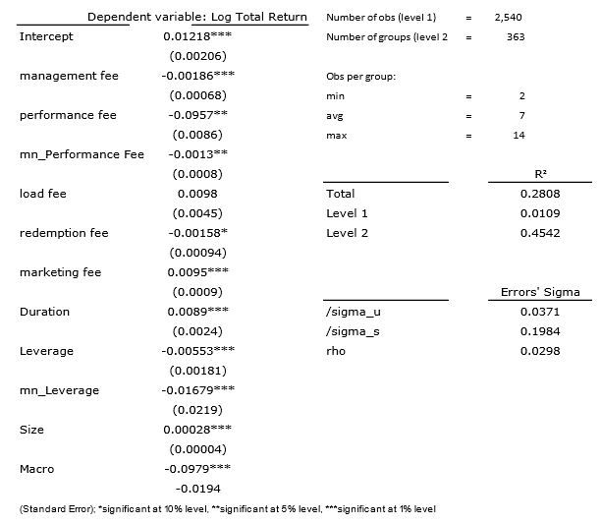
Results
Marketing fee
Duration
Size
Performance fee
Management fee
Redemption fee
Leverage
Macro

Slide 15
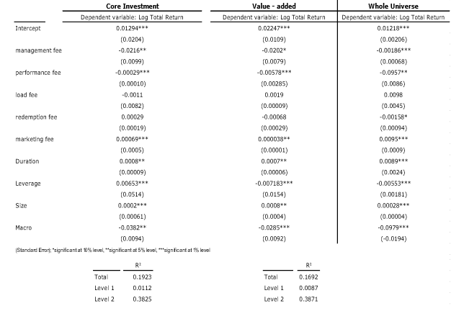
Results by investment style
The proper amount of leverage is crucial to enhance the performance of a fund

Slide 16
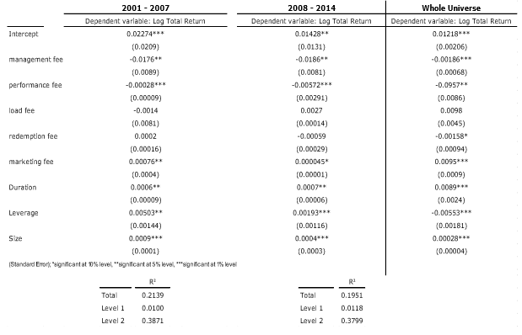
Results by period

Slide 17
Conclusions
All the variables, with the exception of the load fee, included in the analysis have a statistically significant effect on the returns of the funds. Fees have a negative impact on the performance.
The effects of leverage on the performance of a fund vary according to the investment style of the fund
The GFC did not affect the relationship between the return of a fund and the independent variables that have been included in the model.

Slide 18
Giacomo Morri, PhD
SDA Professor of Corporate Finance & Real Estate
Professor of Real Estate Finance, Finance Department, Bocconi University
SDA Bocconi School of Management Bocconi University
Milano – Italy giacomo.morri@sdabocconi.it
www.sdabocconi.it/realestate
www.propertyfinance.it/it/en → Real Estate Resources and Links

