Slide 1
The party’s over: How private residential landlords are experiencing a changing policy and financial environment in Scotland
Farhad Farnood and Colin Jones
Heriot-Watt University

Slide 2
Introduction
Within Europe, however, the nature and experience of the PRS in different countries is diverse
Private landlords in the UK experienced a boom period between 1997 and 2007
Drawn by the availability of mortgage finance and the combination of rental returns and capital growth.
‘Golden decade’ was brought to an end by GFC
But this paper looks beyond this at the subsequent decade

Slide 3
Brief History Sketch
At beginning of 20th century PRS was dominant tenure
It experienced legislative control of both rent levels and security of tenure for most of century
Owner occupation and social housing increased their share of the overall UK housing stock at the expense of PRS
PRS was moribund
Housing Act 1988 reintroduced landlords’ right to set market rents and introduced six month tenancies and reduced security of tenure

Slide 4
Beginnings of a Revival
1988 Act was the potential basis for a revival
BUT the housing market was in downturn that stretched through first half of 1990s
PLUS finance for landlords was difficult
In September 1996 a new mortgage product, ‘buy to let’, was launched tailored for people to invest in the PRS
Lenders required properties to be managed by a registered letting agency and be let on six month tenancies
Seeds were sown

Slide 5
Rise of Buy to Let
By 2001 BTL lending became increasingly mainstream with high street banks and major building societies offering landlord mortgages
Private landlords soon began to flock to the market attracted by the combination of rental returns and capital appreciation
Across UK in 2000 just 4% of all mortgage advances were BTL but by 2006 this figure had grown to 29%
Nearly 7 times BTL loans made in 2006 as 2001 as housing market boomed

Slide 6
Underpinnings of Boom
BTL landlords benefited from a lucrative combination of a booming property market and high and rising rental returns
Willingly assisted by mortgage lenders
Highly geared investment, funding most of purchase price with mortgage
Study in 2007 found BTL landlords had made an annual average compound return of 23.25% per year over previous five years
Returns were remarkably consistent across all regions of the UK

Slide 7
Statistics of Returns
Rental returns of 5%
Asset values rising too
Within period 1997 to 2007 there were five years – 1999 and 2001 to 2004 when total returns were almost or greater than 20%
These assume 100% ownership
Geared returns will be a lot higher taking into account the actual capital invested (perhaps only 5% of property values) and mortgage repayments
Rises in asset values and remortgaging enabled some BTL investors to build their portfolios at a rapid rate

Slide 8
Global Financial Crisis 2008/09
Extent to which BTL landlords were affected by GFC determined bypoint at which they entered the market
Early entry and the lower the leveraging the less the significant falls in house prices during 2008/ 9 would affect viability of a landlord’s investments
Those who entered at end of boom - highly leveraged may have become part of the dramatic rise in repossessions reported in 2009 and beyond
Dramatic profits accrued during boom but bust brought with negative equity, a collapse in returns and even repossessions
In 2008 10% of total repossessions were BTL with 4000 properties repossessed
Not until 2013 that repossession level began to return to pre-crisis levels

Slide 10
Post GFC Market Characteristics
Tightened lending criteria
Lack of growth in property asset values
Very low interest rates
Strong tenant demand
Unaffordability of home ownership

Slide 11
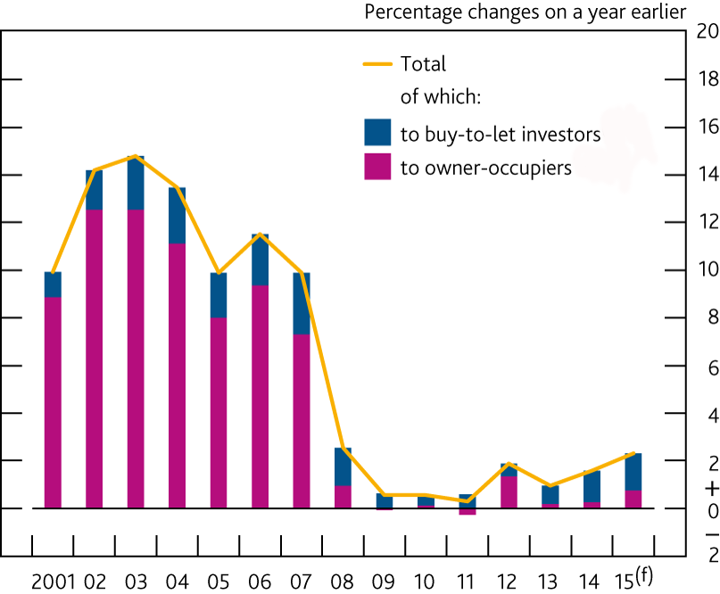

Slide 13
Recent Tax Changes
Landlord buying after the 1st April 2016, pays an extra 3% charge
Landlord in Edinburgh adding an average value property of £234,658 to portfolio has an additional cost of over £7,000
Significant change to the treatment of mortgage interest relief on second homes including buy-to-lets
Over 4 yrs the rate at which relief on mortgage interest payments can be claimed will reduce down to basic tax rate of 20%
Higher rate (40%) tax payer landlords whose mortgage payments interest is 75% or more of rental income will no longer make a profit
From 1 April 2016 Wear and Tear Allowance which enabled landlords to claim tax relief of 10% of rental income replaced with deductible receipted expenses for capital expenditure on replacements/ refurbishments

Slide 14
Regulatory Changes
Since millennium landlords have been subject to a range of ‘consumer regulation’ on quality of the properties or way rent deposits are handled
In Scotland we have new changes in rent regulation and increased security of tenure
Not certain how landlords will respond

Slide 15
Conclusions
During boom economics of being a private landlord became irresistible
GFC brought these benevolent market conditions to an end
However, GFC greatly reduced the affordability of home ownership as lending criteria tightened
Result was PRS continued to grow as a proportion of all housing provision
Private landlords in Scotland have been affected by policy and legislation from both the UK government in Westminster and the Scottish government
Policies have reduced attractiveness of the PRS as an investment
Squeeze on landlords fiscally and in regulatory terms
But strong signs that PRS in Scotland is now a mature market based on the stability of tenure share, the more modest but consistent returns and the characteristics of regulation that match other mature private rental markets across Europe

