Slide 1
Real Estate Valuation And Forecasting In Non-homogeneous Markets: A Case Study In Greece During The Financial Crisis
A. K. Alexandridis
University of Kent
D. Karlis
Athens University of Economics and Business.
D. Papastamos
Eurobank Property Services S.A.
D. Andritsos
Eurobank Property Services S.A.

Slide 2
Outline
Motivation
Introduction
Decline of the Greek housing market
Necessity for Automated Valuation Models (AVMs)
Approaches in real estate valuation
Data description
Sample
Geographical Distribution
Distribution of Properties
Set of Initial Variables
Methodology
Multiple Regression Analysis
Similarity Measure Valuation
Neural Networks
Results
Conclusions and Future work

Slide 3
Motivation
Dimitrios A. Papastamos / ERES 2017 - 28 June-01 July
In recent years big financial institutions are interested in creating and maintaining property valuation models
The main objective is
to use reliable historical data in order to be able to forecast the price of a new property in a comprehensible manner
and to provide some indication for the uncertainty around this forecast
In this paper we develop a mass automatic valuation model for property valuation using a large database of historical prices from Greece

Slide 4
Motivation
Past studies
Focus on large and developed markets (Rossini et al 1992, 1993 etc.).
Small datasets (Tay and Ho ;1992 etc)
The Greek property market
inefficient
non-homogeneous market
still at its infancy and
governed by lack of information
As a result modelling the Greek real estate market is a very interesting and challenging problem

Slide 5
Introduction
The global crisis led to a significant decline in house prices
Financial institutions were the ones most affected with major financial losses
At the moment the Greek market is experiencing an unprecedented situation regarding the current valuations and the future trends
The residential market in Greece has experienced significant contraction over the last 9 years

Slide 6
Decline of the Greek housing market
Since the start of the financial crisis
the private construction activity in Greece is reduced by almost 80%
the house prices showed a cumulative decrease of 41%
43.5% and 45.1% in metropolitan areas such as Athens and Thessaloniki respectively
At the period 2008q1-2015q4
the ratio of non-performing loans to total bank loans increased by 30.9ppts (and by 38.4ppts if restructured loans are also taken into consideration)
35.6% (and 43.5%, respectively) at the end of that period

Slide 7
Necessity for Automated Valuation Models (AVMs)
The need for unbiased, objective, systematic assessment of real estate property has always been important
Banks need assurance that they have appraised a property on a fair value before issuing a loan
The government needs to know the market value of a property (i.e. taxation purposes)

Slide 8
Approaches in real estate valuation
Traditional valuation methods include various expressions of linear regression
multiple, stepwise, quantile, robust and additive regression approaches using hedonic models
Recently more advanced methodologies have been employed
neural networks, fuzzy logic, multi-criteria decision analysis and spatial analysis
Mixed results
Advanced techniques not always outperform simple linear regression

Slide 9
Data Description: Sample
The data were provided by the Eurobank Property Services S.A.
Hedonic characteristics of real estate properties
The sample consists of 36,527 properties that have been professionally evaluated in the period 2012 – 2016
240 different administrative sectors covering all areas in Greece
32 aggregated administrative areas (Index Areas)
The in-sample consists of 32,477 properties while the out-of-sample contains 4,050 properties

Slide 10
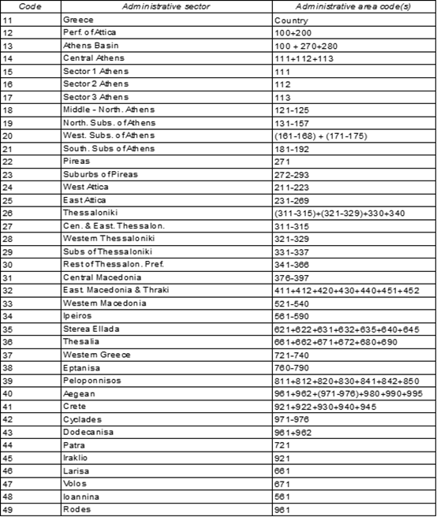
Data Description: Geographical Distribution

Slide 11
Data Description: Geographical Distribution
The majority of the properties are located in the capital or in large cities

Slide 12
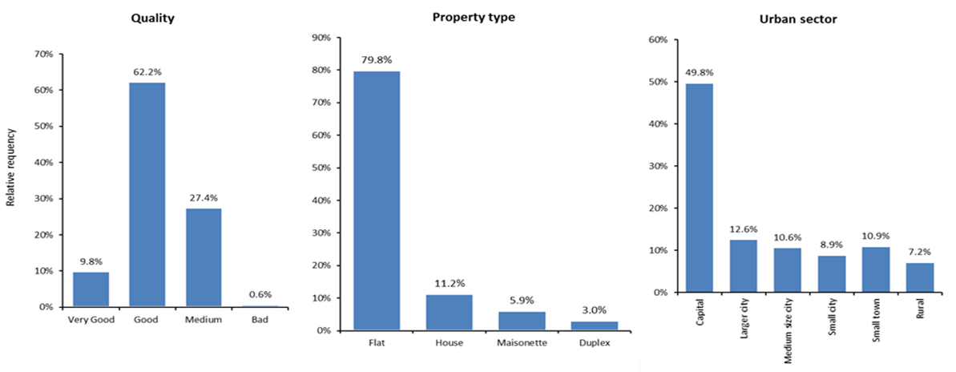
Data Description: Distribution of Properties
80% of the properties are flats
11% are houses
6% maisonettes
3% of type duplex

Slide 13
Data Description: Initial set of variables
V01 | Record code | Value
V02 | Year of valuation | Year
V03 | Month of valuation | Month no.
V04 | Administrative sector | Code value
V05 | Urban classification | Code value
V06 | Survey value | Euro
V07 | Type of residence | Code value
V08 | Usable residence area | Sq. m.
V09 | Land area | Sq. m.
V10 | Year of construction | Year
V11 | Distance from CBD | km
V12 | Floor | Number
V13 | Total number of floors | Number
V14 | Existence of parking space | Yes/no (1/0)
V15 | Type of parking | Yes/no (1/0)
V16 | Type of heating | Code value (0-3)
V17 | Quality of construction | Code value (0-3)
V18 | Number of bedrooms | Number
V19 | Touristic hotspot | Yes/no (1/0)
V20 | Elevator | Yes/no (1/0)
V21 | View | Yes/no (1/0)
V22 | Number of bathrooms | Code value

Slide 14
Methodology
Multiple Regression Analysis
Similarity Measure Valuation
Neural Networks
Variable Selection – Model Identification
Parameter tuning for neural network generalisation improvement

Slide 15
Multiple Linear Regression
Typical hedonic regression model for each index area
Forward variable selection

Slide 16
Similarity Measure Valuation
Based on a “Representative Asset” – The “average” property in the database
The value of each property is converted to its hedonic value
Each value is updated

Slide 17
Similarity Measure Valuation
All available properties in the database are ranked based on their similarity with the property under consideration
After selecting the most suitable properties, a weighted RA value is obtained
Convert the WRAV into the weighted value based on the characteristics of the property under valuation

Slide 18
Neural Networks
Previous studies show that neural networks do not perform adequately
Overfitting
We propose a three-layer NN
Train – Levenberg-Marquardt algorithm
Special care for parameter tuning for neural network generalisation improvement
Model Identification – Alexandridis and Zapranis (2013, 2014)
Variable Selection (select only the statistical significant variables)
Model Selection (correct number of hidden units/neurons)

Slide 20
Further steps to avoid overfitting: Validation sample
The in-sample data were split into two samples
training sample – 85% of the in-sample
computing the gradient and updating the network weights and biases
validation set – 15% of the in-sample
measures the generalisation ability of the network
The in-sample data were split randomly
Training stops when the validation error starts to increase

Slide 21
Further steps to avoid overfitting: Bayesian Regularization
The weights of the network are trained in order to minimize the loss function plus a penalty term
Regularization is attempting to keep the overall growth of weights to a minimum
Allow only the important weights to grow
The rest of the weights are pulled towards zero

Slide 22
Measuring forecasting ability
where
R², squared correlation coefficient

Slide 23
Results – Out-of-Sample Forecasting
 | SMV | NN | MRA | NN+MRA | NN+MRA+SMV
Q1
Average | 6.93% | 2.05% | 1.25% | 1.65% | 3.41%
std | 0.1400 | 0.0423 | 0.0452 | 0.0392 | 0.0510
MAD | 19.73% | 15.05% | 15.34% | 14.54% | 14.86%
P20 | 66.63% | 75.54% | 75.42% | 77.00% | 75.99%
R^2 | 81.13% | 86.98% | 86.85% | 88.31% | 88.11%
Q2
Average | 0.67% | 1.86% | 1.01% | 1.43% | 1.18%
std | 0.0722 | 0.0532 | 0.0581 | 0.0500 | 0.0474
MAD | 18.30% | 16.22% | 17.46% | 16.19% | 15.70%
P20 | 67.27% | 72.06% | 68.06% | 71.06% | 71.76%
R^2 | 81.71% | 85.71% | 78.18% | 84.14% | 85.62%
Q3
Average | 3.20% | 1.61% | 0.10% | 0.85% | 1.63%
std | 0.0661 | 0.0511 | 0.0604 | 0.0502 | 0.0487
MAD | 18.15% | 16.67% | 18.13% | 16.48% | 15.89%
P20 | 66.19% | 70.97% | 65.95% | 69.65% | 71.33%
R^2 | 84.44% | 85.64% | 84.44% | 87.03% | 87.70%
Q4
Average | 10.18% | 3.91% | 2.45% | 3.18% | 5.51%
STD | 0.7240 | 0.2448 | 0.2807 | 0.2390 | 0.3227
MAD | 22.64% | 17.67% | 20.72% | 17.80% | 18.10%
P20 | 65.33% | 68.28% | 60.80% | 67.15% | 69.03%
R^2 | 78.65% | 88.25% | 80.08% | 87.75% | 88.29%

Slide 24
Results – Out-of-Sample Forecasting
Quarter | SMV | NN | MRA
Q1 | 2 | 18 | 11 | - | -
Q2 | 8 | 15 | 9 | - | -
Q3 | 8 | 15 | 8 | - | -
Q4 | 6 | 15 | 11 | - | -
Quarter | SMV | NN | MRA | NN+MRA | NN+MRA+SMV
Q1 | 2 | 11 | 8 | 1 | 9
Q2 | 3 | 9 | 8 | 3 | 9
Q3 | 6 | 10 | 3 | 2 | 10
Q4 | 2 | 8 | 7 | 3 | 12

Slide 25
Forecasting errors: Index areas
The MAPE is greater when only few observations are present
The lower MAPE for all indices is obtained when the average of the three methods is considered
The MAPE is similar across all indices for the NN, the MRA and the averaging method
while is quite different for the SMV method

Slide 26
Forecasting errors: Urban Classification
Higher errors for rural areas and small towns
while it is significantly lower for small, medium and large cities and the capital
the number of observations per urban classification is the same in the out-of-sample set (except the capital) this is not the case in the in-sample
More precisely the MAPE is lower for flats while it is large for houses
The majority of the properties are flats

Slide 27
Forecasting errors: Residence Area
For the SMV the error is minimised for properties between 50m² and 80m² while it is significantly larger for any other category.
For the NN and the MRA the results are similar.
The MAPE is lower for properties up to 120m² and then it increases as the area increases
Finally, the MAPE for the NN is smaller for every category

Slide 28
Forecasting errors: Age
The MAPE is higher for properties constructed before 1970
Also the variation for the SMV is higher compared to the other methods
Relative stable for the remaining methods
Again, the lower MAPE per category is obtained by the NNs

Slide 29
Conclusions
We developed three mass appraisal systems for the automatic valuation of real estate properties in Greece
We perform an extensive out-of-sample analysis in four non-overlapping data sets
In contrast to previous studies, our results indicate that NNs constantly outperform traditional valuation methods
In this study the proposed NN was fine tuned and extra care was taken to avoid overfitting
The MRA method ranks second while the SMV method ranks third
averaging techniques further improve the forecasting accuracy
A simple average of the three methods performs as well as, and in some cases outperforms, the NN

Slide 30
Conclusions
Identify characteristics that lead to large forecasting errors
residence area above 120m²
the property is a house
Very old properties (built before 1970)
NNs are less sensitive to the changes of these characteristics compared to the SMV or the MRA
Our results indicate that the proposed methodology constitutes an accurate tool for property valuation in non- homogeneous, newly developed markets

Slide 31
Future Work
The proposed Mass Appraisal System can be adapted in applications such as:
mortgage quality control
appraisal review
loss mitigation analysis
portfolio valuation
appraisal process redesign

Slide 32
APPENDIX

Slide 33
SMV – Error per Index Area

Slide 34
NN – Error per Index Area

Slide 35
MRA – Error per Index Area

Slide 36
SMV+NN+MRA – Error per Index Area

Slide 37
SMV – Error per Residence Area

Slide 38
NN – Error per Residence Area

Slide 39
MRA – Error per Residence Area

Slide 40
SMV+NN+MRA – Error per Residence Area

Slide 41
SMV – Error per Age category

Slide 42
NN – Error per Age category

Slide 43
MRA – Error per Age category

Slide 44
SMV+NN+MRA – Error per Age category

Slide 45
SMV – Error per Urban classification

Slide 46
NN – Error per Urban classification

Slide 47
MRA – Error per Urban classification

Slide 48
SMV+NN+MRA – Error per Urban classification

